Slide 1
Behavior Analytic Problem Solving
Mark W. Steege, Ph.D., NCSP, BCBA-D
Professor
Educational Psychology and School Psychology
Licensed Psychologist
Nationally Certified School Psychologist
Board Certified Behavior Analyst-Doctoral
mark.steege@maine.edu

Slide 2
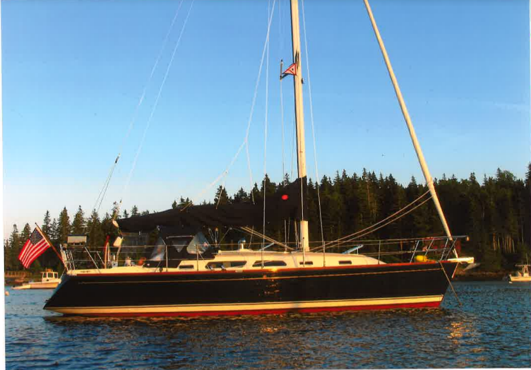
Those who fall in love with practice without science are like a sailor who sails a ship without a helm or compass, and can never be certain whither he is going……
Leonardo DA Vinci (1452-1519)

Slide 3
Behavior Analytic Problem Solving
Philosophical and Ethical Considerations
Professional Development
Conceptual Model

Slide 4
Resources
This presentation will include discussion and illustration of the Behavior Analytic Problem Solving (BAPS) model (Steege, Pratt, Wickers, Guare, & Watson, 2019)
Required Readings:
Chapters: 1,2,3,4,5,6,11,12
Downloads: (www.guilford.com/steege-materials) see page xx of text

Slide 5
Why We Conduct FBAs
A Functional Behavioral Assessment (FBA) is conducted to answer three basic questions:
Why does the student exhibit interfering behaviors?
What can we do to decrease those interfering behaviors?
What can we do to increase socially meaningful replacement behaviors?

Slide 6
Behavior Analytic Problem Solving
Based on:
Philosophical Doubt
Empiricism
Behavioral Compassion
Behavioral Empathy

Slide 7
Philosophical Doubt
Healthy skepticism promotes a scientific approach to understanding human behavior
We begin the FBA process with an open mind and test multiple hypotheses to confirm functional relationships and disconfirm “fake functions"

Slide 8
Philosophical Doubt
“It is with an objective mind endowed with curious skepticism that we engage in careful analysis”
“When there is skepticism, constant inquiry takes place”
“One of the reasons science progresses is because it persistently inquires and performs experiments on the basis of genuine objectivity”

Slide 9
Philosophical Doubt
“Careful analysis indicates that a rough or incomplete analysis is not adequate”
“…logic and epistemology texts emphasize the need for proving the truth of an assertion based on sound reasoning rooted in direct observation”
“With a careful analysis, our conclusions are more stable and sound”
The Dalai Lama (2009)

Slide 10
Empiricism
The BAPS model is based on a data-based problem solving model of practice rooted in:
Evidence-based assessments
Evidence-based interventions
A commitment to evidence-based documentation of the effectiveness of interventions

Slide 11
Behavioral Compassion
We care enough about our clients/students to
Conduct comprehensive assessments to understand the nature of the presenting problem
Use assessment data to design individually tailored evidence-based interventions

Slide 12
Behavioral Compassion cont’d
Conduct ongoing analyses of behavior to monitor for potential shift in behavioral function(s)
Collect data to objectively determine the personal effectiveness of interventions
Modify treatments as needed, especially when they are not longer effective

Slide 13
Behavioral Empathy
When we begin the FBA process, consider the student’s unique point of view:
Imagine how the student, given her/his unique personal characteristics and coping skills, interacts with the environment
Imagine how this ongoing interaction of “self” with the “environment” shapes both interfering and prosocial behaviors

Slide 14

“The temptation to form premature theories upon insufficient data is the bane
of our profession.”
Sherlock Holmes* : The Valley of Fear
*Sir Arthur Conan Doyle
14

Slide 15
Beware of Confirmation Bias
Confirmation bias is a phenomenon wherein decision makers have been shown to actively seek out and assign more weight to evidence that confirms their hypothesis, and ignore or underweigh evidence that could disconfirm their hypothesis. As such, it can be thought of as a form of selection bias in collecting evidence
https://www.sciencedaily.com/terms/confirmation_bias.htm

Slide 16
Beware of Confirmation Bias
Confirmation bias is our tendency to cherry-pick information that confirms our existing beliefs or ideas.
Confirmation bias explains why two people with opposing views on a topic can see the same evidence and come away feeling validated by it.
https://fs.blog/2017/05/confirmation-bias/

Slide 17
Ethical Standards
A man without ethics is a wild beast loosed upon this world
Albert Camus (1913-1960)

Slide 18
Ethical Standards
NASP Principles for Professional Ethics (NASP, 2010d) establish requirements for school psychologists to:
obtain parental consent before conducting an FBA (Standard I.1.2) and to
develop interventions that are consistent with assessment results (Standard II.3.9).

Slide 19
BEHAVIOR ANALYSIS CERTIFICATION BOARD (BACB)
BACB Professional and Ethical Compliance Code for Behavior Analysts (2014) includes ten standards to guide the professional and ethical behavior of behavior analysts.
Standard 3.0 (Assessing Behavior)
Standard 4.0 (Behavior Analysts and the Behavior-Change Program) delineate requirements for completing ethically sound FBAs and linking results to conceptually sound function-based interventions

Slide 20
BACB Ethical Standards
Board Certified Behavior Analysts (BCBAs) conduct functional assessments (e.g., indirect, direct-descriptive, and/or experimental analyses) prior to recommending or designing behavior interventions
BCBAs are expected to use FBA results to design function-based interventions that are conceptually sound and individually tailored to address the unique behaviors, environmental variables, and goals for each student.

Slide 21
FBA: A Behavior Analytic Problem Solving Process
The National Association School Psychologists Model for Comprehensive Model for Integrated School Psychological Services (2010) and the
Behavior Analyst Certification Board Professional and Ethical Compliance Code for Behavior Analysts (2014)
Both clearly support a problem-solving approach to practice

Slide 22
FBA: Developing Competency
To be prepared to competently and ethically implement behavior analytic assessment, intervention, data recording/analysis, and applied research skills, one needs to participate in a behavior analytic model of professional development (i.e., based on behavioral skills training) under the direct supervision of appropriately credentialed and competent professionals

Slide 23
Behavioral Skills Training
Acquisition, maintenance and generalization of behavior analytic assessment, intervention, data recording/analysis, and applied research skills requires a blend of:
didactic instruction (e.g., lectures/discussion)
review and critique of research literature

Slide 24
Behavioral Skills Training cont’d
modeling (by supervisor)
observation (by trainee/consultee/intern)
direct implementation of skills paired with performance feedback, and
ongoing professional development

Slide 25
Behavioral Skills Training Features of this Lecture
This PowerPoint lecture will feature the following components of behavioral skills training:
target skills
didactic instruction (e.g., lectures/discussion)
review of literature and conceptual models
modeling through examples and case presentations/discussion

Slide 26
Supervised Practice
Students are expected to participate in structured learning experiences under the supervision of a qualified professional (e.g., Psychologist, BCBA) that include:
modeling (by supervisor)
observation (by trainee/consultee/intern)
direct implementation of skills paired with performance feedback
programming for generalization and maintenance

Slide 27
Professional Development
Ongoing professional development:
Self-assessment; self-reflection
Peer review
Peer consultation
Attending professional conferences or workshops
Presenting at professional conferences or workshops
Applied research

Slide 28
Behavior Analytic Problem Solving: Guides the Assessment Process
“If you don’t know where you’re going…any road will take you there”
George Harrison (2001)
“To be on your own…with no direction home…like a complete unknown…like a rolling stone”
Bob Dylan (1965)

Slide 29
Behavior Analytic Problem Solving (BAPS)
Formative: used to facilitate the FBA process
Summative: used to organize and synthesize data collected during FBA
Prescriptive: used to identify function-based strategies to reduce interfering behavior and to increase logical replacement behavior

Slide 30
BAPS: Eight Term Conceptual Model*
8 Term Conceptual Model: foundation of the BAPS model
*Steege, et al (2019) described a behavioral assessment model that embraces and expands previous behavior analytic conceptual models

Slide 31
Behavior Analytic Conceptual Models
ABC: Antecdent-Behavior-Consequence (Bijou, Peterson & Ault, 1968)
SORC: Stimulus-Organism-Response-Consequence (Nelson & Hayes, 1979)
Five-Term Conceptual Model (Steege & Watson, 2009)
See pages 80-81 of the text

Slide 32
BAPS: Eight Term Conceptual Model
Context Variables
Personal Characteristics
Delays/Deficits
Motivational “Triggers”
Sources of Reinforcement
Interfering Behavior
Reinforcing Consequences
Parameters of Reinforcement

Slide 33
Resource
BAPS: Assessment Results (see chapter 6, page 105)
Recommendation: when conducting an FBA, use the BASP: Assessment Results form following the completion of a comprehensive FBA
Use the form as a reference as we continue the PowerPoint lecture

Slide 35
Behavior Analytic Problem Solving
Interfering Behavior
Personal Characteristics
Delays/Deficits

Slide 36
BAPS Model: Interfering Behavior
We begin the BAPS Model with identification and description of interfering behavior
Rationale:
This directly addresses the referral issue/question
Behavior does not occur in a vacuum
Behavior is contextual
The BAPS Model contextualizes interfering behavior

Slide 37
Interfering Behavior
Behaviors that are disruptive to the learning of the individual or others; observable behaviors that interfere with the individual’s progress or demonstration of skills
Examples: self-injury, aggression, verbal opposition, verbal threats, property destruction, non-verbal opposition, physical stereotypy, theft, micro aggressions, video/gaming addictions, binge eating, etc.

Slide 38
Behavior: An Adaption to the Environment
Behavior is the result of the interaction between the person and:
Antecedents (events that occur before behavior)
Consequences (events that follow behavior)

Slide 39
BAPS Model: Contextual Variables
We will next describe and illustrate how the following seven (7) variables contribute to occurrences of interfering behavior:
Context variables
Personal characteristics
Delays/Deficits
Motivational triggers
Sources of reinforcement
Reinforcing consequences
Parameters of reinforcement

Slide 40
Interactionism
Identifying the relative and interactive effects of these seven (7) controlling variables on interfering behavior is critical to understanding the function(s) of behavior.
The 8 Term Conceptual Model is not a linear model. Instead, this is a dynamic model in which the contributing variables are always in a state of “ebb and flow”.

Slide 41
Interactionism
Interfering behavior is a result of the relative contributions and intensities of these interacting variables.
This is comparable to weather-related variables (e.g., temperature, wind flow, humidity, dew point, wind speed, high or low pressure systems, jet streams, polar vortexes, etc.) that interact to produce anything from weather conditions ranging from “calm with fair skies” to the “perfect storm”

Slide 42
BAPS: Assessment Results
Descriptions of the behavior analytic contextual components of the BAPS Model are identified, described and illustrated throughout this presentation

Slide 43
Context Variables
Setting, task, activity in which interfering behavior occurs
Examples: academic subjects (e.g., math/reading/written language/science/social studies); transitions; playground/recess; lunch; riding the bus; etc.

Slide 44
Context Variables
Consider the context in which interfering behavior often occurs
Consider the social, behavioral, emotional, and academic expectations that are required to be successful within the context

Slide 45
Personal Characteristics
Traits, sensitivities, beliefs, rules, tendencies, and/or values that contribute to interfering behavior
Examples:
perfectionistic
sensitive to loud noises or touch
sensitive to corrective feedback
prefers sameness
intolerant to changes of routine
inflexible and rigid standards/expectations
tendency to be concrete or literal

Slide 46
Personal Characteristics cont’d
impulsive
paranoid ideations
phobic ideations
polarized thinking
catastrophized thinking
excessive worrying
rule governed
obsessive
compulsive
Others: ____________________________________

Slide 47
Executive Skills: Personal Characteristics
See Chapter 5: Executive Skills in Steege, et al (2019)
Table 5.1 Executive Skill Definitions and Examples
This table identifies potential personal characteristics (“What is the problem?”)

Slide 48
Executive Skills: Personal Characteristics
See Chapter 5: Executive Skills in Steege, et al (2019)
5.1 Executive Skills Questionnaire for Parents/Teachers
5.2 Executive Skills Questionnaire for Students
5.3 Executive skills Problem Checklist, Elementary Version-Teacher
5.4 Executive Skills Problem Checklist, Middle/High School Version
5.5 Executive Skills Problem Checklist, Elementary Version-Parents

Slide 49
Skill Delays/Deficits
Academic, communication, social, and/or self-management skills delays or deficits that contribute to interfering behavior
Examples:
receptive and/or expressive language skills
academic delays
social coping skills
self-management skills
psychological flexibility
reciprocal social skills

Slide 50
Delays/Deficits cont’d
recreation-leisure skills
adaptive living skills
problem solving skills
rational thinking skills
response inhibition
Others: ______________________________
______________________________________
______________________________________

Slide 51
Executive Skills: Delays/Deficits
See Chapter 5: Executive Skills in Steege, et al (2019)
Table 5.1 Executive Skill Definitions and Examples
This table identifies potential skills that may be delayed within the individual (see: “Corresponding executive skills and definition”)

Slide 52
Example
See Chapter 5: Executive Skills in Steege, et al (2019): See pages 59-62
Review this example:
Characteristics of student with a weakness in flexibility
Environmental Modifications
Teaching and Reinforcing the Skill

Slide 53
Personal Characteristics and Delays/Deficits
When completing the BAPS: Assessment Results
Consider the variables that make it difficult or challenging for the individual to navigate or to be successful within the context
Do not list all personal characteristics and deficits/delays
List only those variables that contribute to interfering behavior

Slide 54
Example: Personal Characteristics and Delays/Deficits: Yin and Yang
Consider the case of the child with the following personal characteristics (tendencies) and delays/deficits that contributed to interfering behaviors
Personal characteristics (irrational “black and white” thinking; rigid/resistant to change; impulsive)
Delays/Deficits (rational thinking, psychological flexibility, response inhibition, self-management skills)

Slide 56
Behavior Analytic Problem Solving
Reinforcing Consequences
Parameters of Reinforcement

Slide 57
Reinforcing Consequences
Identification and description of reinforcing consequences results in the determination of:
Motivational triggers
Sources of reinforcement
Parameters of reinforcement
We will next focus on Reinforcing Consequences

Slide 58
Reinforcing Consequences
Variables that follow interfering behavior and thereby strengthen the future probability of behaviors(see pages 31-33 and Table 3.1 of text)
Individually Mediated Positive Reinforcement
Individually Mediated Negative Reinforcement
Socially Mediated Positive Reinforcement
Socially Mediated Negative Reinforcement
Automatic Positive Reinforcement
Automatic Negative Reinforcement

Slide 59
Positive Reinforcement (R+)
Presentation (+) of:
Preferred stimuli/events that follow and strengthen interfering behavior
Examples: social attention, tangibles (food/toys/games/social media devices), activities (preferred leisure, preferred academic)

Slide 60
Negative Reinforcement (R-)
Avoiding or removing ( -):
Personally Aversive (or non-preferred) stimuli/events contingent on interfering behavior and that strengthen interfering behavior
Examples: avoidance or withdrawal of non-preferred attention, difficult academic tasks, non-preferred activities

Slide 61
Negative Reinforcement (R-)
not to be confused with punishment
avoidance of or escape from “demands”
strengthens behavior just as positive reinforcement strengthens behavior

Slide 62
Reinforcement: Socially vs. Individually Mediated
Socially mediated: reinforcement provided by another (e.g., teacher, classmate, parent, etc.)
Parent providing praise (positive reinforcement)
Teacher directing student to leave the classroom (negative reinforcement)
Individually mediated: the individual directly accesses/produces the reinforcement

Slide 63
Reinforcement: Individually Mediated
Individually mediated: the individual directly accesses/produces the reinforcement
Child (alone in room) picks up and plays guitar
Adult stops reading textbook (brief break from task….negative reinforcement) and plays the piano (positive reinforcement)

Slide 64
Automatic Positive Reinforcement
The behavior produces reinforcement (private event)
Behavior produces sensory consequences that are preferred (also referred to as sensory induction)…or “self-stimulation”
Examples: visual, auditory, motor, cognitive stimulation

Slide 65
Automatic Negative Reinforcement
The behavior produces reinforcement (private event)
Behavior reduces sensory consequences that are personally aversive (also referred to as sensory reduction)…
Examples:
reduction of biological drives/states of arousal/aversive emotional states/aversive thoughts

Slide 66
Automatic Negative Reinforcement cont’d
Examples:
reduction of an itch
reduction of tension
reduction of pain
reduction of anxiety
reduction anger
reduction of aversive thoughts
Others: ____________________________

Slide 67
Reinforcement Summary
Individually mediated reinforcement
Positive and negative
Socially mediated reinforcement
Positive and negative
Automatic reinforcement
Positive and negative

Slide 68
Multiple Reinforcing Consequences
Within subject: Interfering behavior may be reinforced by 2 or more reinforcing consequences.
Example: Dylan
Disruptive behavior maintained by two forms of reinforcement:
Individually mediated negative reinforcement (escape from non-preferred homework) and
individually mediated positive reinforcement (access to preferred video games)

Slide 69
Within Subject Multiple Reinforcing Consequences cont’d
Example Neil:
Disruptive behavior maintained by three (3) reinforcing consequences:
Socially mediated negative reinforcement (escape from non-preferred task),
socially mediated positive reinforcement (social attention) and
automatic negative reinforcement (arousal reduction)

Slide 70
Applied Learning Experience
Read “Out of the Frying Pan….but into the Fun” (page 33 of text)
Student: Myway
Interfering Behavior: verbal opposition/arguing
Identify Two Reinforcing Consequences
_________________________________
_________________________________

Slide 71
Reinforcement Summary
Individually mediated reinforcement
Positive and negative
Socially mediated reinforcement
Positive and negative
Automatic reinforcement
Positive and negative

Slide 72
Multiple Reinforcing Consequences
Between subjects: The “same” behavior (i.e., response topography) exhibited by two or more persons but maintained by different reinforcing consequences
Example: Matt and Dan (and Lisa)
”What the Func…..tion” (page 40 of text)

Slide 73
Applied Learning Experience
Read “What the Func…..tion” (page 40 of text)
Children: Matt and Dan
Interfering Behavior: self-slapping
Reinforcing Consequence Matt: ____________
Reinforcing Consequence Dan: _____________

Slide 74
Parameters of Reinforcement
Determining how robust reinforcing consequences are by examining/estimating:
Quality (value….MOs)
Timing (immediate or delayed)
Amount (how much)
Schedule (rate of behavior before reinforcement)

Slide 75
Parameters of Reinforcement
Robust vs. Weak Reinforcement
Robust reinforcement: high value, very available, immediate delivery, high amount, lean schedule (e.g., FR1 or VI 30 seconds)
Weak reinforcement: low value, restricted access, delayed delivery, low amount, ratio strain schedule (i.e. high rates of behavior required for reinforcement)

Slide 76
Matching Law
Matching Law (Herrnstein, 1961): allocate behavioral responses to those conditions with robust vs. weak reinforcement
Consider:
interfering behavior (how robust are reinforcing consequences?) vs.
appropriate/expected behavior (how robust are reinforcing consequences?)

Slide 77
Matching Law cont’d
The behavior analyst can design an intervention that should effectively compete with the parameters of reinforcement that maintain interfering behavior (Mace, Pratt, Zangrillo, & Steege, 2011)
Concurrent schedules of reinforcement

Slide 78
Matching Law Examples
Steege, M. W., Wacker, D. P., Berg, W. K., Cigrand, K. K., & Cooper, L. J. (1989). The use of behavioral assessment to prescribe and evaluate treatments for severely handicapped children. Journal of Applied Behavior Analysis, 22, 23-33
Steege, M.W., Wacker, D.P., Berg, W. K., Cigrand, K.C., & Cooper, L.J. (1990). Use of negative reinforcement in the treatment of self-injurious behavior. Journal of Applied Behavior Analysis, 23, 459-467.

Slide 79
Applied Learning Experience
Consider an interfering behavior. Determine how robust reinforcing consequences are by examining/estimating:
Quality (value….MOs)
Timing (immediate or delayed)
Amount (how much)
Schedule (rate of behavior before reinforcement)

Slide 80
Applied Learning Experience cont’d
Parameters of Reinforcement
Behavior: ______________________________
Reinforcing Consequence: _________________
Quality: _____________________________
Timing: _____________________________
Amount: _____________________________
Schedule: ____________________________

Slide 81
Behavior Analytic Problem Solving
Motivational Triggers
Sources of Reinforcement

Slide 82
Motivational Triggers
Motivating Operations (MOs)
Recent years, examination of MOs has increased our understanding of behavior
MOs are antecedent variables that influence behavior change by momentarily altering the effectiveness (value) of consequences

Slide 83
Motivating Operations
MOs are antecedents (events/stimuli that occur prior to interfering behavior)
MOs serve to:
make reinforcing consequences more valuable
make discriminative stimuli more relevant
make interfering behavior more probable

Slide 84
Motivating Operations
Motivational Triggers (MOs): pps 88-89 of text
Deprivation of preferred
Presentation of aversive (non preferred)
Consider: biological variables, emotions, thoughts (See chapter 4 of the text)

Slide 85
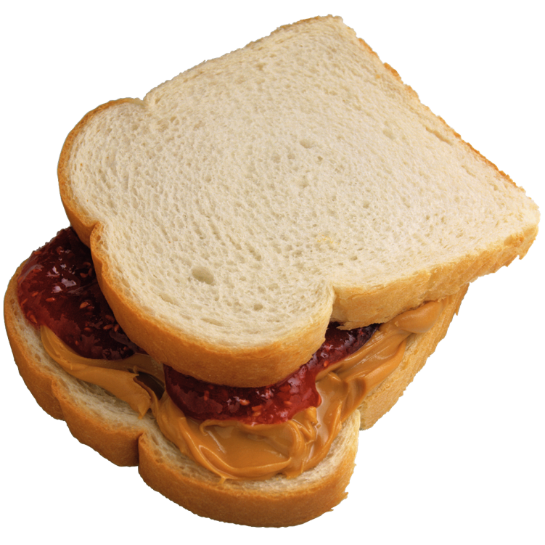
Examples of MOs
Deprivation of food increases (a) the value of food as a positive reinforcer and (b) the probability of food acquisition behaviors
Presentation of loud noises increases (a) the value of escape as a negative reinforcer and (b) the probability of escape reinforced behaviors

Slide 86
Example of MO
CMO-R: math worksheets (warning stimulus) increases (a) the value of escape from task and (b) escape reinforced behaviors (e.g., verbal opposition)
CMO-R = Reflexive
Signals a worsening condition….

Slide 87
CMO-Surrogate (CMO-S)
Stimuli that are paired with a MO may be capable of the same value altering and behavior altering effects of the MO.
Such a stimulus is referred to as a surrogate CMO, or as a CMO-S

Slide 88
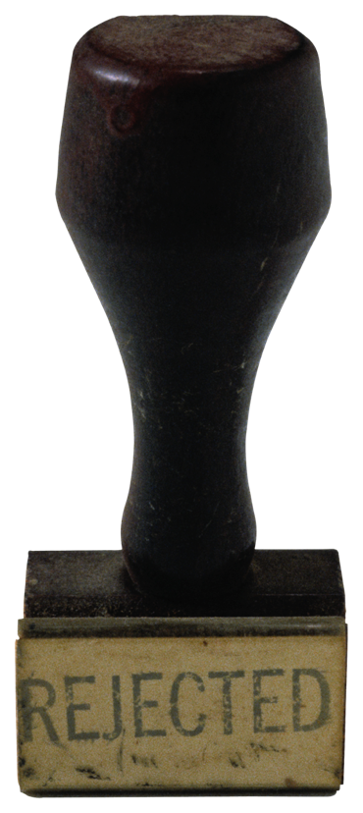
Example of CMO-S
CMO-Surrogate (CMO-S):
thought (“my classmates think I’m a
loser….they are always judging me”
elicits feelings of anxiety
evokes behaviors (e.g., nail biting;
hair pulling disorder) that
temporarily reduce aversive feelings
(i.e., automatic negative reinforcement)

Slide 89
What About Trauma or PTSD?
Many students within school settings or children/adolescents within home-based programs have histories in which they have experienced trauma.
Consider that memories of traumatic events (thoughts, images, odors, etc.) may operate as Motivating Operations (CMO-S)….surrogates for the actual events/experiences

Slide 90
Applied Learning Experience
Read: “Mr. Bojangles”*
Now that’s a warning stimulus
Consider the seven (7) additional examples offered
*page 36 of text

Slide 91
Sources of Reinforcement
Persons, items, or locations that signal the availability of reinforcing consequences thereby possibly triggering interfering behavior

Slide 92
Sources of Reinforcement
Technical Term: Discriminative Stimuli:
Stimuli that precede the occurrence of behavior and signal that reinforcement following the behavior is likely to occur are called discriminative stimuli (S^{D})

Slide 93
S^{D} Example
A student whose interfering behavior has previously been reinforced by a specific classroom teacher is more likely to exhibit similar behaviors when the teacher is present vs. when she is absent

Slide 94
S^{D} Example
A student prompted to begin a difficult assignment is more likely to exhibit disruptive behavior when staff who have previously negatively reinforced the student’s behavior (e.g., withdrawn the assignment or removed the student from class when the disruptive behavior occurs) are present vs. when the staff are absent

Slide 95
S^{D} Example
A young adult who is away at college is more likely to text the parent (A) who has previously reinforced the request for a deposit in her bank account vs. the parent (B) who has previously denied such requests.
A = discriminative stimulus (availability of reinforcement)
B= stimulus delta (unavailability of reinforcement)

Slide 96
S^{D} Example
A student is studying for an exam. The student reaches for a coffee mug that contains freshly brewed coffee. She drinks some of the coffee.
The coffee mug is the S^{D}
The behavior is reaching, grasping, and drinking
FYI: this is an example illustrating individually mediated positive reinforcement
What is the MO? _________________

Slide 97
S^{D} vs. MO
Both are antecedents; i.e., they occur before interfering behavior
Both make interfering behavior more probable

Slide 98
S^{D} vs. MO
S^{D}s signal the availability of reinforcement….MOs alter the value of the reinforcing consequence
MOs change how badly people want something…. S^{D}s change their chance of getting it

Slide 99
S^{D} vs. MO
S^{D}
Source of Reinforcement
MO
Quality/Value of Reinforcement

Slide 100
MOs Impact S^{D}s
MOs also increase the relevance, salience, and effectiveness of the S^{D}
Coffee example (see page 38 of text “I Need a Cup of Coffee”)
when deprived of coffee (the MO) you may become hyper-vigilant in finding a Star-Dunkin coffee shop (the S^{D} )

Slide 101
S^{D}, MO, ….why does it matter?
Function-based interventions
S^{D}: alter stimulus features (e.g., pair the teacher with dense positive reinforcement when behavior has been reinforced by negative reinforcement; change caregivers or staff person; remove the S^{D})
MO: alter motivation (e.g., NCR, extinction, FCT, interspersed trials, behavioral momentum, modify instructional task)

Slide 102
Behavior Analytic Problem Solving
Module 5
Four-Term Contingency
Guided Practice
Independent Practice

Slide 103
Four Term Contingency
Critical to the analysis of behavior
Components:
MO
S^{D}
Interfering Behavior
Reinforcing Consequences

Slide 104
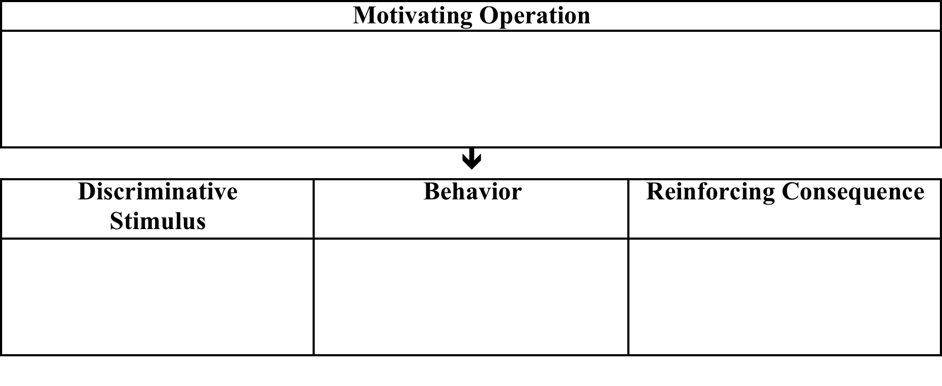

Slide 105
Examples of Four-Term Contingencies
The Incident-Based Functional Assessment form illustrates the basic components of the 4-term contingency
Figure 8.7 (page 142 of the text)
Appendix A (page 242 of the text)

Slide 106
Applied Learning Experience
“What the Func….tion?”
Matt and Dan: chicken pox example (page 40 of text)
Regarding Dan, identify the following:
MO: ____________________________
S^{D}: _____________________________
Reinforcing Consequence: _______________________

Slide 108
Applied Learning Experience: Guided Practice
Consider the following examples
Use the following figure (4 term contingency) to record:
Interfering behavior
Reinforcing consequence
MO
S^{D}

Slide 109
Four-Term Contingency Recording Form
The Incident-Based Functional Assessment form illustrates the basic components of the 4-term contingency
Figure 8.7 (page 161 of the text)
Make 10-12 copies of this form

Slide 110
4-Term Contingency: Guided Practice
A classmate is playing with a toy car. He drops the car and picks up a musical toy. Timmy walks over and grabs the toy car. Timmy plays with the toy car for 3 minutes.

Slide 112
4-Term Contingency: Guided Practice
Phyllis is a 6th grade student who engages in disruptive vocal behaviors within the classroom setting (e.g., independent seat work, sustained silent reading)
Disruptive behaviors often include “wisecracks”, “silly noises (e.g., quacking like a duck), and goofy voices (e.g., talking like Donald Duck).
These disruptive behaviors typically produce laughter from peers. Over time these forms of disruptive behaviors increase dramatically.

Slide 114
4-Term Contingency: Guided Practice
Donny is a senior is high school. He is in AP English and Math classes. He reported that the worries a lot about his academic performance and taking his upcoming SATs.
His AP classroom teachers reported that during class and presented with challenging tasks, Donny often chews his fingernails, twirls his hair, and taps his pencil repetitively. Donny reported that these behaviors occur when he is “really nervous”.

Slide 116
4-Term Contingency: Guided Practice
Sandy is an 8th grade student who often displays disruptive behaviors when directed by teachers to begin math worksheets.
Disruptive behaviors typically result in termination of task expectations and the teacher directing Sandy to leave the classroom and to go to a “quiet area”.
Disruptive behaviors have increased.

Slide 118
Four Term Contingency
“Practice makes permanent”
To support your fluency in using the four-term contingency in the analysis of behavior, complete the following applied learning experiences independently

Slide 119
Applied Learning Experience: Independent Practice
Use the 4 term contingency to conceptualize an example relevant to you in which the interfering behavior is followed by individually mediated positive reinforcement

Slide 121
Applied Learning Experience: Independent Practice
Use the 4 term contingency to conceptualize an example relevant to you in which the interfering behavior is followed by individually mediated negative reinforcement

Slide 123
Applied Learning Experience: Independent Practice
Use the 4 term contingency to conceptualize an example relevant to you in which the interfering behavior is followed by socially mediated positive reinforcement

Slide 125
Applied Learning Experience: Independent Practice
Use the 4 term contingency to conceptualize an example relevant to you in which the interfering behavior is followed by socially mediated negative reinforcement

Slide 127
Applied Learning Experience: Independent Practice
Use the 4 term contingency to conceptualize an example relevant to you in which the interfering behavior is followed by automatic positive reinforcement

Slide 129
Applied Learning Experience: Independent Practice
Use the 4 term contingency to conceptualize an example relevant to you in which the interfering behavior is followed by automatic negative reinforcement

Slide 131
Review
Eight Term Conceptual Model
BAPS: Assessment Results (page 105)

Slide 133
BAPS: Assessment Results Examples
Figure 6.1 (page 99 of text)
Figure 6.2 (page 101 of text)

Slide 136
Bridging The Gap
From assessment results to effective treatments:
“OK, so now we understand the problem. We know the variables that contribute to interfering behavior.
Now what do we do? What are the solutions?”

Slide 137
Function-Focused Interventions
The BAPS: Assessment Results (Form 6.1, page 105 of text) is useful in case conceptualization
The BAPS: Function-Focused Intervention (Form 11.1, page 211 of text) is useful in identifying intervention strategies designed to address the variables that contribute to interfering behavior

Slide 139
BAPS Case Example
BAPS: Assessment Results (Figure 11.1; page 206 of the text)
BAPS: Function-Focused Intervention (Figure 11.2; page 207 of the text)
Compare the results of the FBA and the corresponding function-focused interventions

Slide 140
Behavior Analytic Problem Solving: Assessment Results
Name: ____________________________________ Date: _______________________________________
Personal Characteristics:
Traits, sensitivities, beliefs, and/or values contributing to interfering behavior
Context:
Probable contexts in which interfering behavior occurs
Skill Delays/Deficits
Communication, academic, executive, adaptive living, social, and/or self-management skill delays/deficits contributing to interfering behavior
General education classes that require high levels of oral participation
History of social anxiety
Sensitivity to negative peer evaluation
Belief that males cannot show weakness
Emotional regulation skill deficits
Below average academic performance in all content areas
Motivational “Triggers” (Motivating Operations):
Deprivation of physical or social wants and needs which increase the value of reinforcers and the probability of interfering behavior
Presentation of aversive biological/medical conditions, emotional states, thoughts, academic tasks, or social situations, which increase the value of reinforcers and the probability of interfering behavior
Direct instructions to respond orally to questions and/or participate in class discussions increase the value of escape from the classroom and trigger interfering behaviors
Unpleasant physiological arousal and worries about negative peer evaluation increase the value of arousal reduction and trigger interfering behaviors
Sources of Reinforcement (Discriminative Stimuli):
Persons, items, or locations that signal the availability of reinforcing consequences (i.e. source of reinforcement) thereby occasioning interfering behavior
Classroom teacher with a history of sending students to the principal’s office for disruptive behavior
Sight/proximity of the exit door in the classroom
Interfering Behavior(s):
Vocal opposition: Vocally refusing to comply with a teacher directive by saying no, arguing, and/or swearing
Leaving the area: Exiting the classroom without explicit teacher permission
Reinforcing Consequence(s):
Consequence(s) that strengthen the future probability of the interfering behavior
Parameters of Reinforcement:
Describe the power (robustness) of reinforcing consequences
Escape from the classroom and associated expectations
  Socially-mediated negative reinforcement when sent by the teacher to the principal’s office
  Individually-mediated negative reinforcement when leaving the area
Arousal reduction
  Automatic negative reinforcement
Teacher sends student to the principal’s office after 30 seconds to 1 minute of intense swearing, and student escapes the classroom for about 15 minutes in a location where no peers are present to judge him
Student experiences immediate relief from negative thoughts and emotions

Slide 141
Behavior Analytic Problem Solving: Function-Focused Intervention
Name: ____________________________________ Date: _______________________________________
Personal Characteristics:
Identify strategies to address traits, sensitivities, beliefs, and/or values contributing to interfering behavior
Context:
Identify strategies for modifying contexts and/or participation in contexts in which interfering behavior occurs
Skill Delays/Deficits:
Identify strategies to mitigate communication, academic, executive, adaptive living, social, and/or self-management skill delays/deficits contributing to interfering behavior
Present option for participating in core instruction in the high school resource classroom
Referral to school psychologist for cognitive behavioral therapy to address social anxiety and related thoughts/emotions
Deliver specially designed instruction to address academic skill deficits
Teach emotional regulation skills such as thought-stopping/reframing, deep breathing, and muscle relaxation
Motivational Variables:
Identify strategies to weaken (abolish) motivation for interfering behaviors by preventing conditions of deprivation and/or altering the environment to make motivational “triggers” less aversive
Avoid directly and publicly prompting Mitch to participate orally; instead collaborate with Mitch to identify an unobtrusive gestural cue for teachers to deliver to prompt participation
Provide options for alternative, non-vocal participation in class
Schedule regular opportunities to take a break from class to engage in self-management strategies (e.g., walk to the water fountain and back, while practicing deep breathing)
Sources of Reinforcement (Discriminative Stimuli):
Identify strategies to modify or eliminate persons, items, and/or locations that signal the availability of reinforcing consequences for interfering behaviors
Pair teachers with positive reinforcement, while discontinuing the practice of sending Mitch to the principal’s office for disruptive behavior
Assign a seat away from the classroom exit
Interfering Behavior(s): Identify the behavior(s) that interfere with functioning
Replacement Behavior(s): Identify logical, socially appropriate replacement behavior(s)
Vocal opposition
Leaving the area
Active class participation
Appropriate requests for a break/permission to leave the classroom
Reinforcing Consequence(s):
Identify strategies for minimizing reinforcement of the interfering behavior
Reinforcing Consequence(s):
Identify strategies for maximizing reinforcement of the replacement behavior
Discontinue the practice of sending Mitch to the principal’s office following interfering behavior
Develop and implement a behavioral contract with Mitch to establish goals for active class participation (including reasonable non-vocal ways to participate) and reinforcement options for meeting those goals
Consistently and immediately honor all appropriate requests to take a break or leave the classroom, and allow 5-minutes per break
  Gradually fade over time

Slide 142
Discussion and Future Directions
Discussion of BAPS model
Future Discussion:
Role of executive skills; see chapter 5
Role of private events (biological variables, thoughts and emotions); see chapter 4
Treatment analyses (putting the RTI in FBA); see chapter 12

Slide 143
Behavior Analytic Problem Solving
Applied Learning Experiences

Slide 144
Applied Learning Experience
We will review one case example
Use the BAPS: Assessment Results to identify the variables that contribute to interfering behaviors
Use the BAPS: Function-Focused Interventions form to identify specific strategies

Slide 146
Case Example
Background Information:
15 year-old student (George)
Interfering Behavior: inappropriate comments directed at peers

Slide 147
Background Information cont’d
George has been referred to as being: “anti-social”, “resistant to change”, “inflexible”, “has low frustration tolerance”, “is rule governed”; “impulsive”
George has a history of delays in: social skills; reciprocal social interactions with classmates; psychological flexibility;

Slide 148
Background Information cont’d
Previous Diagnoses:
Autism Spectrum Disorder
Asperger’s Disorder
Generalized Anxiety Disorder
Social Anxiety Disorder
Intermittent Explosive Disorder

Slide 149
Case Example cont’d
Interfering Behavior: “inappropriate verbal scripts” (i.e., socially inappropriate and threatening statements)
“Stop looking at me”
“Get away from me…and while you’re at it…just mind your own beez wax”
“I hate it when you smile at me. I want to smash my fist in your face”

Slide 150
Case Example cont’d
Referred by school team
The behavior typically occurs within informal or small group interactions with classmates during unstructured times
Tentative hypothesis: positive reinforcement; attention seeking; classmates’ reactions; “negative attention” from classmates

Slide 151
Case Example cont’d
Current Behavioral Intervention Plan (BIP):
When interfering behaviors occur, George is immediately directed by teachers to leave the area and report to the main office
The main office has a small conference room designated as “in-school suspension”

Slide 152
Case Example cont’d
This intervention is used every time George displays these behaviors
Sometimes when he displays these behaviors a teacher may provide a verbal reprimand (e.g., “George, that is not appropriate language for a school setting. You need to go to the office”)

Slide 153
Case Example cont’d
When George is directed by teachers to go to the office, he immediately leaves the setting
When he goes to the office a secretary provides George with an I-PAD (why?...see next slide)
Duration of in-school suspension: 30 minutes to two (2) hours

Slide 154
Case Example cont’d
Rationale for the I-PAD: (a) this helps keep him busy and (b) helps him to calm down. This strategy has been used for 2 years.
Since onset this intervention package (in-school suspension and I-PAD), interfering behaviors have increased markedly

Slide 155
Functional Behavioral Assessment
FBA procedures:
Indirect (behavior analytic interviews with teachers, parents, and student)
Executive skills checklists
Behavioral stream interviews
Direct descriptive (behavior analytic observations during lunch)
Incident-Based Functional Assessment

Slide 156
Interview with George
During interviews, George explained:
social attention from and interactions with peers is annoying….
“I just prefer to be by myself”
he is “rule governed”
he views social interactions as “necessary evils”

Slide 157
Interview with George cont’d
he described the in-school suspension as his “sanctuary”
he explained that being with classmates made him feel nervous and queasy (“butterflies in my stomach” and “sometimes I wanna puke”)

Slide 158
FBA Results
Interfering behaviors occur during social interactions within the context of break times (e.g., unstructured activities within classes)
Personal characteristics: inflexible, rigid, impulsive,
Delays in reciprocal conversational skills; executive skills (flexibility) self-management skills (self-control), response inhibition

Slide 159
FBA Results
MOs: Interfering behaviors more likely to occur when interactions with classmates are expected or occur spontaneously
MOs: strong negative emotions (anxiety?)
S^{D}: Conference room (“in-school suspension”) signals availability of “sanctuary” (highly reinforcing)
S^{D}: teachers who quickly direct George to the office when interfering behaviors occur

Slide 160
FBA Results
Interfering behavior maintained by automatic negative reinforcement (reduction of anxiety)
Interfering behavior maintained by socially mediated negative reinforcement (i.e., escape/avoidance of “aversive social interactions”; directed by school staff to conference room)
Interfering behavior maintained by socially mediated positive reinforcement (i.e., access to “sanctuary” and tangible/activity reinforcer: I-Pad)

Slide 161
FBA Results
How robust are these reinforcing consequences;
Schedule: FR1 (the behavior always results in reinforcement)
Quality: High (avoidance of aversive interactions, reductions of anxiety, access to “sanctuary” and I-PAD)
Magnitude: 30 to 120 minutes
Timing: reinforcement occurs within seconds of interfering behaviors

Slide 162
BAPS: Assessment Results
Based on the information included in the previous slides, complete the BAPS: Assessment Results form

Slide 164
Function-Focused Interventions
Review the BAPS: Assessment Results in the case of George
Review the BAPS: Function-Focused Interventions form

Slide 166
Applied Learning Experience
Based on the case conceptualization (BAPS: Assessment Results in the case of George) identify corresponding function-focused interventions
Resource:
BAPS: Function-Focused Interventions (Form 11.1)

Slide 167
References
Steege, Pratt, Wickerd, Guare, & Watson (2019) Conducting school-based functional behavioral assessments: A practitioner’s guide (3rd Ed.) New York: Guilford.
Check out the reference section of the text for citations (e.g., Miltenberger)

Slide 168
References: Books
Steege, Pratt, Wickerd, Guare, & Watson (2019) Conducting school-based functional behavioral assessments: A practitioner’s guide (3rd Ed.) New York: Guilford.
Brown-Chidsey, R. & Steege, M. W. (2010). Response to intervention: Principles and strategies for effective practice (2nd Ed.) New York: Guilford.
Hayes, L. & Ciarroci, J. (2015). The thriving adolescent: Usinf acceptance and commitment therapy and postive psychology to help teens manage emotions, achieve goals, and build connections. Oakland, CA: Context Press
Steege, M. W. & Watson, T. S. (2009). Conducting school-based functional behavioral assessments: A practitioner’s guide (2nd Ed.) New York: Guilford.

Slide 169
References: Chapters
Brown, R., Steege, M., & Bickford, R. (2014). Best practices in evaluating the effectiveness of interventions using single-case methods. In A. Thomas & P. Harrison (Eds.), Best practices in school psychology VI (371-380). Bethesda, MD: National Association of School Psychologists
Steege, M. & Scheib, M. (2014). . Best practices in conducting functional behavioral assessments. In A. Thomas & P. Harrison (Eds.), Best practices in school psychology VI (pp. 273-286). Bethesda, MD: National Association of School Psychologists

Slide 170
Book Chapters
Brown, R., Steege, M., & Bickford, R. (2014). Responsive assessment and instruction practices. In S. G. Little & A. Akin-Little (Eds.), Academic assessment and intervention (pp. 161-178). New York: Routledge.
Steege, M. & Pratt, J. (2012). Functional behavioral assessment: The cornerstone of effective problem solving. In, R. Brown-Chidsey & K. Andren (Eds.), Assessment for intervention: A problem-solving approach (2nd Ed) (pp. 125-143). New York: Guilford.
Mace, F., Pratt, J., Zangrillo, A., & Steege, M. (2011). Schedules of reinforcement. In, W. Fisher, C. Piazza, & H. Roane (Eds.), Handbook of applied behavior analysis. (pp. 55- 75). New York: Guilford.

Slide 171
Journal Articles
Shamlian, K., Fisher, W.W., Steege, M., Cavanaugh, B.M, Samour, K., Querim, A.C. (2016). Evaluation of multiple schedules with naturally occurring and therapist-arranged discriminate stimuli following functional communication training. Journal of Applied Behavior Analysis, 492(2), 228-250.
DeRosa, N., Fisher, W., & Steege, M. (2015). Establishing operation manipulations during treatment of problem behavior with functional communication training. Journal of Applied Behavior Analysis, 48, 115-130.
Gadaire, D., Fisher, W. & Steege, M. (2014). The effects of presenting delays before and after task completion on self-control responding in children with behavior disorders. Journal of Applied Behavior Analysis, 47, 192-197.

