Slide 1
The Role of ESA Support Staff: Providing Comprehensive Behavioral Health Services
Nita Hill, MA.Ed, National Board Certified School Counselor, Washington School Counselor Association
Carrie Syvertsen, MSW LICSW, Vice President of WASSW, Washington Association of School Social Workers
Laurie Harrison, PhD, President of WSASP, Washington State Association of School Psychologists
School Nurse Organization of Washington
Notes:
Carrie to do 1-5

Slide 2
Goals for Today
2016 AWSP/WASA Conference
Concrete definitions and distinguishing characteristics of a school nurse, psychologist, counselor and social worker
Explain the best-practice social and emotional health and wellness services that can be provided by each profession through an Integrated Students Support Systems (ISSS) model, in the context of a Multi-Tiered System of Support (MTSS)
Current data on how these four professions are being utilized in Washington.
Model examples that highlight the importance of a strong partnership and collaboration between all 4 professions to maximize benefits for all students.
Explore the funding implications of the McCleary decision for all 4 professions
What would “fully-funded” really look like? Next steps…?

Slide 3
Origin of the ESA-Behavioral Health Coalition
The School Social Workers and School Psychologists had representatives testifying on the same bills and referencing one another’s work in our testimony
We connected after testimony and formed the idea of this group, then we went home and made it a reality!

Slide 4
Mental Health Vs Mental Illness

Slide 5
2016 AWSP/WASA Conference
Did you know…
Learning supports are necessary in addition to effective academic instruction to ensure that all students are socially, emotionally, behaviorally, physically and mentally well, so that they are able to consistently engage in learning?
That’s 220,000 students in Washington!
National research indicates that
approximately 20 percent of youth have
diagnosable mental health conditions
(Merikangas et al., 2010)
Notes:
Slides 1-5 5-10 minutes

Slide 6
Integrated Students Support Systems
2016 AWSP/WASA Conference
Supports the academic, social, emotional, behavioral, and physical growth of all students
Notes:
Laurie 6-8

Slide 7
2016 AWSP/WASA Conference
Each of the 4 student services professional disciplines contributes unique skills, knowledge, experience and perspective to the collective work.
When student services are integrated, each disciplines unique contributions remain essential and must be coordinated (planned) in order to maximize the effectiveness of those services to all students.

Slide 8
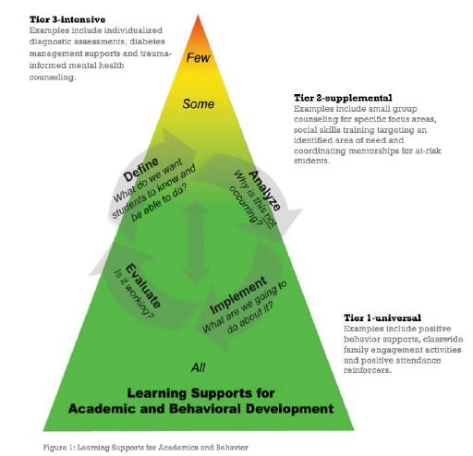
Multi-Tiered Support Systems
2016 AWSP/WASA Conference
Did you know…
Learning supports are more efficient and effective when they are coordinated by teaming across disciplines
and integrated with academic/behavioral instruction and interventions within the MTSS…
Notes:
6-8 5 minutes

Slide 9
Top 3 Distinguishing Factors
Notes:
9-10 Nita

Slide 10
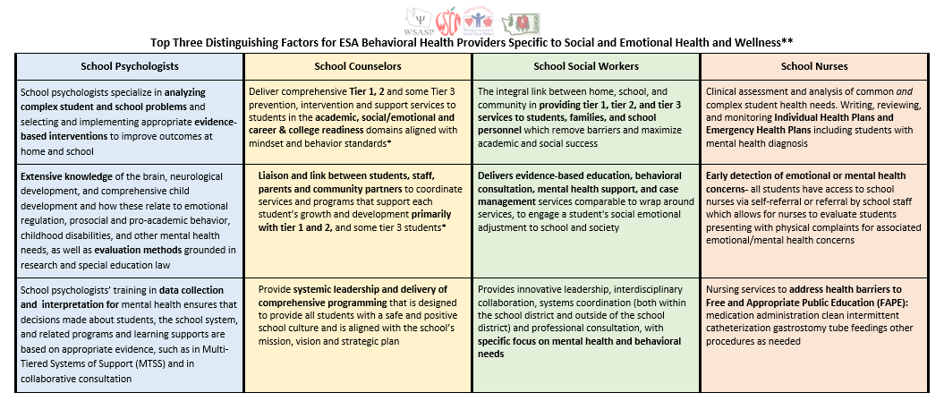
Notes:
Nurses: We are not just here for band aids and lice checks.

Slide 11
School Psychologists
School psychologists specialize in analyzing complex student and school problems and selecting and implementing appropriate evidence-based interventions to improve outcomes at home and school
Extensive knowledge of the brain, neurological development, and comprehensive child development and how these relate to emotional regulation, prosocial and pro-academic behavior, childhood disabilities, and other mental health needs, as well as evaluation methods grounded in research and special education law
School psychologists’ training in data collection and interpretation for mental health ensures that decisions made about students, the school system, and related programs and learning supports are based on appropriate evidence, such as in Multi-Tiered Systems of Support (MTSS) and in collaborative consultation
Notes:
Laur9ie

Slide 12
School Counselors
Deliver comprehensive Tier 1, 2 and some Tier 3 prevention, intervention and support services to students in the academic, social/emotional and career & college readiness domains aligned with mindset and behavior standards*
Liaison and link between students, staff, parents and community partners to coordinate services and programs that support each student’s growth and development primarily with tier 1 and 2, and some tier 3 students*
Provide systemic leadership and delivery of comprehensive programming that is designed to provide all students with a safe and positive school culture and is aligned with the school’s mission, vision and strategic plan
Notes:
Nita

Slide 13
School Social Workers
The integral link between home, school, and community in providing tier 1, tier 2, and tier 3 services to students, families, and school personnel which remove barriers and maximize academic and social success
Delivers evidence-based education, behavioral consultation, mental health support, and case management services comparable to wrap around services, to engage a student's social emotional adjustment to school and society
Provides innovative leadership, interdisciplinary collaboration, systems coordination (both within the school district and outside of the school district) and professional consultation, with specific focus on mental health and behavioral needs
Notes:
Carrie

Slide 14
School Nurses
Clinical assessment and analysis of common and complex student health needs. Writing, reviewing, and monitoring Individual Health Plans and Emergency Health Plans including students with mental health diagnosis
Early detection of emotional or mental health concerns- all students have access to school nurses via self-referral or referral by school staff which allows for nurses to evaluate students presenting with physical complaints for associated emotional/mental health concerns
Nursing services to address health barriers to Free and Appropriate Public Education (FAPE): medication administration clean intermittent catheterization gastrostomy tube feedings other procedures as needed
Notes:
9-14 15 minutes total
Laurie

Slide 15
Tiered Roles
Review Tiered Roles Document
Vignette Activity
Notes:
Carrie 15-16

Slide 16
Vignette
Get into a small group and discuss how each of our roles would be involved with this student situation.
Notes:
10-15 for discussion
10-15 for group work

Slide 17
Current Role
Notes:
Nita 17-20

Slide 18
2016 AWSP/WASA Conference
The Survey Results re: Current Ratios
Each organization conducted a survey in 2015, and of those who responded:
91% of Social Workers are above the nationally recommended ratio of 1:250
75% of Psychologists are above the nationally recommended ratio of 1:700
62% of Nurses are above the previous nationally recommended ratio of 1:750, though the recommended ratio has changed to 1:School
95% of Counselors are above the nationally recommended ratio of 1:250***

Slide 19
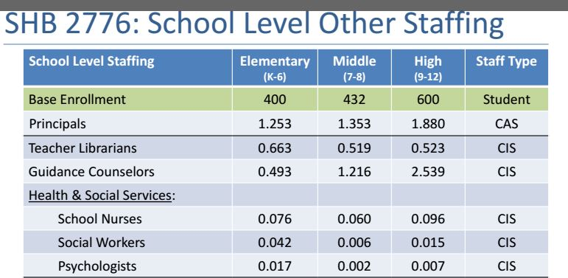
Prototypical School Funding Model
2016 AWSP/WASA Conference
These are BEA Allocations

Slide 20
Prototypical School Funding Model: 1.0 FTE Individual Provider Time in Building Per Week
2016 AWSP/WASA Conference
National Model recommendations:
Counselors = 1:250
Nurses = 1:School
Social Workers = 1:250
Psychologists = 1:700
17 h
42 h
90 h
3 h
2 h
34 h
1.5 h
12 m
30 m
40 m
4 m
15 m

Slide 21
Implications for 2016-17 & beyond
2016 AWSP/WASA Conference
Increase Staffing ratios
Advocate for Integrated Student Services within your buildings
Support ESA providers in implementing their national practice models
Support Collaboration between and within ESA providers
Prioritize an Integrated Student Services Model in your legislative agenda
Notes:
Laurie 21-22

Slide 22
How do we move forward now?
As an association, your legislative priorities include:
Investing in students by providing flexibility and resources to meet every students needs
Attracting and retaining quality staff by investing in professional development, collaboration, and prep time as well as enhancing the prototypical school funding model for school support staff
As School Directors, you can support allocating more money to ESA providers in your districts, and you can support a collaborative model of services
Higher teacher retention
Help all students grow and succeed
Reduce suspensions and expulsions
Increase engagement
Reduce chronic absenteeism
Improve graduation rates and reduce drop out rates
Improve school climate and culture
Notes:
18-22 15 minutes

Slide 23
Don’t forget to complete the evaluation
Notes:
Carrie to close

Slide 24
Evidence for Integrated Student Supports
Integrated Student Supports: A Summary of the Evidence Base for Policymakers
http://www.childtrends.org/wp-content/uploads/2014/02/2014-05ISSWhitePaper1.pdf
The Experts Have Spoken: Integrated Student Supports Improve Educational Outcomes
http://www.huffingtonpost.com/dan-cardinali/the-experts-have-spoken-i_b_4842549.html
Integrated Student Supports and Equity
http://smhp.psych.ucla.edu/pdfdocs/integpolicy.pdf

Slide 25
ISSS at OSPI
http://www.k12.wa.us/Workgroups/ISS.aspx

Slide 26
Real World Examples of Integrated Student Services
Florida Dept. of Education
http://www.sss.usf.edu/integrated/fissm/Tools/IntegratedSS_Final_1.pdf
An example from one Florida district
http://www.polk-fl.net/PARENTS/studentservices/default.htm
Alexandria City Public Schools, Virginia
https://www.youtube.com/watch?v=c8So5ic9v6o

Slide 27
References
School Nurse Organization of Washington website: www.schoolnurseorganizationofwashington.org
American Academy of Pediatrics (AAP)
Role of the School Nurse in Providing School Health Services, June 2016
http://pediatrics.aappublications.org/content/121/5/1052
National Association of School Nurses (NASN)
School Nurse Workload: Staffing for Safe Care
http://www.nasn.org/PolicyAdvocacy/PositionPapersandReports/NASNPositionStatementsFullView/tabid/462/ArticleId/803/School-Nurse-Workload-Staffing-for-Safe-Care-Adopted-January-2015
Scope and Standards of Practice: https://portal.nasn.org/members_online/members/viewitem.asp?item=S001&catalog=MAN&pn=1&af=NASN
Framework for 21st Century School Nursing Model: https://www.nasn.org/Framework
SNOW Presenter Contact Information:
Heather Graham, MSN, RN
Central Valley School District
DHGRAHAM4@comcast.net

Slide 28
References
School Social Worker National Practice Model: http://www.sswaa.org/?page=459
WASSW website: http://www.wassw.org/
School Psychologist National Practice Model: https://www.nasponline.org/Documents/Standards%20and%20Certification/Standards/2_PracticeModel.pdf
WSASP website: www.wsasp.org
WSCA website: http://www.wa-schoolcounselor.org/
ASCA website: http://schoolcounselor.org/
School Counselor National Practice Model: http://schoolcounselor.org/school-counselors-members/asca-national-model

