Slide 1



Slide 2

Goals for the day
What is PBIS and how PBIS can look like at an Elementary School
How to turn your school into a proactive school rather than reactive
Explore fun ways to celebrate appropriate student behaviors

Slide 3
Positive Behavioral Interventions & Supports - What is PBIS?
Philosophy:
PBIS is a team based, systematic approach in teaching behavioral expectations throughout the school. It is based on a proactive model which teaches the behaviors, reinforces and recognizes students who are able to model these behaviors and has systems in place to support students who have a difficult time or may present with more challenging behaviors.
The team approach is what truly makes this system work and we really need every family’s support to help us be successful.
Approach:
Instead of using a patchwork of individual behavioral management plans, we have moved to a school-wide discipline system that addresses the entire school, the classroom, areas outside the classroom (such as hallways, restrooms, offices, cafeteria, playground/school grounds etc.).
Every person who works in the school is aware of the behavioral expectations and works to ensure students are consistently getting the same message, regardless of the setting they are in or the adult they come in contact with

Slide 4
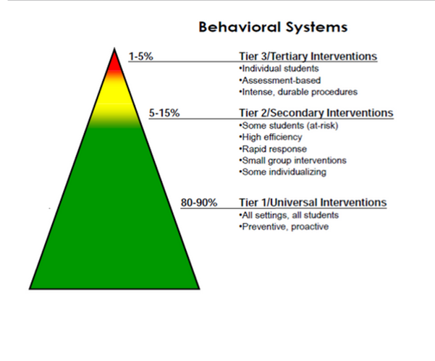

Slide 5

Why PBIS?
For our kid’s sake:
  The majority of our students are meeting our expectations so why not recognize them for their efforts
  Our kids are coming with more and more ACEs – kids need positive relationships with staff
  Decrease off task behaviors and increase on task behaviors
For our sake:
  We tend to spend the majority of our day focusing on the off task behaviors – wouldn’t it be fun to flip that and focus on the positive!
  Make teaching/school climate more fun

Slide 7
Adverse Childhood Experiences
(ACEs)
Personal
1. Emotional abuse
2. Physical abuse
3. Sexual abuse
4. Emotional neglect
5. Physical neglect
Family
1. Witnessing domestic violence
2. Alcohol or substance abuse in the home
3. Mentally ill or suicidal household members
4. Parental marital discord (as evidenced by divorce)
5. Incarcerated household member

Slide 9
Jason Lee Background…
Our school has implemented PBIS for 6 years
Shift from intervention to prevention model
Start and end with a matrix, but don’t let it constrain the creativity of the students and staff
“Don’t admire the problem”- Flint Simonsen

Slide 10
The “Reality”
Tier I
Tier II
Tier III
80-90% of Time/Resources/Energy

Slide 11
The “Shift”
Tier III
Tier II
Tier I
80-90% of Time/Resources/Energy

Slide 12
PBIS Behavior Matrix

Slide 13
SLANT

Slide 14


Cougar
Cooperation
Attitude
Respect
Effort
Safety
C
A
R
E
S

Slide 15
Cougar CARES Assembly
Each classroom recognizes one student that exemplifies the focused character trait for the month
Selected student will receive certificate, pencil, and a medal
Use the time to review the current trait and roll out the next trait to focus on.

Slide 16
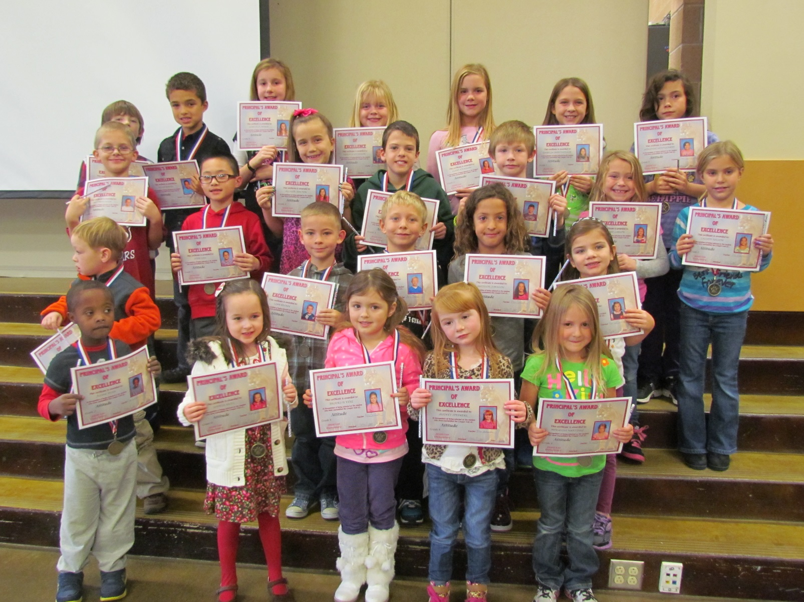
See “Attitude” CARES assembly

Slide 17

What is PBIS?
PBIS is:
a positive behavior management process to make Jason Lee a safe place.
a system of clear school wide expectations with consequences and incentives.
interventions when you need help.
recognition and celebration for your successes!

Slide 18
What does PBIS do for you?
Students are recognized and praised for positive behaviors.
  Cougar Cash, Extra Recess, Prizes, Special jobs, Time with adults
Students receive interventions to help them self manage their unsuccessful behaviors.
  Teacher-student conference, parent contact, Classroom Reset, Make it Right, parent conference, office referral, CARES room
Self Check, please!!!

Slide 19
How does PBIS work?
All students follow the same set of rules and expectations throughout all areas in the building.
When students follow the rules and expectations, they are recognized.
When students do not follow the rules, there are planned consequences to help them get back on track.

Slide 20
What is “Cougar Cash?”

Slide 21
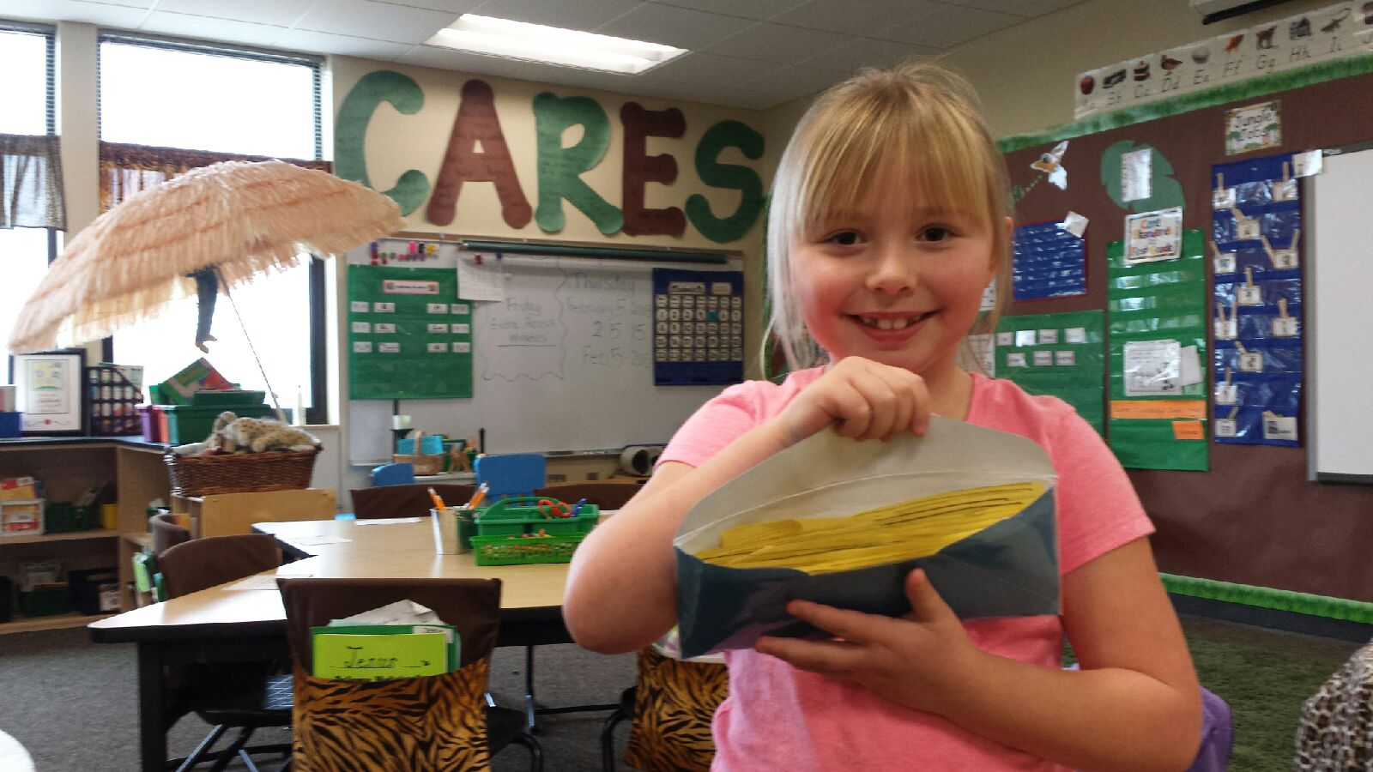
Show me the Money!!

Slide 22

How can you earn Cougar Cash?
Following the CARES rules
Going above and beyond to make Jason Lee safe
Showing respect to all students and staff
Doing the right thing (even if nobody is looking)
Playing nicely with everyone
Trying your hardest
Showing good sportsmanship

Slide 23

Who awards Cougar Cash?
All Staff including:
Teachers
Substitute Teachers
Office staff
Cafeteria Staff
Custodians
Playground Supervisors
Crossing Guards
Para-educators

Slide 24

Where can students spend their Cougar Cash?
At the Cougar Student Store!!!
Store will be open every Thursday during Lunch!
Items priced according to value

Slide 25
What can I buy with my Cougar Cash
1: * Raffle ticket
2: * Pencils, Erasers, Stickers,
* Milk Mustaches
5: * Small treats
10: * Hat day Pass
* Otterpop at lunch
15: * Name on Billboard
* Lunch at Special table with friend
* Announcement on intercom
with your name
20: * Dairy Queen Blizzard Coupon
* Custodian/Cafeteria Helper
during lunch recess
25: * Lunch w/ Teacher, Specialist, Principal or Counselor and 1 Friend
* Gum day pass
* Playground supervisor
35: * Mr. Jisa or Mr. Neill’s chair for the day
* Indoor recess pass with a friend
* Extra 5 minutes of recess for class
50: * Specialist, Principal, or Counselor for 1 hour
* Extra 15 minutes of recess for class
* Playworks game for class for 15 min
* Bingo for your class for 30 minutes

Slide 26

Junior Joggers
Cash can also be earned for running during Junior Joggers!
Every card completed equals 2 Cougar Cash

Slide 27

Grade Level Recognition
Days
Any particular day when there are NO office referrals that break any of the CARES rules
Results = 1 Peace Day
Office referrals will result in a lost Peace Day
When a particular grade level accumulates a certain number of peace days, the entire grade will be recognized
The target levels are: 5, 10, 20, 30, 50, 75, and 100 days

Slide 28
Peace Days
No office referrals for the day equals 1 peace day. Student referrals may include discipline referrals from the classroom, playground, specials, hallways, or bathrooms.
5th: 5 minutes extra recess
10th: 5 minutes extra recess
20th: 5 min extra recess + free choice seating in café
30th: 5 min extra recess + free choice seating in café
40th: Bingo for grade level
50th: 10 min extra recess + free choice seating in café
65th: 10 min extra recess + free choice seating in cafe
75th: 10 min extra recess + free choice seating in café
85th: Bingo for grade level
100th: 10 min extra recess + free choice seating in café + Otterpop Party for class

Slide 29
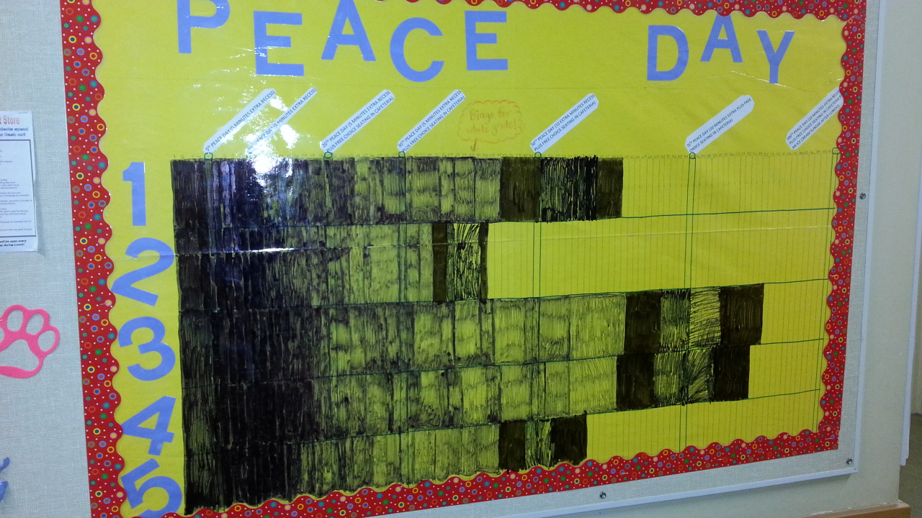

Slide 30
Awesome Attendance Day
No Tardies or Absences for the entire class equals 1 Awesome Attendance Day. Pre-excused absences accepted.
5th: Each student receives 1 Cougar Cash
10th: 1 Cougar Cash
20th: 1 Cougar Cash + AM Announcement recognizing class
30th: 2 Cougar Cash
40th: 2 Cougar Cash
50th: 5 Cougar Cash + AM Announcement recognizing class
75th: 5 Cougar Cash + AM Announcement +
10 min of extra recess
100th: 10 Cougar Cash + AM Announcement +
10 min of extra recess

Slide 31
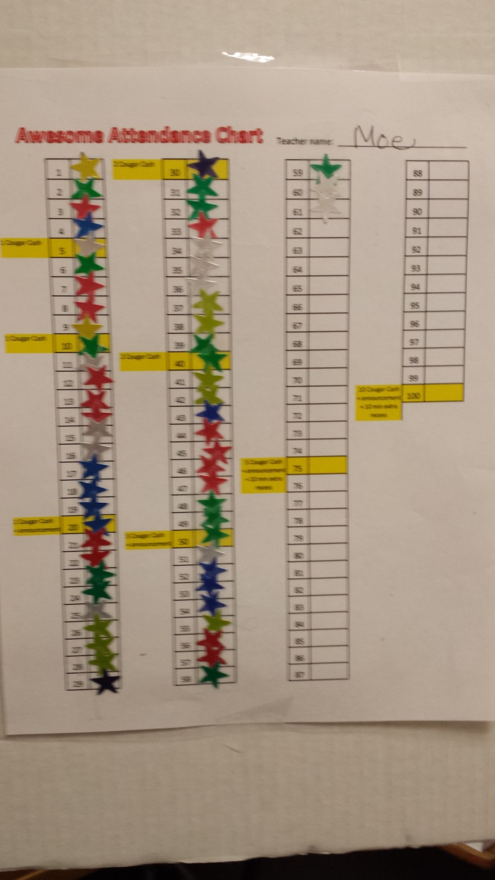

Slide 32
Also…..
Any Student with a Peace Month will receive 2
No behavior referrals

Slide 33
Also…..
Any Student with Awesome Attendance in a month will receive 2
No Absences or Tardies

Slide 34
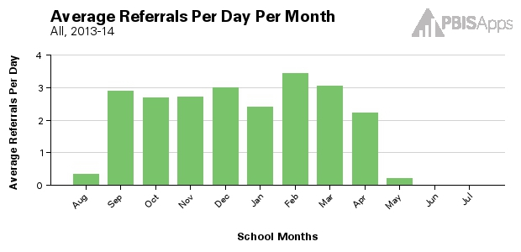
School Peace Month
April would count as a school-wide Peace Month!
November would not count as a school-wide Peace Month
School-Wide Peace Month:
The whole school earns 15 minutes of extra recess + free choice seating in the cafe

Slide 35
Café Day
Classes can also earn Cougar Cash by following the CARES rules and managing their behaviors during lunch
  Walking, Showing Manners, Speaking quietly, picking up after self
If your class meets the cafeteria expectations for that day, you class will earn a “Cafe Day.”
When a class accumulates a certain number of Cafe Days, the entire class will be recognized.
The target levels are: 5, 10, 20, 30, 40, 50, 75, and 100 days.

Slide 36
Café Day
Classes can earn a Café Day by following the CARES rules while in the cafeteria
5th: Each student receives 1 Cougar Cash
10th: Entire class eats lunch at outdoor tables
20th: 1 Cougar Cash + AM Announcement recognizing class
30th: 2 Cougar Cash
40th: 2 Cougar Cash
50th: 5 Cougar Cash + AM Announcement recognizing class
75th: 5 Cougar Cash + AM Announcement +
lunch at outdoor tables
100th: 10 Cougar Cash + AM Announcement +
lunch at outdoor tables

Slide 37
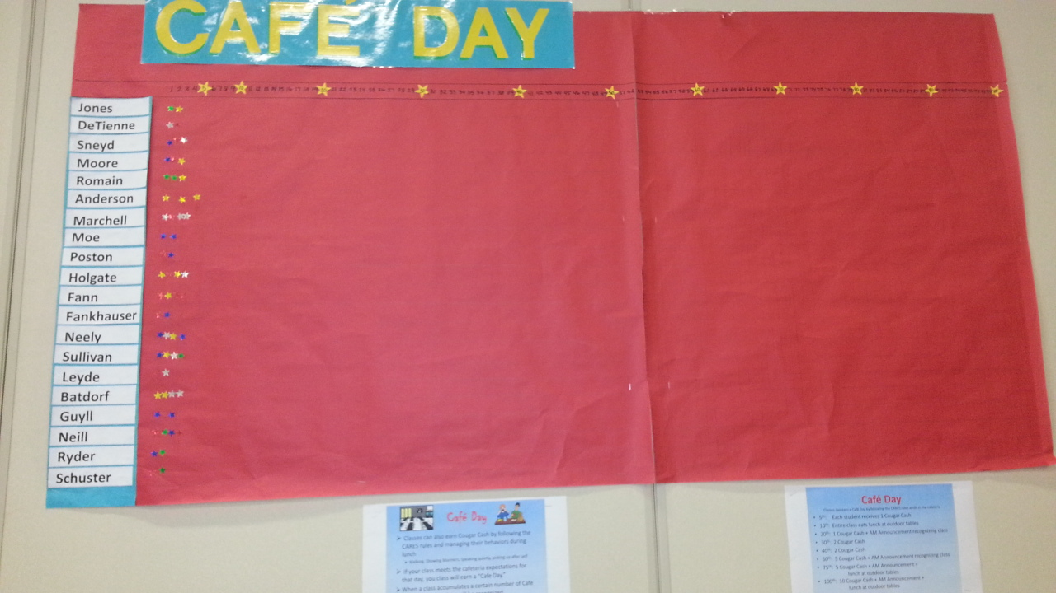
Cafeteria Teach To Video

Slide 38
Golden Garbage Can
The three classrooms who show the most effort in keeping their classroom clean and tidy will be recognized every week
Night custodians will award the Golden Garbage Can to the three classrooms each week
Those classrooms will have the honor of the Golden Garbage Can for the entire week of school
Mr. Jisa will also make an announcement that Monday morning

Slide 39
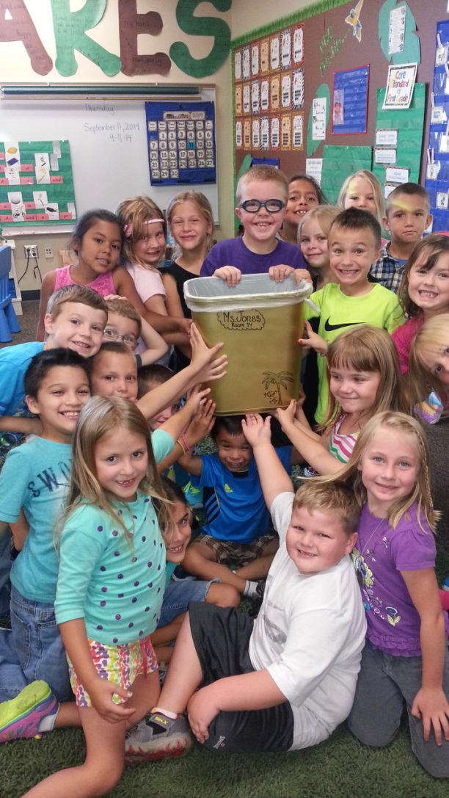
The Golden Garbage Can

Slide 40
Quiet as a Mouse Award
Purpose:
Decrease the noise in the hallways
Recognize classrooms that are moving in the hallways quietly
Award:
3 classrooms will be receive the Quiet as a Mouse Award each week
Intercom recognition along with Cougar Cash

Slide 41
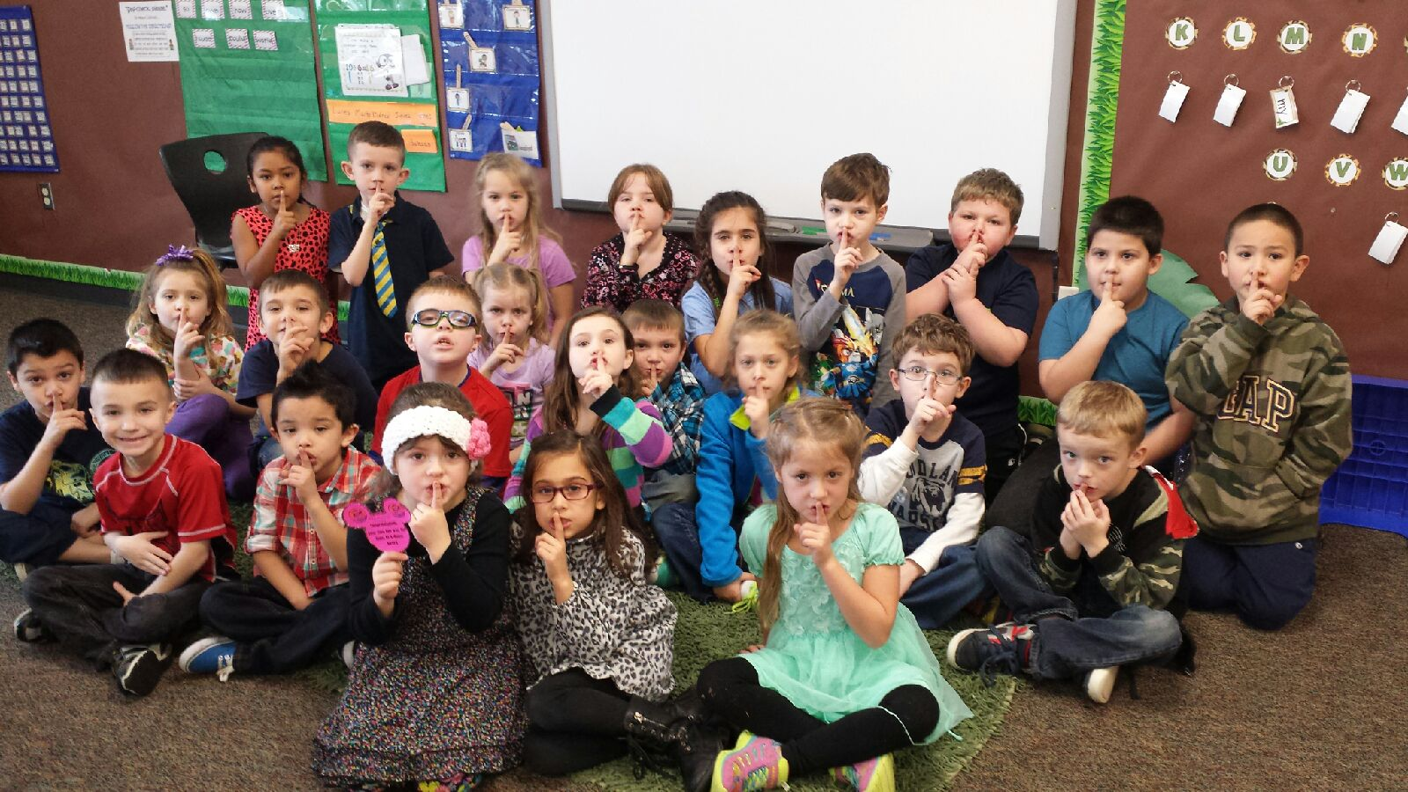
Quite as a Mouse Award
Hallway Teach To Video

Slide 42
Jason Lee PBIS webpage
https://jasonleeelementarypbis.shutterfly.com/
Contacts
Joe Jisa (Principal): joe.jisa@rsd.edu
Brian Neill (Counselor): brian.neill@rsd.edu

