Slide 1
MTSS and Inclusionary Practices
Enhancing the Role of the School Psychologist

Slide 2
Why Inclusion?

Slide 3

What is the ?
80+ years of research: Placement in general education
improves outcomes for students with disabilities!
Carlberg & Kavale (1980)
50 research studies
from 1932 – 1970
Wang & Baker (1985)
Meta-analysis
from 1975 – 1984
Oh-Young & Filler (2015)
Research studies
from 1980 – 2013
Theobald, et al. (2018)
WA Study on
CTE & Outcomes
Inclusive practices have also been shown to have positive
or neutral results for students without disabilities.
Ruijs & Peetsma (2009)
Positive/neutral effects
Szumski, et al. (2017)
Benefits for all students
Shogren, et al. (2015)
SEL benefits
Notes:
Students without disabilities:
Two meta-analyses, analyzing the results of multiple, international studies into the effects of inclusive practices, since 1999 and 1980, respectively, while the third study focuses on social-emotional benefits beyond academic outcomes.
The first study found that “Studies into the effects of inclusion on the academic achievement of children without special educational needs mostly found positive or neutral results” (p. 78).
The second study includes the following summary: “The main finding of this meta-analysis shows that not only students with SEN [special educational needs] may benefit from this form of education, which has been demonstrated in all the meta-analyses performed so far, but also that inclusive education may be beneficial for students without SEN” (p. 47).

Slide 4
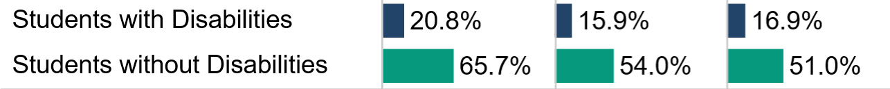
The Need to Improve Outcomes for SWD
Research (& our student demographics!) show 85-90% of students with disabilities can progress in grade-level curriculum with appropriate supports.
According to the National Council on Disability (2018), Washington State is in the lowest quintile nationwide for inclusive practices.
  Only 57.7% are placed in general education for 80-100% of the day.
  For students of color, that level of access falls to 48.7%.
2018-19 Opportunity gap: ELA Math Science
Sources: OSPI State Report Card, 2019; Draft Special Education Federal Child Count, Office of Superintendent of Public Instruction, 2019.
Notes:
LRE 1 is up from 56.6% in 2018 to 57.7% in 2019

Slide 5
2019 WA Students with Disabilities, by Eligibility Category
Students with Disabilities, ages 6-21 (134,239)
Source: Draft Special Education Federal Child Count, Office of Superintendent of Public Instruction, 2019.

Slide 6
2019 WA Students with Disabilities, by Eligibility & EL Status
Source: Draft Special Education Federal Child Count, Office of Superintendent of Public Instruction, 2019.

Slide 7
2019 Placement of Students with Disabilities, by Grade
Source: Draft Special Education Federal Child Count, Office of Superintendent of Public Instruction, 2019.

Slide 8

The Equity Imperative
Image copyright Presenter Media. Used here under purchased license
Barriers to equity for students with disabilities:
  Low expectations
  Lack of access and opportunity to core instruction from content experts
  School schedules contribute to removals from core instruction in general education
  Teacher and ESA shortages
  Staffing models that encourage segregation
  Disproportionate discipline
  Training needs for school staff & educators who support them
How will school leaders remove or reduce these barriers?
Notes:
Pause for discussion question/reflections

Slide 9
Why MTSS?

Slide 10
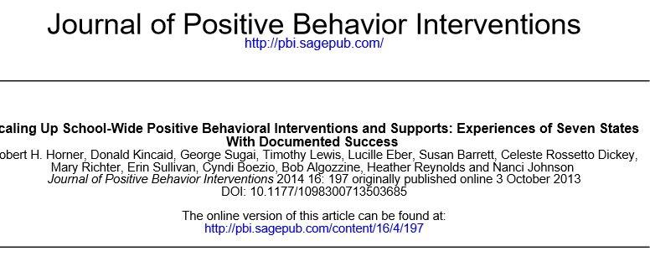
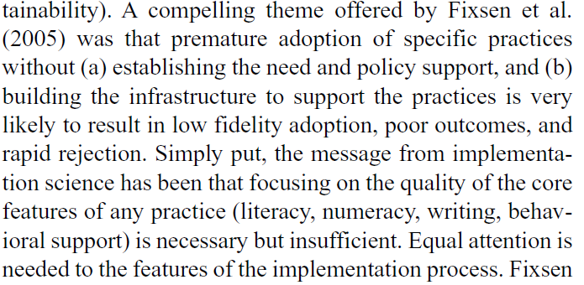

Slide 11
What is Inclusion?

Slide 12
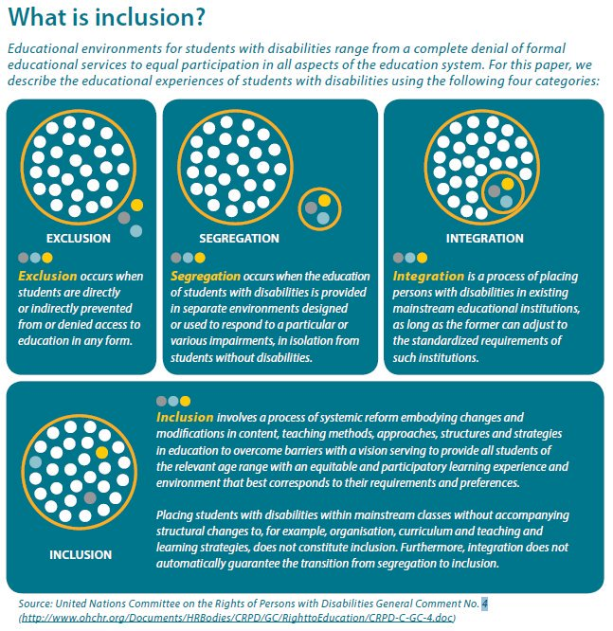
Notes:
Inclusionary practices in WA:
Inclusion is the belief that all students have a right to meaningfully participate in general education settings, both academically and socially.
Inclusion is realized when all students, regardless of their designation to receive special education services, are provided targeted interventions and accommodations; allowing them to learn in the general education classroom and engage the core curriculum.

Slide 13
Notes:
http://www.ohchr.org/Documents/HRBodies/CRPD/GC/RighttoEducation/CRPD-C-GC-4.doc

Slide 14
Inclusive Education
What it IS:
What it is NOT:
Vision & Practice (belief everyone belongs, regardless of perceived ability)
Practice of Differentiating
Instruction (providing all students with opportunities to practice self-determination)
Presumed Competence (holding the highest expectations by creating personally meaningful curriculum opportunities to acquire academic and functional knowledge within the context of general education and natural routines)
Supported by Research (students with disabilities educated in regular classes do better academically and socially)
Mainstreaming (focusing on a student being ready to learn instead of a school ready to support diverse learners)
Integration (focusing on physical and social access with limited or no academic expectations for students with moderate or severe disabilities)
Routinely or automatically grouping students (homogeneous grouping of students perceived as performing low educationally or behaviorally)
Source: Villa & Thousand, 2016
Notes:
Success with graduation pathways is directly tied to equitable access and rigor – inclusive education must be part of this planning process…

Slide 15
What are Inclusionary Practices?
Universal Design for Learning (UDL)
Multi-tiered Systems of Support (MTSS)
Positive Behavior Interventions & Support (PBIS)
Culturally-responsive pedagogy
Master Scheduling to support inclusion
Differentiated instruction
Students engaged in core content
Student engagement
Co-teaching and co-planning
Inclusive IEPs
Family/community partnerships
Flexible service delivery
Leadership development
Use of assistive technology (AT)
Social emotional learning (SEL)
Visible learning
Data literacy and data analysis protocols
Teacher collaboration
Inclusive extracurricular activities
PLCs that include inclusive viewpoints
Embedded academic (and nonacademic!) instruction in general education
Inclusive vision and mission
Teaching self determination
Person-centered/Strengths-based planning
Blended learning

Slide 16
Who is Responsible for Inclusionary Practices?
Each of us, (and most especially those closest to the students, including principals, educators, and families)…
Principals “can inhibit or inspire school personnel to accept the inclusion of students with disabilities in the general education classroom. Moreover, their attitudes are critical in the design and implementation of programs and practices in their schools. Principals’ attitudes can either promote or discourage the inclusion practices in their schools.”
Source: Vazquez, M. 2010. “Inclusionary Practices: Impact of Administrators’ Beliefs on Placement Decisions.”
Unpublished Doctoral dissertation, University of Central Florida, Orlando, Florida.

Slide 17
What is SDI

Slide 18
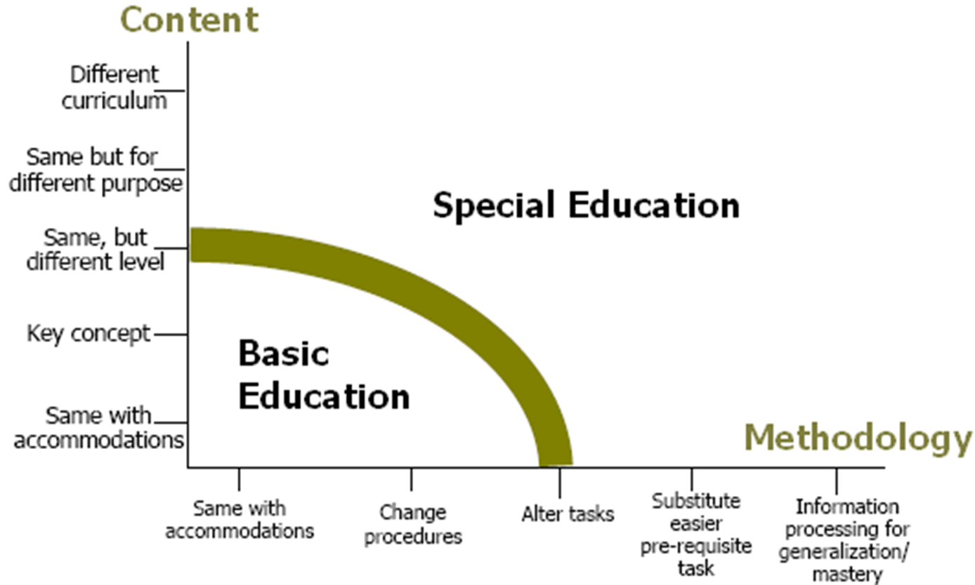
What is Specially Designed Instruction (SDI)?
Notes:
This conceptual framework shows the continuum of instructional modifications/ accommodations relating to content and methodology, including the point at which instruction becomes “specially designed”. The vertical axis includes the range of content modifications, while the horizontal axis represents modifications in methodology.
The IEP team determines how the instruction will be delivered, based on the unique needs of the student.
Individual accommodations are not, by themselves, considered to be specially designed instruction. Accommodations are changes that are environmentally-related, while specially designed instruction involves adapting the content, methodology, or delivery of instruction.
Students with disabilities may have goals that are not related to the general curriculum, but instead are designed to address their very individual needs that are non-academic. They may also have goals that are related to the general curriculum, but at different levels than their non-disabled peers.
Students with disabilities may need to have the elements of instruction broken down and taught separately or with greater intensity.
No matter how one adapts the content, methodology, or delivery of instruction, the instruction that is provided should be designed to: (a) meet the student’s unique individual needs that result from the student’s disability (as identified in the student’s current evaluation report); and (b) ensure the student’s access to the general curriculum so that the student can meet the educational standards that apply to all students.

Slide 19
SDI vs. Accommodations
Accommodations:
SDI:
Text highlighted for a student
Student given extra time to complete assignment
Paraeducator or peer reading text aloud to student
Student permitted to turn in a shortened/abbreviated assignment
Student permitted to address literary concepts orally instead of in writing
Student provided with instruction on how to read text for information
Student taught vocabulary strategies using content from a specific text
Student provided reading instruction using adapted materials for the same piece of text/literature other students are reading

Slide 20
SDI vs. Accommodations
Accommodations:
SDI:
Student given 3 opportunities prior to removal from class due to behavioral needs
Student given the choice of moving to a quiet, non-stimulating area to regain control when upset
Student given tokens for good behavior which s/he may use for classroom rewards
Student provided instruction in anger management, alternative behavioral strategies, etc.
Student provided instruction and practice developing appropriate social skills

Slide 21
What is MTSS?

Slide 22
A framework for enhancing the implementation and adoption of a continuum instructional intensity and interventions to achieve important outcomes for all students

Slide 23
Foundational Values of MTSS
Inclusion
Equity
Collaboration
Family, Student, Community Engagement
Notes:
Freeman, Traverso, 2019.

Slide 24
Implementation components
Team-Driven shared Leadership
Data-Based Decision Making
Universal Screening
Progress Monitoring
Problem Solving/Continuous Improvement Cycles
Continuum of Supports matched to student need
Universal Instruction
Layered tiers of support
Family, Student, Community Engagement
Use of Evidence Based Practices

Slide 25
Positive Behavioral Interventions and Supports (PBIS) for Continuous Improvement and Alignment of Initiatives
is a Multi-Tiered System of Supports (MTSS) Framework
Supporting culturally equitable Targets including
social/emotional competence & academic achievement
OUTCOMES
Supporting culturally knowledgeable Staff Behavior
team-based leadership and coordination
professional development, coaching, and content expertise
Supporting culturally valid Data-based Decision Making
universal screening
progress monitoring
evaluation of fidelity
SYSTEMS
DATA
PRACTICES
Midwest PBIS Network 2/7/19. Adapted from:
“What is a systems Approach in school-wide PBIS?” OSEP Technical Assistance on Positive Behavioral Interventions and Supports. https://www.pbis.org/school
McIntosh, K.& Goodman, S. (2016). Integrated Multi-Tiered Systems of Support: Blending RTI and PBIS. New York: Guilford Press.
Supporting Student Behavior
three-tiered continuum of culturally relevant evidence-based interventions
Notes:
25
Slide Starter: “This visual is the organizing logic of a Multi-Tiered Behavioral Framework…
Sources:
1. What is a systems Approach in school-wide PBIS? OSEP Technical Assistance on Positive Behavioral Interventions and Supports.
2. McIntosh, K.& Goodman, S. (2016). Integrated Multi-Tiered Systems of Support: Blending RTI and PBIS. New York: Guilford Press.
Outcomes: academic and behavior targets that are endorsed and emphasized by students, families, and educators. (What is important to each particular learning community?)
Practices: interventions and strategies that are evidence based. (How will you reach the goals?)
Data: information that is used to identify status, need for change, and effects of interventions. (What data will you use to support your success or barriers?)
Systems: supports that are needed to enable the accurate and durable implementation of the practices of MTSS. (What durable systems can be implemented that will sustain this over the long haul?)
The framework language is familiar and used often when discussing MTSS. By framework, we mean MTSS is a singular method of organizing the decision making, implementation, and progress monitoring of school operations. The circles represent the key components of that framework, and are used to organize the school’s way of work. Start with identifying outcomes, which for whole school is often Social Competence and Academic achievement…
Then we look to the data to uncover our “current reality” or what is showing up around this outcome-where are we/where do we stand. We would use the data to identify a precision statement that clearly defines the current reality (problem to address). Then we would look to our resources (e.g., resource map) to identify what practices we might have that would support students with the issues showing up in our data (e.g., school-wide expectations defined, taught, and reinforced for respectful behavior). Then we look at what supports would be necessary to support the adults to implement the practices identified to support students. Then we return to data to monitor progress and make decisions as to whether or not what we implemented worked. If not, was it because we lacked fidelity? Or was it because it wasn’t the right match of practices to need? Do we need different systems (supports) for the adults.
Cultural Relevancy:
Culturally relevant behavior support: Teach behaviors that are socially relevant to Culturally and Linguistically Diverse (CLD) students
Culturally validating behavior support: Acknowledge students’ cultural identity as a strength
Establish cultural validity of data: Carefully review operational definitions of behavioral violations
Disaggregate ODR data by student race. For example, ethnicity report of the School Wide Information System (www.swis.org)
Revise measures: Provide schools with tools to assess extent to which culturally responsive systems and practices are in place
Generate school-wide commitment to culturally equitable behavioral outcomes: Define school-wide behavioral goals in collaboration with parents of CLD students
Increase accountability for equitable outcomes. Review extent to which defined goals are met.

Slide 26
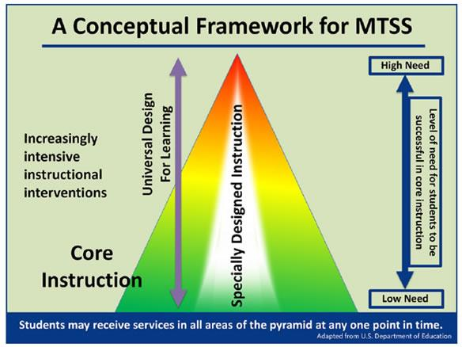

Slide 27
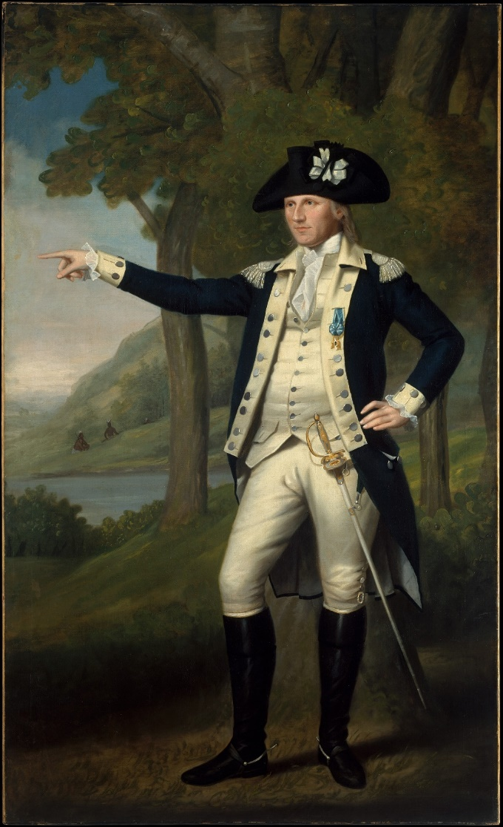
In the Chat Window:
What role can/do the school psychologists play in MTSS leadership at the building and/or district levels?
Notes:
Marinus Willett,ca. 1791
Ralph Earl American

Slide 28

15 Minutes

Slide 29
How do we do this work?

Slide 30
Implementation Science Frameworks
Usable Innovations
Implementation Drivers
Improvement Cycles
Implementation Stages
Teams

Slide 31
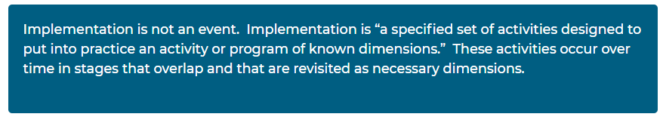
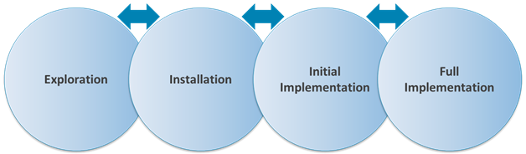
Implementation Stages

Slide 32
(Latham, 1988)

Slide 33
Teaming Across Tiers and Systems

Slide 34
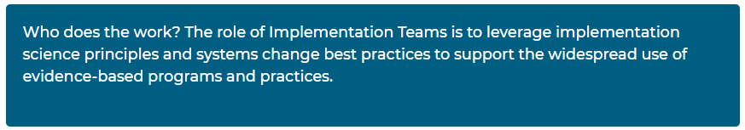
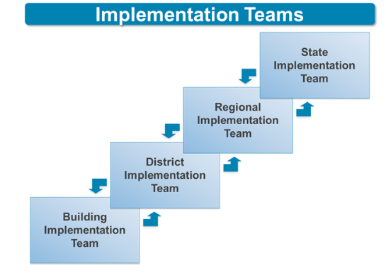
Implementation Teams

Slide 35
District Leadership Teams
Stakeholder Engagement
Funding and Alignment
Policy
Workforce Capacity
Executive Functions
LEADERSHIP TEAMING
Implementation Functions
Training
Coaching
Evaluation
Local Implementation Demonstrations

Slide 36
3-Tiered System of Support
Necessary Conversations (School Teams)
Universal
Team
Secondary Systems Team
Brief Function-Based Problem Solving Team
Tertiary Systems Team
Uses Process data; determines overall intervention effectiveness
Uses Process data; determines overall intervention effectiveness
Plans SW & Class-wide supports
Standing team; uses FBA/BIP process for one youth at a time
CICO
Universal Support
Modified
CICO
Brief
FBA/BIP
Complex
FBA/BIP
WRAP
RENEW
SAIG
Brief FBA/BIP
Overview: Tier II Systems
Notes:
36
36
“At the top, pay attention to the word ‘Conversations’
You have these teams/conversations taking place for the difference components of your systems development and implementation and progress-monitoring of your practice
This team is talking about the system. How is that different than the FBA Problem-solving team?
Tier 3 team is also focused on building the interventions, not working on individual students. The individual student teams are the bottom boxes of “Complex FBA/BIP” and “Wrap/RENEW”

Slide 37

In the Chat Window:
In your district/building(s), how would you describe the roles and activities of school psychologists within all Tiers of MTSS implementation?
Notes:
The American School,1765
Matthew Pratt American

Slide 38
The Role of the School Psychologists in MTSS Teams
(Stoiber, 2014)
Universal Team: Supports for ALL Students
Assist with selection & identification of evidence-based core classroom instruction
Assist with selection & implementation of universal screening measures
Support data-based differentiation of instruction and fidelity
Facilitate selection and use of classroom management strategies & school-wide supports
Provide professional development

Slide 39
The Role of the School Psychologist in MTSS
(Stoiber, 2014)
Secondary Systems Team: Supports for SOME Students
Guide, monitor, follow up on collaborative team decisions for student interventions
Consult with teachers & families regarding effective implementation of evidence-based programs, approaches, and strategies
Provide resources and support teachers in using effective strategies
Assist in selection & implementation of progress monitoring measures
(10-25%)

Slide 40
The Role of the School Psychologist in MTSS
(Stoiber, 2014)
Tertiary Systems Team: Supports for a FEW Students
Support in defining the scope, practice and location of Tier 3 interventions
Supervision of regular and sufficient data collection
Ensuring fidelity and dosage of instruction/intervention
Provide professional training to staff on interventions, progress monitoring and data-based decision making.
(3-5%)

Slide 41
The Expanded Role of the School Psychologist in MTSS
(Skalski, 2014)
Develop and provide system-wide prevention activities delivered within a MTSS
Interpret data for program planning
Develop and monitor program services
Provide system-wide, classroom, and individual case consultation
Develop crisis prevention and response protocols;
Assist in the important coordination of these potentially overlapping services.

Slide 42
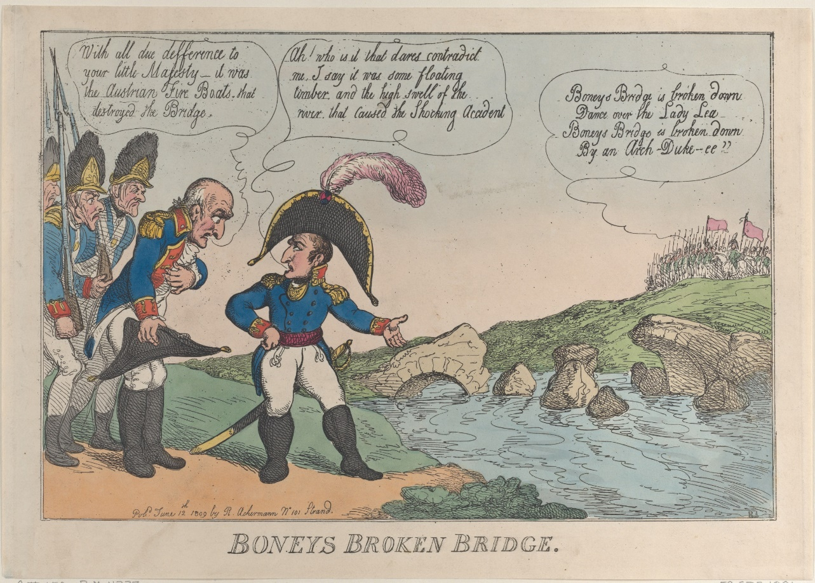
In the Chat Window:
What is preventing you from having a larger role in MTSS?
Notes:
Marinus Willett,ca. 1791
Ralph Earl American

Slide 43
Collaboration with Community Partners and Families is at the core of successful tier three MTSS.

Slide 44
Barriers to Collaboration
Mastro & Jalloh (Enhancing Service School/Community Collaboration, 2005) identified several significant barriers to effective collaboration. They are in areas of:
Cultural: Many professionals lack the understanding or have an appreciation for the cultural values of the families they serve. Because of their professional status, this may create a barrier to parent collaboration. Therefore, cultural influences in relation to the family system impact successful collaboration.
Organizational: There may be requirements for school personnel that community organizations do not require of their staff or issues that may prevent staff from being willing or available for after school activities which may hinder partnership growth.
Structural: Schools are usually more formal in structural organization than community agencies. Hierarchical issues such as credentialing and tenure and designated levels of responsibility are more rigid, and because of this structural design, decision making happens at a slower pace than community.

Slide 45
Barriers to Collaboration (cont.)
Groups and lead to a lack of understanding and/or respect for the constraints under which each of the entities must operate.
Competitive Mindsets: Social service organizations and educational institutions may seem to be in competition with one another for student funding, be charged with evaluating each other’s performance, or have a history of friction with one another, as as well as with families—all of which can be expected to interfere with collaboration.
Threat of Bureaucracy: Agency representatives may create layers of bureaucracy by forming an interagency “czar” or “superagency” , and the focus on service delivery is lost.
Threat of Domination: One single entity of the collaborative team may try to dominate proceedings, leaving other members feeling they have little influence.

Slide 46
Strategies Toward Collaboration
The research of(Ascher et. al., 1990,1988) have identified what they believe to be essential strategies to effective collaboration and are achieving successful in meeting their objectives.
Service delivery is ‘family- centered’, rather than ‘student-centered’. The student with a disability is treated as a member of the family, and the family is treated as a member of the community, so that a family unit, rather than a group of individuals, is served.
Staff are given the time, training, and skills—including culturally responsive and communication skills to establish and maintain sustained and supportive relationships.

Slide 47
Strategies Toward Collaboration (cont.)
Flexibility is essential, going beyond rigid rules and procedures to allow the focus to remain on the service and not the structure.
Actions are results orientated and accountable to families, professionals, and the general public.

Slide 48
Strategies Toward Collaboration (cont.)
The provision of a range of participants– families along with professionals, from nurses to teachers to psychologists and administrators who function as a team and build trusting, respectful relationships with one another.
The frequent use of case managers (or coordinators) who serve as liaisons between student/families and the various service-providing agencies.
Response is toward local needs in that no one administrative arrangement or service setting fits every situation.

Slide 49
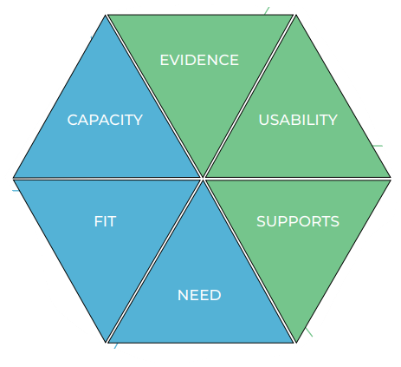
Hexagon Tool
Notes:
https://nirn.fpg.unc.edu/sites/nirn.fpg.unc.edu/files/imce/documents/NIRN%20Hexagon%20Discussion%20Analysis%20Tool%20v2.2.pdf

Slide 50
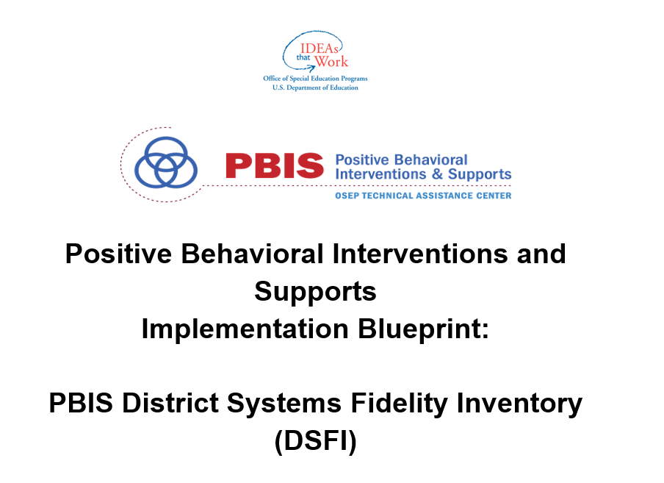
Notes:
https://assets-global.website-files.com/5d3725188825e071f1670246/5d7ab7e503d8cef8bf626227_PBIS%20Implementation%20Blueprint%20Part%202%20Self-Assessment%202017-5-15.docx

Slide 51
CEC High Leverage Practice | Tiered Fidelity Inventory (TFI) Reading Tiered Fidelity Inventory (R-TFI)
HLP1: Collaborate with professionals to increase student success | TFI: 1.1, 1.2, 2.1, 2.2, 3.1, 3.2 R-TFI: 1.1, 1.2, 1.3, 1.4, 1.5, 2.1, 2.2, 3.1, 3.2, 3.3, 3.4
HLP2: Organize and facilitate effective meetings with professionals and families | TFI: 1.2, 1.11, 2.2, 3.2, 3.6 R-TFI: 1.2, 1.3, 1.5, 2.1, 3.1, 3.3, 3.4,
HLP3: Collaborate with families to support student learning and secure needed services | TFI 1.11, 2.8, 3.6 R-TFI: 2.6, 3.7
HLP4: Use multiple sources of information to develop a comprehensive understanding of a student’s strengths and needs | TFI 1.12, 1.13, 2.3, 2.7, 2.11, 3.3, 3.8, 3.9 R-TFI: 1.23,
HLP5: Interpret and communicate assessment information with stakeholders to collaborative design and implement educational programs | TFI: 1.10, 1.11, 2.6, 2.7 R-TFI

Slide 52
CEC High Leverage Practice | Tiered Fidelity Inventory (TFI) Reading Tiered Fidelity Inventory (R-TFI)
HLP6: Use student assessment data, analyze instructional practices, and make necessary adjustments that improve student outcomes | TFI 2.11 R-TFI 3.5, 3.11
HLP 7: Establish a consistent, organized, and respectful learning environment | TFI 1.3 R-TFI 1.10, 1.11,
HLP8: Provide positive and consistent feedback to guide students’ learning and behavior | TFI: 1.9 R-TFI
HLP9: Teach social behaviors | TFI: 1.4, 1.8 R-TFI: 1.10, 1.11
HLP10: Conduct functional behavioral assessments to develop individual student behavior support plans | TFI: 3.9, 3.10 R-TFI
HLP11: Identify and prioritize long and short-term learning goals | TFI R-TFI: 3.2
HLP12: Systematically design instruction toward a specific learning goal | TFI: 2.7 R-TFI

Slide 53
CEC High Leverage Practice | Tiered Fidelity Inventory (TFI) Reading Tiered Fidelity Inventory (R-TFI)
HLP13: Adapt curriculum tasks and materials for specific learning goals | TFI R-TFI
HLP14: Teach cognitive and metacognitive strategies to support learning and independence | TFI: 3.11, R-TFI
HLP15: Provide scaffolded supports | TFI: R-TFI: 1.9, 2.2
HLP16: Use explicit instruction | TFI: R-TFI: 1.6, 2.3, 3.6
HLP17: Use Flexible Grouping
HLP18: Use strategies to promote student engagement | TFI: 1.8, R-TFI: 3.6
HLP19: Use assistive and instructional technologies
HLP20: Provide positive and constructive feedback to guide student’s learning and behavior | TFI: 1.9, 2.6, R-TFI 1.10, 3.6
HLP21: Teach students to maintain and generalize new learning across time and settings
HLP22: Provide intensive instruction | TFI: R-TFI: 3.5, 3.6

Slide 54
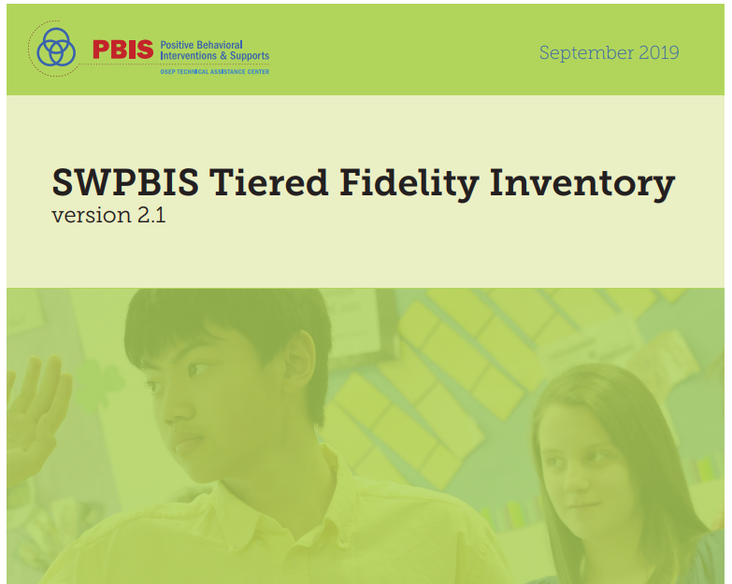

Slide 55
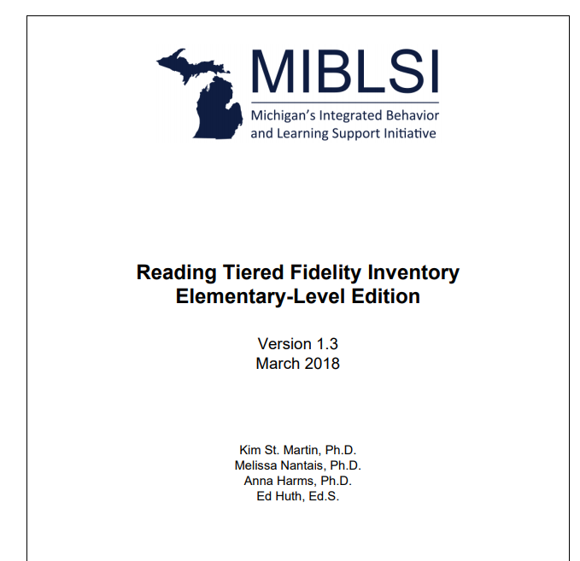
Notes:
https://miblsi.org/sites/default/files/Documents/Evaluation/Fidelity/RTFI/website_March2018_R-TFI%20Elementary-Level%20Edition_v1.3.pdf

Slide 56
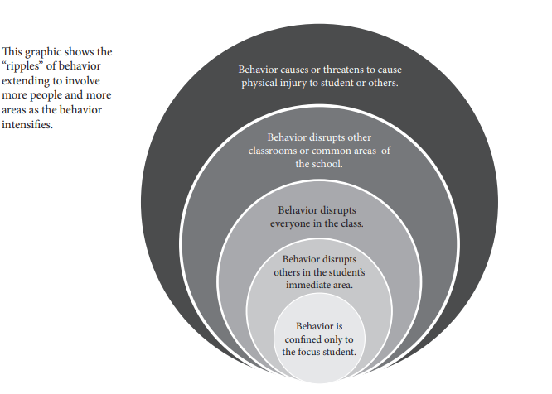

Slide 57
