Slide 1
Diagnosing ADHD: Conducting Valid, Comprehensive, and Collaborative Assessments
Caroline Buzanko
Assistant Professor
Athabasca University
carolinebuzanko@athabascau.ca

Slide 2
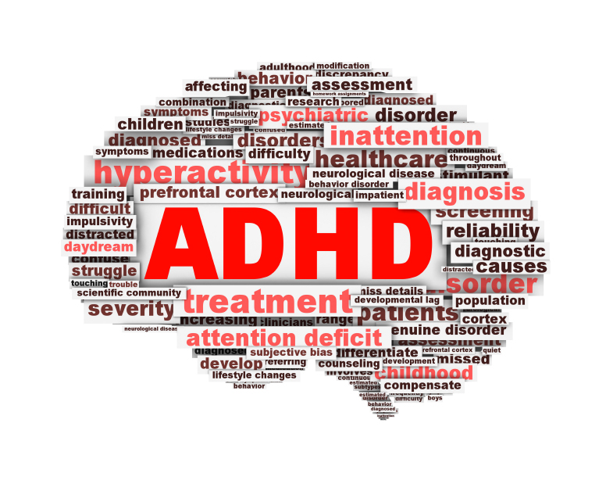
Overview
Brief overview of the nature of ADHD
Assessment of ADHD
Purpose
Methods & measures
Working collaboratively
Integrating results
Linking results to intervention

Slide 4
ADHD
Affects 5-8% of the population
70% increase in children
100% increase in adults
Male:female ratio:
6:1 (clinical)
3:1 (community)

Slide 5
ADHD
Cluster of behavioral deficits
Impairments to meet societal expectations

Slide 6
ADHD
Use a practical definition of ADHD to guide assessment
Greater understanding of the child
Translates data into functional behavior

Slide 7
Practical Definition
Impulsivity
Difficulty with gratification
Overarousal
Inattention
Emotions and locus of control

Slide 8
Inattention
Intention vs. attention
Difficulty with repetitive, effortful, uninteresting, neutral/non-preferred
Unable to inhibit impulse to move off task (= overactivity, dazing, or emotional arousal)
Problems with organization

Slide 9
Impulsivity
Limited self-control; overwhelming immediate need to act that they cannot resist (e.g., TV vs. homework)
Point of performance impaired
Repeat offenders, fail to learn from past mistakes
Difficult to think about actions/consequences

Slide 10
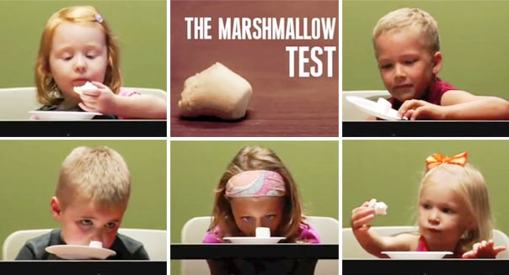
Difficulty with gratification

Slide 11
Overarousal

Slide 12
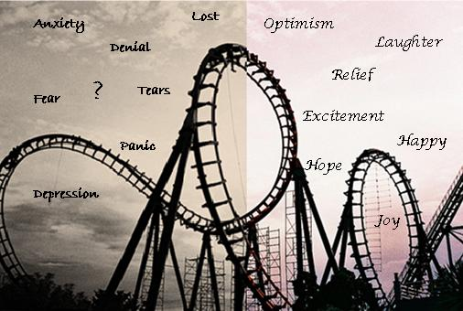
Emotions and External Locus of Control

Slide 13
ADHD:
A disorder of inhibition (vs. attention)

Slide 14
ADHD:
A problem of performance and of inconsistency (vs. skill deficit or inability)

Slide 15
Impairments in day-to-day activities
Difficulty managing distractions
Inconsistent
(vs. lazy or inability)
Very motivated
Have skills
No matter how many reminders

Slide 16
ADHD: A Disorder of EF
Disorder of performance
Disorder of “point of performance”
Disorder of when and where (vs. how and what)
Of doing what you know

Slide 17
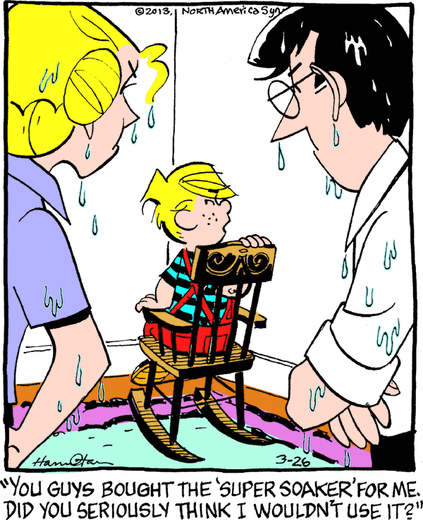

Slide 18
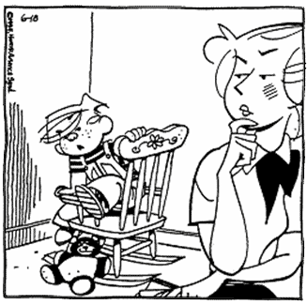
“By the time I think about what I’m going to do
I’ve already done it”

Slide 19
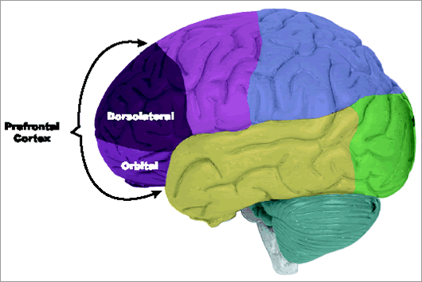
EF: Developmental Considerations

Slide 20
ADHD
Secondary impacts
Family functioning
Adults vulnerable to multitude of difficulties:
Psychiatric
Emotional
Cognitive
Academic
Vocational
Substance
Antisocial

Slide 21
What is the Purpose of Assessment?

Slide 22
Purpose of Assessment?
Determine presence/absence of ADHD
Second opinion
Social/Emotional/Behavioral/Academic functioning
Outline appropriate interventions to address the impairments revealed
Funding purposes
Determine comorbid conditions
Affect prognosis?
Identify child’s strengths and weaknesses and treatment planning
Parents:
Understanding of ADHD & intervention strategies
Motivation for change

Slide 24
Evidence Based Assessments
Using research and theory to inform the assessment process
Reliability and validity
Context of instruments
Incremental validity and clinical utility

Slide 25
“Textbook approach”
Comprehensive
Thorough emotional, behavioural, and developmental assessment
Multiple sources across settings (home, school and social settings)
Multiple measures
Decisions based on accepted standard

Slide 26
Assessing ADHD

Slide 27
ADHD: It’s Complex!
Heterogeneous
Comorbidities
No developmental, biological, or cognitive markers
Based on observable behaviours
Social and non-social influences
Vague guidelines: inconsistencies

Slide 28
Assessing ADHD
Major Criticisms
Too much focus on symptoms/diagnosis Little treatment outcomes Problems with diagnostic criteria Difficulties not about symptoms Heterogeneous populations and difficulties manifest differently Little information about functional outcomes Specificity of needs No info on emotional and behavioural outcomes Implications for family Comorbid diagnoses and poor prognosis Ecological validity Differential diagnosis

Slide 29
Assessing ADHD
*****Planning for intervention*****

Slide 30
Assessing ADHD: Beyond Symptoms
Identify all presenting problems
Identify areas of impairment
Family functioning
Peer relationships
Academic performance
Comorbidity and associated difficulty
Targeted behaviors

Slide 33
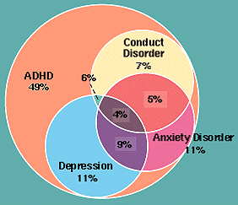
Assessing Comorbidities

Slide 34
Assessing Comorbidities
Is a diagnosis be the main focus?
What is the nature of the impairment? What are the behaviours that need to be targeted?
Measures of impairment vs. symptoms
Rating scales & FBA
Developmental deviance?

Slide 35
Assessment considerations
Working understanding of diagnostic criteria
Practical understanding of symptoms’ affect individual’s functioning
Diagnostic strategy
Multidimensional
Frequency/severity fluctuate across settings and people
Ultimate goal: promoting success

Slide 36
Objectives
Reliability and validity of approaches to assessing symptoms and impairments of ADHD
Effective integration of information
Balance between treatment utility and cost effectiveness

Slide 37
Methods
Social, Emotional, Behavioral, and Academic Functioning (across contexts)
History and Clinical interviews
Empirically supported behaviour rating scales
Review of files
Behavioural observations
Anecdotal comments
Measures of Psychological Processes
Cognitive ability
Academic achievement
Neuropsychological tests

Slide 40
Parents experiences

Slide 41
Unsure of child’s needs
Unprepared & Anxious
Lack of involvement/ collaboration
What next?
Unsure of what their child is assessed for
Unsure of how to support their child

Slide 44
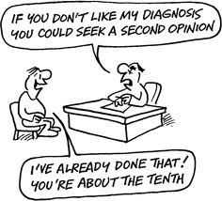

Slide 47
Intake
Formal Assessment
Communicating results
Notes:
For the purpose of the remainder of this, will split the assessment into three key parts

Slide 48
Phase 1: Intake
Clinical interviews
Engaging parents

Slide 49
Intake: Textbook recommendations
Initial questions:
Referral question & purpose of the assessment
Previous assessments?
Other diagnoses?
Medications?
If so, possible to withhold for testing?
Initial paperwork (1st or 2nd phase):
Information forms/demographic information
Developmental/medical forms
Behavior rating scale
Rating scale for ADHD symptoms
EF rating scale
Adaptive functioning checklist
Home/school situations questionnaire
Previous reports/records

Slide 50
Intake: Clinical interviews
With parents
Clarify reason for assessment
Child’s development and behavior
General descriptions and presenting problems
Get specifics
Range of behaviours and settings
EF and manifestations at home and school
Rule out alternative explanations

Slide 51
Intake: Clinical interviews
Functioning in developmental domains
Academic, intellectual, language, motor, emotional
Consideration of differential diagnosis
Social
Trouble making/keeping friends? Interactions/behaviors with peers? Relationships with classmates?
Recreational activities
School History (preschool to present)
Relationships with teachers/classmates, academic functioning, accommodations/strategies, comments from teachers about performance/behaviors

Slide 52
Intake: Clinical interviews
Extended family history
Sibling development, parent development, psychiatric difficulties in the child/family, medical history, developmental disorders or tic disorders
Family relations & other parental factors
Employment problems
Family functioning (e.g., stress, parent-child interactions, child compliance, marital difficulties, parent and child’s social network)
Parent psychopathology, knowledge and skills
Previous treatment
Parent understanding of ADHD

Slide 53
Intake: Clinical interviews
Medical history
Significant events
Obtain impressions on child and parent functioning
Parent-child interactions

Slide 54
Intake: Clinical interviews
With teachers
Symptoms and associated impairments
Productivity
Behaviours and environmental influences
Relationships (teacher/peers)
Academic skills and challenges
Learning to learn skills/EF skills
Strategies

Slide 55
Sample questions:
Range of behaviors:
When does student pay attention?
When does student have trouble paying attention?
Why do you think there is a difference between these situations?
What typical activities do you share/direct with this student?
e.g., Classroom lectures vs. interactive hands-on activities; chores and homework vs. leisure activities
Obtain benchmark samples of behaviors
Probe: degree of problems/success with task, influences on behavior in the task, developmental appropriateness of the behavior

Slide 56
Intake: Clinical Interviews
Unstructured
Allows for flexibility
Can be useful for treatment planning
BUT
Questionable reliability and validity
Influence of personal biases
Structured
Reliability/validity
Map onto DSM criteria
BUT
Limited utility for treatment planning
Time-consuming, rigid

Slide 57
Intake: Engage parents through preparation
Info re: process and questions
What to expect
Purpose of initial interview
Goals and major concerns
What is investigated (ongoing)
What is used and how decisions are made
What they would like to learn
Prepare them beforehand
Strategies for specific difficulties
What it entails & explain instruments

Slide 58
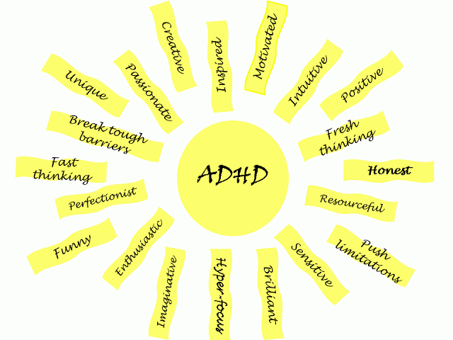

Slide 59
Phase 2: Formal assessment
Rating scales
Clinical measures
Collaboration
Assessment intervention

Slide 60
Engage Parents: communicate throughout
Ongoing collaboration
Feel one-sided – problematic
Be transparent
What is tested at each step (to prepare for diagnostic outcomes)
Purpose and relevance of each test
Purpose of all data collected
Extended inquiry

Slide 61
Rating Scales
At least two adults who interact with the child regularly (e.g., teacher and parent)
Assessment tools:
Broadband assessments
Not sufficient for diagnosis but useful for: screening for ADHD, identifying comorbidities, developmental appropriateness of behaviour
Narrowband
Non-DSM based ADHD rating scales

Slide 62
Rating Scales
Symptom count and pervasiveness of difficulties at home and school
Measuring impairment
Teacher and parent report
Can provide information on key impaired functional domains (for further assessment/treatment)
Parent functioning

Slide 63
Rating Scales
Consider:
Purpose of instrument
Choice of respondents
Length of time known child
Familiarity with behaviours in specific setting
Interrater reliability
Reliability/validity of instruments
Incremental validity
Clinical utility

Slide 64
Rating Scales: Engage parents
Explanations of purpose
Amount expected to complete
Extended Inquiry!!!

Slide 65
Functional impairment
Clinically meaningful symptoms AND clinically meaningful impairment
Determine if symptoms cause impairment
Measuring impairment
Can provide information on impaired functional domains
Across contexts
Teacher and parent report
situational and contextual factors explored

Slide 66
Functional Impairment
School Functioning
School records
Rating scales
IQ-Achievement tests
Interviews
Behavior tracking data

Slide 67
Functional Impairment
Home Functioning
Parent rating scales
Interviews
Behavior tracking data

Slide 68
Functional Impairment
Social Functioning
Interviews
Rating scales
Observation

Slide 69
Behavioural Observations
Within clinic (analog)
Two children may obtain similar scores, but one may respond impulsively without checking his answer, whereas the other one takes her time and second guesses herself
Within classroom (natural)
Independent observer
Supplemented by teacher or parent implemented frequency counts

Slide 70
Additional Information
Anecdotal information
School records
Report cards
Group achievement testing
Individualized education program
Assessment data

Slide 71
Functional Behaviour Analysis
Notes:
Critical for intervention

Slide 72
Functional Behaviour Analysis

Slide 73
Clinical Measures
MUST have a specific goal for using a measure before you begin
Explore extraneous factors or coexisting conditions
Potential causes of attention problems
Clarify nature and extend of child’s difficulties

Slide 74
Psychological Processes
Cognitive capacity
Executive functions

Slide 75
Psychological Processes
WM (verbal & nonverbal)
Processing speed
Goal-directed behavior
Executive decision making & Interference
Sustained attention and inhibitory control
Problem solving, flexibility, set shifting, response to feedback

Slide 77
Psychological Processes
Academic
Learning difficulties
Motor precision and consistency

Slide 78
Clinical Measures
Considerations:
Determine the processing demands of the tasks
Psychometric properties
Context being used
Incremental validity
Clinical utility
Child’s age
Area of difficulty
What has already been given

Slide 79
Clinical Measures
Consider level of performance, pattern between measures, and manifestation in real world
E.g., functional working memory
Careful with interpretation!
Medications
Provision of prompts and reinforcement

Slide 81
Immediate
1:1
Delayed consequence
Frequent
High salience
Early
Supervised
Novel
Father
Stranger
Infrequent feedback
Low salience
Late in the day
Unsupervised
Group situations
Familiarity
Mothers
Parents
Fun
Boring

Slide 82
Incremental Validity
How to conduct the most efficient and effective assessment?
Child’s age
Useful informants
Relevant constructs

Slide 83
Incremental Validity
Uses of information
Clinical utility?
Does more testing give us new , useful information?
Interviews and/or rating scales?
Are the outcomes/purpose of the assessment met?
Subset of items on a measure vs. full measure?
Will observations/other methods provide information beyond rating forms?
Verbally intrusive behaviors , seatwork completion/accuracy & required supplies in desk
FBAs that focus on functioning vs. DSM symptoms

Slide 84
Functional Impairment?
Impairment due to ADHD symptoms?
Some impairment from ADHD symptoms in 2+ settings?
Meet criteria for inattentive symptoms?
Meet criteria for hyperactive impulsive symptoms?

Slide 85
Symptom Presentation
Developmental Deviance
Rating scales
Clinic measures
Duration
Frequency
Interviews
Rating scales
Records
Interviews

Slide 86
Potential Problems

Slide 87
Integrating data
Need to have enough:
Information for diagnostic accuracy
Information for diagnostic certainty
Move beyond symptom count
What are kids referred for?
Focus assessment on specific areas of impairment
Highlight strengths and challenges

Slide 88
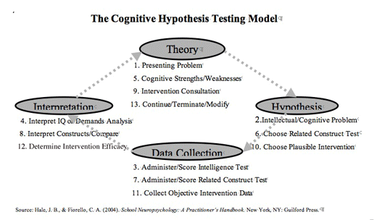
Linking to intervention

Slide 89
Linking to intervention
Using data to inform interventions
Understanding impairment & real world outcomes
Linking results to specific difficulties the child has, family needs, and referral question
Reduce symptom severity
Develop relevant life factors

Slide 90
Linking to intervention
Relationship between cognitive process and real-world outcomes
Capitalize on strengths
Compensation strategies
Problem-solving consultation

Slide 91
Symptom vs. impairment
“often does not seem to listen when spoken to directly”

Slide 92
Assessment intervention
Purpose:
Engage in meaningful discussions about client concerns
Test items can be used to invoke the issues found relevant through prior discussion/testing
Test hypotheses
Practice potential intervention strategies
Collaborative problem-solving

Slide 93
Third phase: Communicating the Diagnosis
Influential in how parents perceive entire process
Majority of parents who have expressed dissatisfaction were most dissatisfied with how the diagnosis was communicated
Three major reasons:
Professional manner of clinicians
Context in which the diagnosis was
communicated
How information imparted

Slide 94
Professional Manner
Empathy
Warmth
Sensitivity
Friendliness
Compassion
Reflective listening

Slide 95
Professional Manner
Be careful with words used
Avoid negative comments
Maintain a hopeful and strengths-based approach
(Congratulations!)
Be direct and transparent
Open and honest about child’s difficulties and needs

Slide 96
Context
Privacy
In-person
Both parents together

Slide 97
Communicating the results
Acknowledge anxiety/worries,
questions/concerns
Collaborative summary discussion
Describe the measure overall
No need for detailed review of test scores

Slide 98
Communicating the results
Offer a “day in the life” of the child
Extent and severity of problems experienced in different areas of functioning
Relationship of one problem to another
Hypothesized reasons for problems
How these problems affect the child

Slide 99
Communicating the results
Clear information about diagnosis
How diagnosis was made (explain process etc.)
Common sense definitions (i.e., what parents already likely know)
Immediate and long-term implications of diagnosis
Relationships between diagnoses

Slide 100
Communicating the results
Specific information as it relates to their child
Relevant information about how child’s presenting difficulties relates to diagnosis
What are the child’s needs/target problems
Describe child vs. label
Information as it relates to their family
Issue concerning the affect on families (e.g., stress, marital conflict, parent psychopathology)
Help them understand they may operate differently
Highlight child’s strengths and abilities

Slide 101
Communicating the results
Specific information how to best support the child
Appropriate, individualized, specific treatment recommendations
Specific behaviour management strategies etc.
How recommendations to be implemented
What can be done to further insulate the child from additional problems
Help them to understand the forces that affect their child

Slide 102
Parents need to leave with a layman’s understanding of their child’s problems, their strengths, their diagnosis and recommendations

Slide 103
Communicating collaboratively
Parents reflect on how the results fit their own experience and understanding
Give real-life examples to help refine the meanings of the assessment findings
Through collaborative dialogue, the meaning of test results is reached
By the end of the meeting, there are joint answers to the assessment questions

Slide 105
Communicating collaboratively
Parents to take an active role, primary role for creating change
Parent assessment about ADHD
Identify specific and useful information how to best support the child
Empower parents to accept their responsibility for supporting/managing child’s problems
Highlight family variables that can promote child development, such as lifestyle, emotional support etc.
Brainstorm Interventions

Slide 106
considerations

Slide 109
Key Recommendations | Applications
Use the assessment to help the child and family | Provide more than one feedback session Offer follow-up sessions to review the results and questions. Offer intervention sessions to give parents strategies to use with their child. Implement follow up measures to ensure children and families are well supported. Identify what types of recommendations and supports will be most useful for the family. Offer feedback and specific strategies for the school. Offer practical information and goals for the school IPP Advocate for parents Connect parents to community resources (e.g., support groups) Offer packages and resources about ADHD and effective treatment

Slide 110
Key Recommendations | Applications
Look at the whole child | Identify the child’s strengths. Start with the positives. Observe and investigate the child’s functioning across contexts (e.g., at home, at school, socially), with different people and in different situations Collect information from multiple sources of informants including parents and teachers
Look at the entire family | Include both parents throughout the assessment process Consider the effect the child’s difficulty has on his sibling(s) Investigate the effects of the child’s behaviour on the entire family Investigate parental well-being and skills and resources to cope and manage with their child’s difficulties

Slide 111
Key Recommendations | Applications
Foster the working alliance | Educate the child about the assessment process Have regular check-in’s before and after each session with parents Explain the relevance and rationale for various tests and relate its purpose to the child’s situation Refer as needed Identify what will be most helpful for parents through the assessment process and beyond Identify structures needed to increase parent participation within the assessment Validate parents’ experiences Respect parents’ expertise on their child Fully understand parents’ perspectives Attend to what parents have to say Demonstrate compassion and empathy Take the time to allow parents to share their story and journey thus far Acknowledge parents’ anxiety coming into the assessment Understand that it is hard to hear their child’s diagnosis and that there is a grief process

Slide 112
Key Recommendations | Applications
Communicate results effectively | Address parent fears and anxiety at the start of the feedback session Provide honest, straightforward information Break the information down Confirm accuracy of the findings and report with parents Use clear language that is easy to understand and meaningful to parents Offer information that is useful for parents Put recommendations up front in the written feedback Include practical strategies that are easy and feasible to implement by teachers and parents Identify what the test results mean for their specific child and provide specific examples as to how that manifests at home and in the classroom Discuss how conclusions/diagnosis was made based on the tests used Educate parents about “normal” developmental expectations and where their child fits Check-in with parents to explain what they understand of the information Explain the root difficulties the child is experiencing to promote parent understanding and shift their understanding of presenting behaviours

Slide 114
References
American Academy of Pediatrics Committee on Quality Improvement and Management, Subcommittee on Attention-Deficit/Hyperactivity Disorder. (2011). ADHD: Clinical practice guideline for the diagnosis, evaluation, and treatment of attention-deficit/ hyperactivity disorder in children and adolescents. Pediatrics, 128(5), 1007-1022. doi: 10.1542/peds.2011-2654
American Psychiatric Association. (2013). Diagnostic and statistical manual of mental disorders (5th ed.). Washington, DC: Author.
Anastopoulos, A. D., & Shelton, T. L. (2001). Assessing attention-deficit/hyperactivity disorder. New York: Kluwer Academic/Plenum.
Angold, A., Costelio, E. J., Farmer, E. M., Burns, B. J., & Erkanli, A. (1999). Impaired but undiagnosed. Journal of American Academy of Child and Adolescent Psychiatry, 38(2), 129-137. doi: 10.1097/00004583-199902000-00011
Aschieri, F. (2012). Epistemological and ethical challenges in standardized testing and collaborative assessment. Journal of Humanistic Psychology, 52(3), 350–368. doi:10.1177/0022167811422946.
Aschieri, F., Fantini, F., & Bertrando, P. (2013). Therapeutic assessment with children (TA-C): Psychological assessment as a family systems intervention. Australian and New Zealand Journal of Family Therapy, 33(4), 285–298. doi:10.1017/aft.2012.37
Barkley, R. (2015). Attention-deficit hyperactivity disorder: A handbook for diagnosis and treatment (4th ed.). New York, NY: Guilford Press.
Barkley, R. & Mash, E. J. (2007). Assessment of childhood disorders. New York: Guilford Press.
Biederman, J. (2005). Attention-deficit/hyperactivity disorder: A selective overview. Biological Psychiatry, 57(11), 1215-1220. doi: 10.1016/j.biopsych.2004.10.020
Canadian Attention Deficit Hyperactivity Disorder Resource Alliance (CADDRA; 2011). Canadian ADHD practice guidelines (3rd. ed.). Toronto ON: CADDRA. Retrieved from http://www.howardschneider.ca/resources/caddraGuidelines2011.pdf
Goldstein, S. (2010). Attention-Deficit/Hyperactivity Disorder. In S. Goldstein & C. R. Reynolds Handbook of neurodevelopmental and genetic disorders in children, Second edition (pp. 131-144). New York: Guilford Press.

Slide 115
References
Goldstein, S. & Naglieri, J. A. (2008). The school neuropsychology of ADHD: Theory, assessment, and intervention. Psychology in Schools, 45, 859-874. doi: 10.1002/pits.20331
Goldstein, S., & Naglieri, J. A. (2006). The role of intellectual processes in the DSM-V diagnosis of ADHD. Journal of Attention Disorders, 10, 3–8. doi: 10.1177/1087054705286059
Hale, J. B., Reddy, l. A., Wilcox, G., McLaughlin, A., Hain, L., Stern, A.,Henzel, J., & Eusebio, E. (2010). Assessment and intervention practices for children with ADHD. In D. C. Miller (Ed.) Best practices in school neuropsychology (pp. 225-279). New Jersey: John Wiley & Sons.
Hale, J. B., Yim, M., Schneider, A. N., Wilcox, G., Henzel, J., & Dixon, S. Cognitive and neuropsychological assessment of Attention-Deficit/Hyperactivity Disorder. In Contemportary intellectual assessment: Theories, tests and issues, Third edition (pp. 687-707). New York: Guilford Press.
Heffer, R. W., Barry, T. D., & Garland, B. (2009). History, overview and trends in child and adolescent psychological assessment. In Matson et al. (eds) Assessing Childhood Psychopathology and Developmental Disabilities. doi: 10.1007/978-0-387-09528-8
Hunsley, J., & Mash, E. J. (2007). Evidence-based assessment. Annual Review of Clinical Psychology, 3, 29-51. doi: 10.1146/annurev.clinpsy.3.022806.091419
Johnston, C., & Mash, E. J. (2001). Families of children with attention-deficit/hyperactivity disorder: Review and recommendations for future research. Clinical Child and Family Psychology Review, 4(3), 183–206. doi: 10.1023/A:1017592030434
Koonce, D. (2007). Attention Deficit Hyperactivity Disorder assessment practices by practicing school psychologists. Journal of Psychoeducational Assessment, 25, 319-333. doi: 10.1177/0734282906298264
National Association of School Psychologists (2011). Position statement: Students with attention deficit hyperactivity disorder. Retrieved from http://www.nasponline.org/about_nasp/positionpapers/Students_With_ADHD.pdf
National Institute for Clinical Excellence (NICE; 2013). Attention deficit hyperactivity disorder: Diagnosis and management of ADHD in children, young people and adults. (London, NICE). Retrieved from http://www.nice.org.uk/nicemedia/live/12061/42059/42059.pdfPelham, W. E., Fabiano, G. A., & Massetti, G. M. (2005). Evidence-based assessment of Attention Deficit Hyperactivity Disorder in children and adolescents. Journal of Clinical Child and Adolescent Psychology, 34(3), 449-476. doi: 10.1207/s15374424jccp3403_5

Slide 116
References
Pelham, W. E., Fabiano, G. A., & Massetti, G. M. (2005). Evidence-based assessment of Attention Deficit Hyperactivity Disorder in children and adolescents. Journal of Clinical Child and Adolescent Psychology, 34(3), 449-476. doi: 10.1207/s15374424jccp3403_5
Sayal, K., Letch, N., & El Abd, S. (2008). Evaluation of screening in children referred for an ADHD assessment. Child and Adolescent Mental Health, 13, 41–46. doi: 10.1111/j.1475-3588.2007.00463.x
Sowerby, P., & Tripp, G. (2009). Evidence-based assessment of attention-deficit/hyperactivity disorder (ADHD). In J. L. Matson et al. (Eds). Assessing childhood psychopathology and developmental disabilities (pp. 209-239). doi: 10.1007/978-0-387-09528-8
Wolraich, M. L., Lambert, E. W., Bickman, L., Simmons, T., Doffind, M. A., & Worley, K. A. (2004). Assessing the impact of parent and teacher agreement on diagnosing Attention-Deficit Hyperactivity Disorder. Developmental and Behavioral Pediatrics, 25, 41- 47. doi: 0196-206X/00/2501-0041
Wright, K. D., Waschbusch, D. A., Frankland, B. W. (2007). Combining data from parent ratings and parent interview when assessing ADHD. Journal of Psychopathology and Behavior Assessment, 29, 141–148. doi: 10.1007/s10862-006-9039-4

