Slide 1
The Adolescent & Child Urgent Threat Evaluation
Distress Assessment:
Understanding and Responding to Student Distress in Schools.
R. Copeland © eMed Colorado, Inc. (2000-2014)
J. Schneller © PAR (2005)
The Suicidal Ideation Questionnaire
W. Reynolds © PAR (1987)
Presented to the
Washington Association of School Psychologists
August 17, 2018
Jay Schneller, PhD, NCSP
Tacoma Public Schools

Slide 2
Ethics and Confidentiality
NASP :
…It is ethically permissible to provide psychological assistance without parent notice or consent in emergency situations of if there is a reason to believe a student may pose da danger to other, is at risk for self-harm; or is danger of injury, exploitation, or maltreatment.
…Maintain privacy & confidentiality except in those situations in which failure to release information would result in danger to the student or others, or where otherwise required by law.
ASCA:
… Keep information confidential unless legal requirements demand that confidential information be revealed or a breach is required to prevent serious and foreseeable danger to the student.

Slide 3
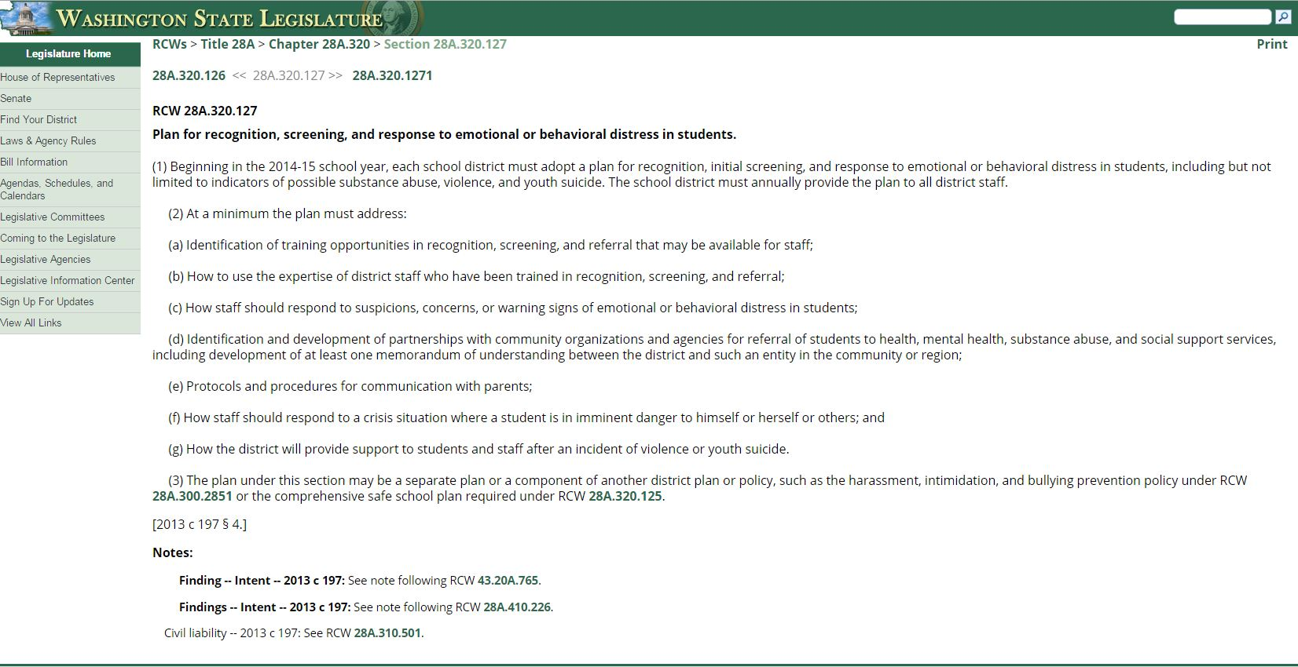
Notes:
Qualitative classification

Slide 4
Washington Youth Suicide facts:
Statistics
An average of 2 youth (ages 10 and 24) die by suicide each week in WA
15% of WA 6th graders, 17% of 8th graders, 19% of 10 graders, and 17% of seniors reported seriously considering suicide in the last year.
Suicide is the second leading cause of death for Washington youth.
Most youth who attempt suicide survive
Males are more likely to complete a suicide attempt & females are more likely to be hospitalized.
Nonfatal self-inflicted injuries by type (2008-2012 - n=4354 – approximate %).
Poison (70%), Cut/Pierce (15%), Other (5%), Suffocation (2%), Firearm (1%)
Fatal self-inflicted injuries by type (2008-2012 - n=617 –approximate %).
Firearm (40%), Suffocation (40%), Poison (10%), Jump/Fall (5%)
YSPP.ORG

Slide 5
School Shooting Statistics: Odds are one in 1 million that a student will die at school as a result of a violent act.
Statistics
95% were current students.
93% had behavior that caused others concern prior to attack.
93% planned out the attack in advance.
68% acquired the weapon used from home or from a relative.
63% had a known history of weapons use.
59% occurred during the school day.
37% exhibited interest in violence in writings, poems, essays, or journals.
27% exhibited interest in violent movies.
Motives
75% felt bullied/persecuted/threatened by others.
61% motivated by desire for revenge.
34% motivated by attempt to solve a problem.
27% motivated by suicide or desperation.
24% motivated by desire for attention or recognition.
54% had multiple motives.
http://info.publicintelligence.net/FBI_The_School_Shooter_A_Quick_Reference_Guide.pdf

Slide 6
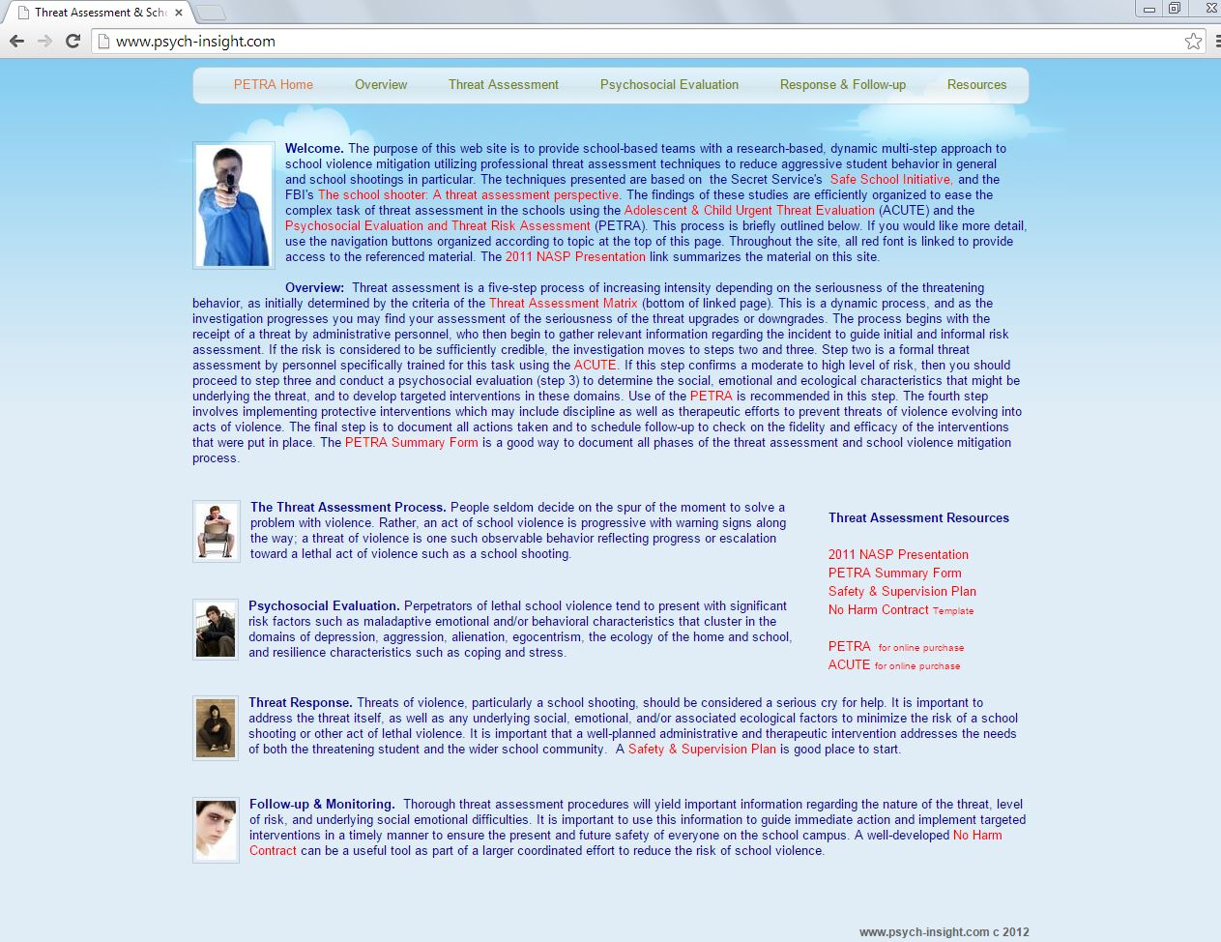
www.schoolpsych.net

Slide 7
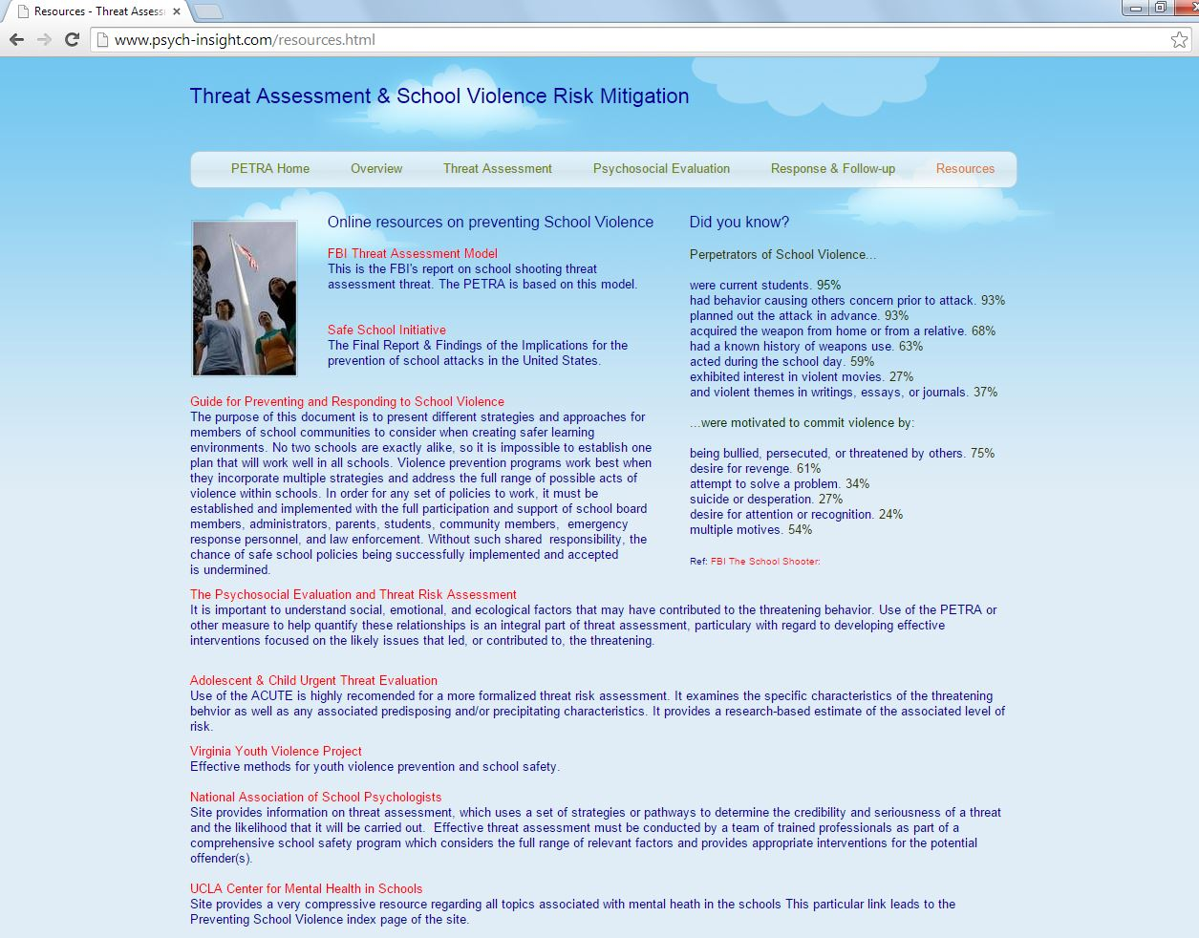
www.schoolpsych.net

Slide 8
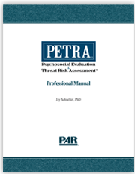
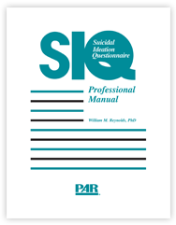
Empirically Based Models for Effective Crisis Mitigation in the Schools:
“A clear, consistent, rational, and well-structured system for dealing with threats is
vitally important in a school.” -FBI

Slide 9
Distress Assessment Process
based on the threat assessment approach of the National Center for the Analysis of Violent crime model
Consider approaching the process in a linear manner as outlined here.
Step 1: Receipt of the Communication
Admin becomes aware of a student in distress
Admin initiates EBDF Process (admin interview)
Complete EBDF Demographic info & Summary of Concern
Step 2: Assessment of the communication
Note specificity of the communication regarding plan, motive, etc.
Step 3: Assessment of psychosocial factors
Parent interview (ACUTE) followed by student interview (PETRA)
Consider other sources of info including mandatory teacher input
Consider SIQ or other measure to quantify suicide risk, if concern
Estimate Violence & Suicide Risk based on available information
Step 4: Documentation & Response
Team meeting, share/update results,
Document concerns regarding student safety & other factors as noted
Consider protective factors as well as risk factors
Determine & implement response
Schedule follow-up
Copeland, R. (2005). Adolescent and child urgent threat evaluation. Psychological Assessment Resources, LLC, Lutz, FL
O’Toole, M. (2000). The school shooter: A threat assessment perspective. Washington, DC: FBI
Schneller, J. (2005). Psychosocial Evaluation and Threat Risk Assessment. Psychological Assessment Resources, Inc. Lutz. FL

Slide 10
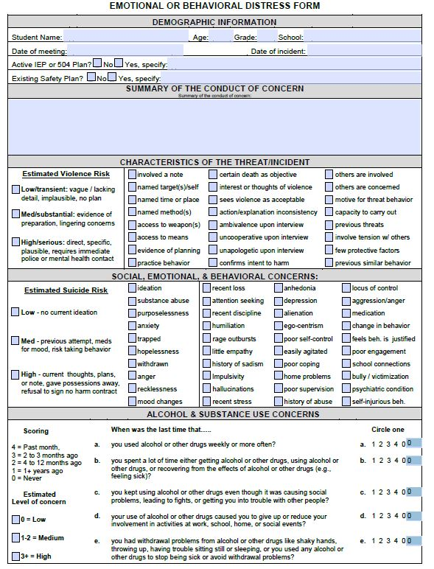
Emotional or Behavioral Distress Form
Demographic Information
Gathering information
Interview those involved
Summarize the Concern
Identify the details of the incident
Characteristics of the Threat
target, means, specificity, preparation,
etc. Estimate violence risk
as high, medium, or low
Social, Emotional & Behavioral factors
in need of intervention
Estimate Suicide Risk
Low, Medium, or High
Identify Alcohol & Drug use concerns
Low, Medium, or High
Document Recommendations
Immediate & follow-up
strategies to prevent violent act
Notes / elaboration of findings
assign case manager
schedule follow up date
Follow-up & monitoring
This form is available online

Slide 11
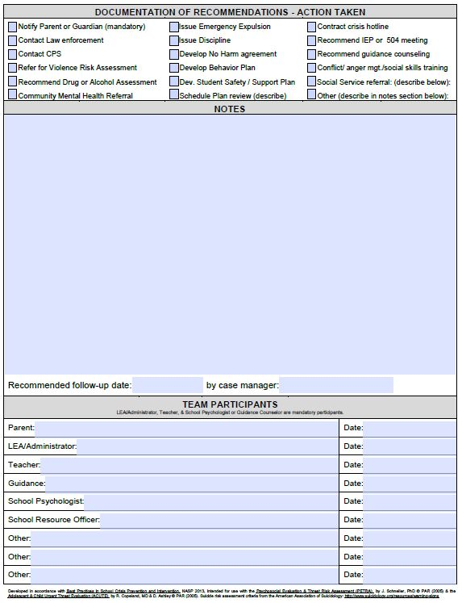
Emotional or Behavioral Distress Form
Demographic Information
Gathering information
Interview those involved
Summarize the Concern
Identify the details of the incident
Characteristics of the Threat
target, means, specificity, preparation,
etc. Estimate violence risk
as high, medium, or low
Social, Emotional & Behavioral factors
in need of intervention
Estimate Suicide Risk
Low, Medium, or High
Identify Alcohol & Drug use concerns
Low, Medium, or High
Document Recommendations
Immediate & follow-up
strategies to prevent violent act
Notes / elaboration of findings
assign case manager
schedule follow up date
Follow-up & monitoring
This form is available online

Slide 12
“They just snapped.”
There are many warning signs
Change in behavior, grades, social interaction
Practice behaviors
Threats
In fact, targeted violence represents a pattern of thinking and behavior that is understandable and often discernable; likely preceded by a communication of intent.
National School Safety Center. (2001). Report on school associated violent deaths. CA.
Vossekuil, B., Reddy, M., Fein, R., Borum, R., & Modzeleski, W. (2000) . U.S.S.S. Safe school initiative: An interim report on the prevention of targeted violence in schools. Washington, DC: U.S. Secret Service, National Threat Assessment Center.
Notes:
Warning Signs: change in behavior, grades, violence, gang affiliation, drugs, prejudicial discipline problems
Continuum of anger : hurt feelings-angry feelings- angry thoughts – angry threats- violent plans- violent acts.
nearly all of the school shooters identified in the literature made a threat prior to their acting upon it

Slide 13
Key Terms
Straightforward, clear, explicit.
“I am going to place a bomb in the school’s gym.”
Vague, unclear, ambiguous.
“If I wanted to, I could kill everyone in this school.”
Strong implication but not explicit.
“We would be better off without you around anymore.”
Typically seen in extortion cases.
“If you don’t pay me, I will place a bomb in the school.”
Threat: Any expression of intent to do harm.
Direct Threat:
Indirect Threat:
Veiled Threat:
Conditional Threat:
O’Toole, M. (2000). The school shooter: A threat assessment perspective. Washington, DC: FBI
Notes:
Threat - An expression of intent to do harm. Threats may be direct or indirect, specific and detailed or general, well thought out or impulsive, veiled, conditional, or implied, written, or spoken. (Reddy et al.).

Slide 14
Key Terms Continued
Threat Risk Assessment: A method of identifying, assessing, and managing persons who pose a risk for violence.
Profiling: The arbitrary identification of individuals who may pose a threat.
Predisposing factors: Characteristics that increase the likelihood of a threat being carried through.
Precipitating factors: suggests degree of progress toward a violent act.
Motive: Underlying purpose for the threatening behavior.
O’Toole, M. (2000). The school shooter: A threat assessment perspective. Washington, DC: FBI
Notes:
Threat - An expression of intent to do harm. Threats may be direct or indirect, specific and detailed or general, well thought out or impulsive, veiled, conditional, or implied, written, or spoken. (Reddy et al.).

Slide 15
Characterizing Threats of Violence
Low
The threat is vague and/or indirect.
The details of the threat are inconsistent, implausible, and/or lacking detail.
The threat lacks realism.
Medium
The threat is more direct and more concrete than a low level of threat.
There is indication of possible place and time.
There is indication of preparatory steps to carry out the threat.
High
The threat is direct, specific, and plausible.
There is evidence that steps have been taken to carry out the threat.
Identification of the victim
Reason for the threat
Means, weapon, or method
Date, time, or place
Lingering concern
“The degree of detail may reflect the level of risk associated with the threat being carried out.” - FBI
O’Toole, M. (2000). The school shooter: A threat assessment perspective. Washington, DC: FBI
Schneller, J. (2005). Psychosocial Evaluation and Threat Risk Assessment. Psychological Assessment Resources, Inc. Lutz. FL PETRA

Slide 16
Threat Risk Indicators
Expression of lethally violent or suicidal behaviors.
Identification of a particular victim other than self.
Violent or suicidal behavior involving a note.
Access to firearms or other lethal weapons.
Evidence of an executable and likely lethal plan.
Expressions of dire predictions (e.g., “being dead” or “stopping the pain”).
Behavior reflecting “black & white” thinking (e.g., words like only, forever).
Expressions of fantasies of death (e.g., “eternal sleep” or “reunion with family”).
Copeland, R (2005). Adolescent and child urgent threat evaluation. Psychological Assessment Resources, LLC, Lutz, FL. ACUTE
Notes:
Stress: the effects of stress may be cumulative (DHHS, 2001) and may account for a significant percentage of the variance in behavior commonly attributed to mental health problems (Plancherel, Bolognini, Bettschart, Dumont, & Halfon, 1997).
Compas (1987) suggested a strong association among self-reported stressful life events and degree of psychological functioning, behavioral functioning, and physical well being among adolescents.
There is near consensus in the literature that poor resilience to negative or stressful life experiences are often implicated in the development of behavioral and/or psychological disorders, (Doll & Lyon, 1998), such as depression, impaired self-esteem, and social rejection (Schwartz, Dodge, & Coie, 1994), which in turn may become the source of further stress

Slide 17
Predisposing Characteristics that influence carrying out a threat of violence
History of arrests before age 15, aggression, verbal cruelty, violence, or antisocial behavior
History of suicidal behavior with self-inflicted tissue injury*
History of sexual delinquency or sadism
History of self-mutilation
Soft neurological signs, coordination or language difficulties, or sub-average IQ*
Diagnosis of ADHD or Conduct Disorder*
Diagnosis of Paranoid Personality Disorder*
*Related to Impulsivity
Copeland, R (2005). Adolescent and child urgent threat evaluation. Psychological Assessment Resources, LLC, Lutz, FL. ACUTE
Notes:
Stress: the effects of stress may be cumulative (DHHS, 2001) and may account for a significant percentage of the variance in behavior commonly attributed to mental health problems (Plancherel, Bolognini, Bettschart, Dumont, & Halfon, 1997).
Compas (1987) suggested a strong association among self-reported stressful life events and degree of psychological functioning, behavioral functioning, and physical well being among adolescents.
There is near consensus in the literature that poor resilience to negative or stressful life experiences are often implicated in the development of behavioral and/or psychological disorders, (Doll & Lyon, 1998), such as depression, impaired self-esteem, and social rejection (Schwartz, Dodge, & Coie, 1994), which in turn may become the source of further stress

Slide 18
Predisposing Characteristics Continued
Family history of mental illness or suicide
Family history of violence or substance abuse
Unstable home environment*
Escalation of rage outbursts if present*
Pattern of poor social relationships, few family ties, personal losses of peers, or problems in school*
Acquisition of behavior and skills of a delinquent peer group
Likelihood to support follow-up plan
*Related to Impulsivity
Copeland, R (2005). Adolescent and child urgent threat evaluation. Psychological Assessment Resources, LLC, Lutz, FL. ACUTE
Notes:
Stress: the effects of stress may be cumulative (DHHS, 2001) and may account for a significant percentage of the variance in behavior commonly attributed to mental health problems (Plancherel, Bolognini, Bettschart, Dumont, & Halfon, 1997).
Compas (1987) suggested a strong association among self-reported stressful life events and degree of psychological functioning, behavioral functioning, and physical well being among adolescents.
There is near consensus in the literature that poor resilience to negative or stressful life experiences are often implicated in the development of behavioral and/or psychological disorders, (Doll & Lyon, 1998), such as depression, impaired self-esteem, and social rejection (Schwartz, Dodge, & Coie, 1994), which in turn may become the source of further stress

Slide 19
Early Precipitating Characteristics
signifying potential progress & increased risk of carrying out a threat of violence
Expressions with certain death as the objective
Identification of a particular victim(s)
Expressions of dire predictions
Violent or suicidal behavior involving a note
Access to firearms or other lethal weapons
Alcohol or drug abuse
Perception of actual or perceived social tension
Result of threat to self-esteem and/or humiliation
Expected return to problematic situation or setting
Copeland, R (2005). Adolescent and child urgent threat evaluation. Psychological Assessment Resources, LLC, Lutz, FL. ACUTE
Notes:
Stress: the effects of stress may be cumulative (DHHS, 2001) and may account for a significant percentage of the variance in behavior commonly attributed to mental health problems (Plancherel, Bolognini, Bettschart, Dumont, & Halfon, 1997).
Compas (1987) suggested a strong association among self-reported stressful life events and degree of psychological functioning, behavioral functioning, and physical well being among adolescents.
There is near consensus in the literature that poor resilience to negative or stressful life experiences are often implicated in the development of behavioral and/or psychological disorders, (Doll & Lyon, 1998), such as depression, impaired self-esteem, and social rejection (Schwartz, Dodge, & Coie, 1994), which in turn may become the source of further stress

Slide 20
Late Precipitating Characteristics
indicate an impending act of violence following a threat
Black & white thinking (e.g., words like only, forever)
Well developed (i.e., plausible) and lethal plan
Fantasies of death, such as “eternal sleep” or “reunion with family”
Symptoms of agitation or motor restlessness
Copeland, R (2005). Adolescent and child urgent threat evaluation. Psychological Assessment Resources, LLC, Lutz, FL. ACUTE
Notes:
Stress: the effects of stress may be cumulative (DHHS, 2001) and may account for a significant percentage of the variance in behavior commonly attributed to mental health problems (Plancherel, Bolognini, Bettschart, Dumont, & Halfon, 1997).
Compas (1987) suggested a strong association among self-reported stressful life events and degree of psychological functioning, behavioral functioning, and physical well being among adolescents.
There is near consensus in the literature that poor resilience to negative or stressful life experiences are often implicated in the development of behavioral and/or psychological disorders, (Doll & Lyon, 1998), such as depression, impaired self-esteem, and social rejection (Schwartz, Dodge, & Coie, 1994), which in turn may become the source of further stress

Slide 21
Precipitating Factors Related to Impulsivity
that increase the risk following a threat of violence
Presentation of agitation or motor restlessness
Alcohol or drug abuse
Actual or perceived social tensions
Result of threat to self-esteem and/or humiliation
Copeland, R (2005). Adolescent and child urgent threat evaluation. Psychological Assessment Resources, LLC, Lutz, FL. ACUTE
Notes:
Stress: the effects of stress may be cumulative (DHHS, 2001) and may account for a significant percentage of the variance in behavior commonly attributed to mental health problems (Plancherel, Bolognini, Bettschart, Dumont, & Halfon, 1997).
Compas (1987) suggested a strong association among self-reported stressful life events and degree of psychological functioning, behavioral functioning, and physical well being among adolescents.
There is near consensus in the literature that poor resilience to negative or stressful life experiences are often implicated in the development of behavioral and/or psychological disorders, (Doll & Lyon, 1998), such as depression, impaired self-esteem, and social rejection (Schwartz, Dodge, & Coie, 1994), which in turn may become the source of further stress

Slide 22
Adolescent & Child Urgent Treat Evaluation
R. Copeland, MD & D. Ashley © PAR (2005)
27-item structured to identify risk for near-future violence (e.g., hours to days).
542 children and adolescents ages 8-18 years in four study groups:
(a) Non-Threat, (b) Suicide Threat, (c) Homicide Threat, and (d) Homicide-Suicide Threat
moderate to high for cluster scores, Total score alpha coefficients ranging from .70-.85.
clusters ranging from .74-.99; Total score .94
.71-.97 over a period of 24 to 48 hours.
demonstrated via Clinical Assessment of Depression™ (CAD™), the Children's Depression Inventory (CDI), and the Suicide Ideation Questionnaire (SIQ).
demonstrated in age-matched psychiatric group (n = 70) who were not at risk for violence.
school psychologist, guidance counselor, clinical social worker.
(20 minutes) Rating form, Professional manual.
Format:
Standardization:
Internal consistency:
Inter-rater reliability:
Test-retest:
Convergent and discriminant validity:
Criterion-related validity:
Professional Requirements:
Test materials:
Copeland, R (2005). Adolescent and child urgent threat evaluation. Psychological Assessment Resources, LLC, Lutz, FL. ACUTE
Notes:
The measure provides the user with an overall Threat Classification (i.e., Extreme Clinical risk factors, High Clinical risk factors, Moderate Clinical risk factors, Low Clinical risk factors) as well as additional cluster scores including Precipitating Factors, Early Precipitating Factors, Late Precipitating Factors, Predisposing Factors, Impulsivity, and the ACUTE Total score.
The ACUTE is designed to be used in a variety of situations and settings including emergency room, inpatient care, outpatient care, schools, and research, and can be used by a number of psychiatric/psychological personnel including physicians, psychiatrists, school psychologists, clinical psychologists, psychiatric nurses, and licensed clinical social workers. In addition, the ACUTE may be useful in assessing adverse drug reaction
.

Slide 23
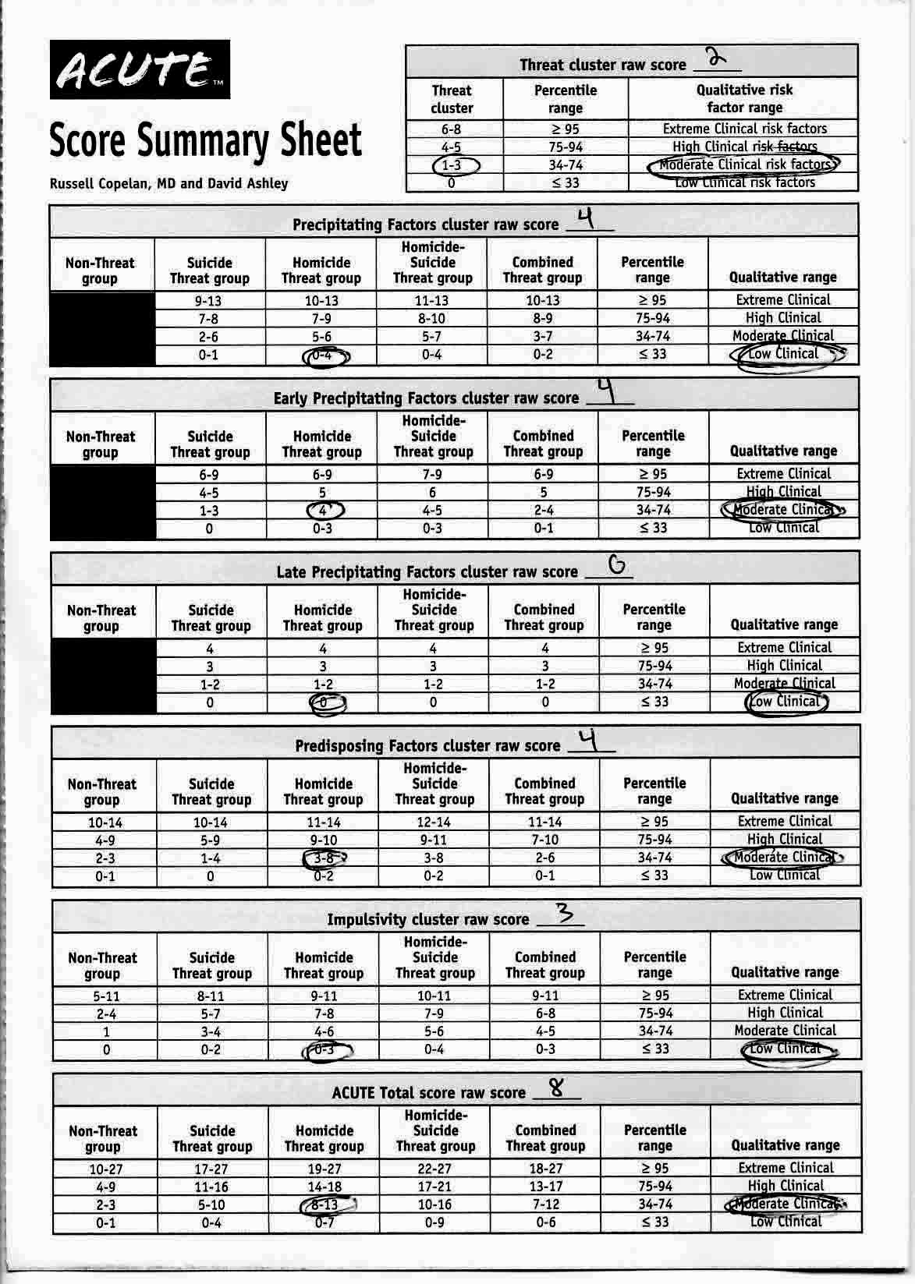
ACUTE Domains Adolescent & Child Urgent Threat Evaluation Interpretation:
Threat cluster classification
Precipitating characteristics
Predisposing characteristics
Impulsivity indicators
Total ACUTE Raw Score
Quantitative interpretation Percentile range
Extreme Clinical risk >95%
High Clinical risk 75-94
Moderate clinical risk 34-74
Low clinical risk <33%

Slide 24
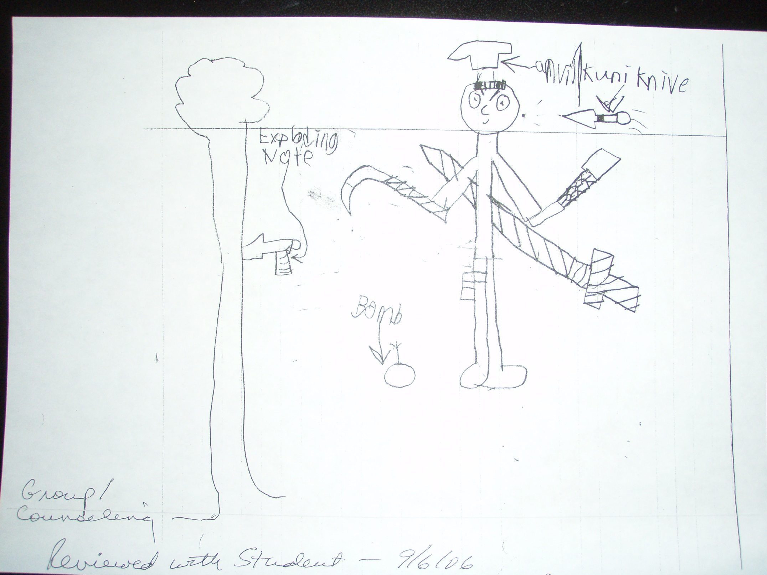

Slide 25
FBI Threat Assessment Methodology: A four-pronged approach
Prong one: Personality Traits & Behavior
Prong two: Family Dynamics
Prong three: School Dynamics
Prong four: Social dynamics
”This model provides a framework for evaluating a student to determine if they have the motivation, intention, ability, & means to carry out a proclaimed threat.”- FBI
O’Toole, M. (2000). The school shooter: A threat assessment perspective. Washington, DC: Federal Bureau of Investigation

Slide 26
FBI Four-Pronged Assessment Approach: Prong one: Personality Traits & Behavior
Inappropriate, macabre, insulting, belittling, or mean humor
Exaggerated sense of entitlement & need for attention
Behavior appears relevant to carrying out a threat
Fascination or interest in sensational violence
Rationalization of violent ideology & behavior
Lack of empathy, dehumanization of others
“Injustice collector” - externalizes blame
Intolerance, hatred, and/or prejudice
Anger management problems
Low tolerance for frustration
Failed love relationship
Rigid and opinionated
Attitude of superiority
Negative role models
Poor coping skills
Lack of resiliency
Lack of trust
Manipulation of others
Changes in behavior
Closed social group
Signs of depression
Narcissism
Alienation
Leakage
O’Toole, M. (2000). The school shooter: A threat assessment perspective. Washington, DC: Federal Bureau of Investigation

Slide 27
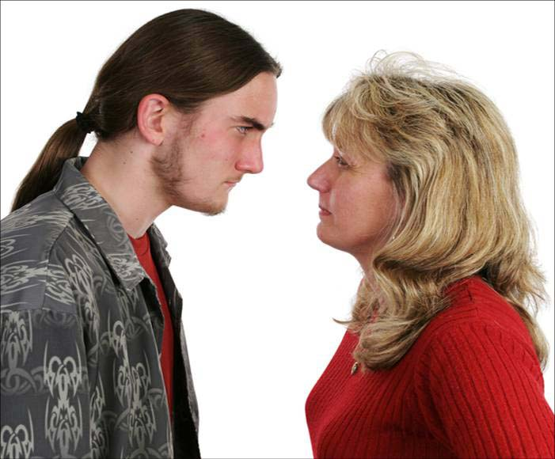
FBI Four-Pronged Assessment Approach: Prong two: Family Dynamics
No limits or monitoring of TV and internet
Turbulent parent-child relationships
Acceptance of pathological behavior
Student “rules the roost”
Access to weapons
Lack of intimacy
O’Toole, M. (2000). The school shooter: A threat assessment perspective. Washington, DC: Federal Bureau of Investigation

Slide 28
FBI Four-Pronged Assessment Approach: Prong three: School Dynamics
Student’s attachment & involvement in school
Inflexible culture & impersonal environment
Tolerance for disrespectful behavior
Pecking order among students
Perception of inequitable discipline
Racial or class divisions
Poor trust between staff and students
Unsupervised computer access
Code of silence
Culture of bullying, victimization, & bystanders
“It is important to understand, from the student’s perspective, why he would target his own school.” - FBI
O’Toole, M. (2000). The school shooter: A threat assessment perspective. Washington, DC: Federal Bureau of Investigation

Slide 29
FBI Four-Pronged Assessment Approach: Prong four: Social Dynamics
Unmonitored access to media & entertainment
The Copycat Effect after violence in the news
Outside interests can mitigate school violence
Use or change in use of drugs or alcohol
Peer groups of similarly-minded students
O’Toole, M. (2000). The school shooter: A threat assessment perspective. Washington, DC: Federal Bureau of Investigation

Slide 30
PETRA
A Psychosocial Organization of the Four-Pronged Model
Psychological Domain
Alienation
Depression
Aggression
Egocentrism
Ecological Domain
Resilience Domain
Home
School
Coping
Stress
“How does a student come to of feeling that shooting others at school was in some way an answer to his problems? Were there signs along the way –not a catalogue of traits identifying him as a predicted killer, but clues that could have indicated a need for help?” -FBI
Notes:
Ecological Systems Theory (Brofenbrenner, 1979) asserts that children exist within a number of nested, or interrelated and mutually influential systems.

Slide 31
Alienation
increases the risk associated with threats of violence
Does the student feel they belong?
What is the quality of the student’s social life?
Does the student have friends?
Does the student feel liked by peers?
Is the student accepted by classmates?
Schneller, J. (2005). Psychosocial Evaluation and Threat Risk Assessment. Psychological Assessment Resources, Inc. Lutz. FL PETRA
Notes:
Alienation: Peer victimization, also known as bullying, refers to repeated, unprovoked, harmful physical or psychological actions by one or more individuals against another. Bullying includes hitting, kicking, pushing, intimidating, name calling, teasing, taunting, and making threats.
Increases risk for depression
Depression: As many as 8% of adolescents - girls are twice as likely as boys to develop the disorder
Adolescents suffering from depression are at an increased risk for illness, as well as for interpersonal and psychosocial difficulties including substance abuse and suicidal behavior
7% may commit suicide in the young adult the third leading cause of death in 10- to 24-year-olds
Aggression: more in middle school - as many as 1/3 - boys more aggressive

Slide 32
Characteristics of Aggression
contribute to the escalation from threat to act of violence.
Is there easy access to guns?
Does the student ever carry a weapon?
Does the student think about hurting people?
Does the student get mad easily?
Is the student destructive?
Does the student like to fight?
Is there a fascination with violence?
Is the student conflict-oriented?
Schneller, J. (2005). Psychosocial Evaluation and Threat Risk Assessment. Psychological Assessment Resources, Inc. Lutz. FL PETRA
Notes:
Alienation: Peer victimization, also known as bullying, refers to repeated, unprovoked, harmful physical or psychological actions by one or more individuals against another. Bullying includes hitting, kicking, pushing, intimidating, name calling, teasing, taunting, and making threats.
Increases risk for depression
Depression: As many as 8% of adolescents - girls are twice as likely as boys to develop the disorder
Adolescents suffering from depression are at an increased risk for illness, as well as for interpersonal and psychosocial difficulties including substance abuse and suicidal behavior
7% may commit suicide in the young adult the third leading cause of death in 10- to 24-year-olds
Aggression: more in middle school - as many as 1/3 - boys more aggressive

Slide 33
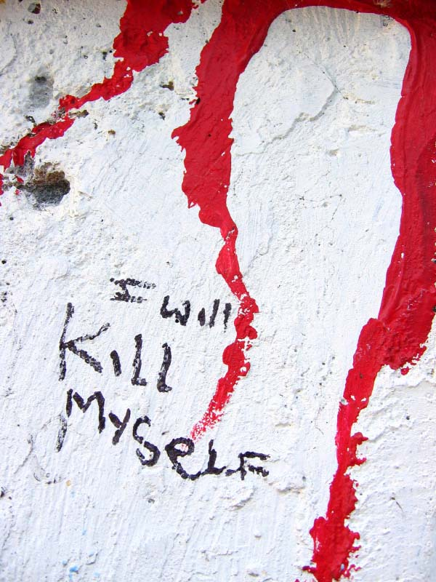
Depressed Mood
is frequently associated with violence following a threat
What is the student’s mood?
Does the student feel sad or depressed most of the time?
Are there feelings of anhedonia?
What is the estimated risk of suicide?
No history? Previous attempt? Current thoughts?
Schneller, J. (2005). Psychosocial Evaluation and Threat Risk Assessment. Psychological Assessment Resources, Inc. Lutz. FL PETRA
Notes:
Alienation: Peer victimization, also known as bullying, refers to repeated, unprovoked, harmful physical or psychological actions by one or more individuals against another. Bullying includes hitting, kicking, pushing, intimidating, name calling, teasing, taunting, and making threats.
Increases risk for depression
Depression: As many as 8% of adolescents - girls are twice as likely as boys to develop the disorder
Adolescents suffering from depression are at an increased risk for illness, as well as for interpersonal and psychosocial difficulties including substance abuse and suicidal behavior
7% may commit suicide in the young adult the third leading cause of death in 10- to 24-year-olds
Aggression: more in middle school - as many as 1/3 - boys more aggressive

Slide 34
Egocentrism
often marks characteristics that may precipitate an act of violence
Does the student exhibit feelings of grandiosity?
Does the student demonstrate empathy?
Is the student attention-seeking?
Does the student brag about themselves?
Does the student feel that they are better than their peers?
Schneller, J. (2005). Psychosocial Evaluation and Threat Risk Assessment. Psychological Assessment Resources, Inc. Lutz. FL PETRA
Notes:
Alienation: Peer victimization, also known as bullying, refers to repeated, unprovoked, harmful physical or psychological actions by one or more individuals against another. Bullying includes hitting, kicking, pushing, intimidating, name calling, teasing, taunting, and making threats.
Increases risk for depression
Depression: As many as 8% of adolescents - girls are twice as likely as boys to develop the disorder
Adolescents suffering from depression are at an increased risk for illness, as well as for interpersonal and psychosocial difficulties including substance abuse and suicidal behavior
7% may commit suicide in the young adult the third leading cause of death in 10- to 24-year-olds
Aggression: more in middle school - as many as 1/3 - boys more aggressive

Slide 35
The Home Environment
provides protective qualities, but can also represent a source of risk
How is the relationship between the student and their parents?
Does the student follow rules at home?
Are the parents good role models?
Is there an open line of communication at home?
Do the parents keep track of what the student does with their friends?
Schneller, J. (2005). Psychosocial Evaluation and Threat Risk Assessment. Psychological Assessment Resources, Inc. Lutz. FL PETRA
Notes:
Home: Males reported a much higher rate (6.1%) of gun-carrying at school than females (3%). YRBS 1.6 in FL
School: others knew and encouraged them – discipline not the answer

Slide 36
The School Environment
is important to consider when evaluating threats of violence
Is the student an active part of the school community?
Does the student like the school?
Are the teachers perceived as fair?
Are drugs a problem on campus?
How is the security?
Does the student feel he or she could sneak a weapon into school?
Schneller, J. (2005). Psychosocial Evaluation and Threat Risk Assessment. Psychological Assessment Resources, Inc. Lutz. FL PETRA
Notes:
Home: Males reported a much higher rate (6.1%) of gun-carrying at school than females (3%). YRBS 1.6 in FL
School: others knew and encouraged them – discipline not the answer

Slide 37
Stress
reduces resilience and is commonly associated with acts of violence
Has the student been picked on or bullied at school?
Is lack of money or resources causing stress?
Is the student sad or depressed most of the time?
Is there a recent loss of a loved one?
Is the student alienated?
Has the student been abused?
Is the student involved in the school community?
Is the student experiencing thoughts of death?
How is the student’s health?
Are family matters a source of stress?
Is school the source of stress?
Schneller, J. (2005). Psychosocial Evaluation and Threat Risk Assessment. Psychological Assessment Resources, Inc. Lutz. FL PETRA
Notes:
Home: Males reported a much higher rate (6.1%) of gun-carrying at school than females (3%). YRBS 1.6 in FL
School: others knew and encouraged them – discipline not the answer

Slide 38
Victimization can take several forms
physical
sexual
emotional
peer
Peer victimization, also known as bullying, refers
to repeated, unprovoked, harmful physical or
psychological actions by one or more individuals
against another. Bullying includes:
hitting
kicking
pushing
making threats
peer rejection and exclusion
Cyber-bullying
intimidating
name-calling
teasing
taunting
Notes:
Alienation: Peer victimization, also known as bullying, refers to repeated, unprovoked, harmful physical or psychological actions by one or more individuals against another. Bullying includes hitting, kicking, pushing, intimidating, name calling, teasing, taunting, and making threats.
Increases risk for depression
Depression: As many as 8% of adolescents - girls are twice as likely as boys to develop the disorder
Adolescents suffering from depression are at an increased risk for illness, as well as for interpersonal and psychosocial difficulties including substance abuse and suicidal behavior
7% may commit suicide in the young adult the third leading cause of death in 10- to 24-year-olds
Aggression: more in middle school - as many as 1/3 - boys more aggressive

Slide 39
Coping
or the lack thereof is important to take into consideration
Is the threatening student open to remediation?
Are they optimistic or pessimistic?
Will they ask for help?
Is the student impulsive?
Does the student use drugs?
Are there issues related to poor locus of control?
Schneller, J. (2005). Psychosocial Evaluation and Threat Risk Assessment. Psychological Assessment Resources, Inc. Lutz. FL PETRA
Notes:
Home: Males reported a much higher rate (6.1%) of gun-carrying at school than females (3%). YRBS 1.6 in FL
School: others knew and encouraged them – discipline not the answer

Slide 40
Critical Items
mark areas in need of immediate attention
Perception of poor school security.
Report or history of being picked on or bullied at school.
Acknowledgment of desire to hurt others.
Suicidal ideation.
Use or possession of a weapon.
Easy access to guns.
History of abuse.
Psychological Domain PETRA
Schneller, J. (2005). Psychosocial Evaluation and Threat Risk Assessment. Psychological Assessment Resources, Inc. Lutz. FL PETRA
Notes:
Alienation: Peer victimization, also known as bullying, refers to repeated, unprovoked, harmful physical or psychological actions by one or more individuals against another. Bullying includes hitting, kicking, pushing, intimidating, name calling, teasing, taunting, and making threats.
Increases risk for depression
Depression: As many as 8% of adolescents - girls are twice as likely as boys to develop the disorder
Adolescents suffering from depression are at an increased risk for illness, as well as for interpersonal and psychosocial difficulties including substance abuse and suicidal behavior
7% may commit suicide in the young adult the third leading cause of death in 10- to 24-year-olds
Aggression: more in middle school - as many as 1/3 - boys more aggressive

Slide 41
Psychosocial Evaluation & Threat Risk Assessment (PETRA)
J. Schneller © PAR (2005)
Appropriate Population:
Format:
Standardization:
Internal consistency:
Test-retest:
Convergent and discriminant validity:
Criterion-related validity:
Professional Requirements:
Test materials:
students ages 11-18 who have made a threat of violence.
60 Item Self Report @ 3rd grade level with validity scales and normative ratings
1770 adolescents ages 11-18 years, normed by age and gender.
moderate to high:
Age(.66-.82) Race (.65-.84) Gender (.70-.81) Total (.84-90)
cluster correlations .79 to .85 over a period of 7 to 10 days
demonstrated via expected correlation to Achenbach CBCL, BASC2, CAD, & RADS2 among others.
demonstrated validity among..
(a) Out patient psychiatric group (n = 29) to demographically-matched sample
(b) Full time SED (n=60) and their general education peers.
School psychologist, guidance counselor, clinical social worker.
(20 minutes) Rating form, Professional manual, profile/score forms.
Schneller, J. (2005). Psychosocial Evaluation and Threat Risk Assessment. Psychological Assessment Resources, Inc. Lutz. FL PETRA
Notes:
60 Item Self Report
Flesch-Kincaid 3.0 grade reading level
Utilizes a 4 point Likert scale
Normative ratings for domains, percentiles for clusters.
Validity Scales
Socially desirable pattern of endorsement
Inconsistency of response
Criterion-related validity; (a) demonstrated in demographically-matched psychiatric group (n = 29) who were not at risk for violence. All three domains, dm alien agg fam/home cope clusters. Total score?
EBD Students in general demonstrated what are domains?
Higher incidence of poor health
Decreased likelihood to accept others ideas
Higher drug & alcohol use... HS more than MS
Greater likelihood of abuse… Females more than males
MS Students with EBD demonstrated…
Increased stress
Decreased coping skills

Slide 42
PETRA Scoring Template
Automated scoring Intuitive interpretation Domain-level classifications
Critical item markers Elevated item markers

Slide 43
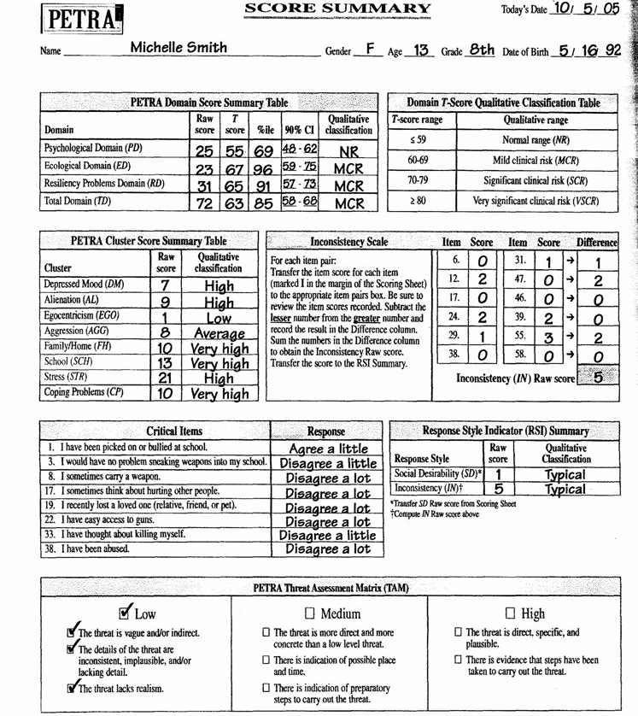
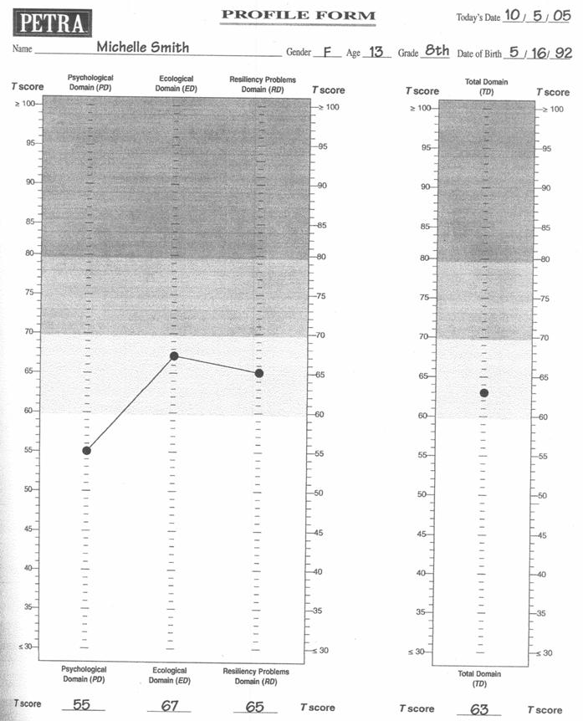
PETRA Score Summary Forms
Notes:
Qualitative classification

Slide 44
Inconsistency Indicators
help to identify inconsistency among PETRA self-report responses
Conflict:
Sadness:
Coping:
Stress:
Anger mgt.:
Aggression:
I do not like conflict.
I like to fight.
I am happy most of the time.
I feel sad or depressed most of the time.
I take my time to make a decision.
I am quick to make a decision.
I have never been abused.
I have been abused.
I get mad quickly.
I never get angry.
I sometimes think of hurting others.
I seldom think of hurting others.
Schneller, J. (2005). Psychosocial Evaluation and Threat Risk Assessment. Psychological Assessment Resources, Inc. Lutz. FL PETRA

Slide 45
PETRA Lie & Social Desirability Indicators
I have never met a person I did not like.
I have never put anything off until later.
I have never felt like cursing.
I have not eaten in a week.
I have never been sick.
I have never told a lie.
I never get angry.
Schneller, J. (2005). Psychosocial Evaluation and Threat Risk Assessment. Psychological Assessment Resources, Inc. Lutz. FL PETRA

Slide 46
Suicidal Ideation?
These are the emotional & behavioral warning signs of acute suicide risk:
Threatening to hurt or kill self, or talking of wanting to hurt or kill him/herself; and or,
Looking for ways to kill themselves by seeking access to firearms, available pills, or other means; &/or,
Talking or writing about death, dying or suicide, when these actions are out of the ordinary.
IS PATH WARM mnemonic to help you remember the Warning Signs of Suicide?
Ideation
Substance Abuse
Purposelessness
Anxiety
Trapped
Hopelessness
Withdrawal
Anger
Recklessness
Mood Changes
Thoughts of self harm.
Increased substance (alcohol or drug) use No reason for living; no sense of purpose in life
Anxiety, agitation, unable to sleep or sleeping all of the time
Feeling trapped - like there's no way out
Hopelessness
Withdrawal from friends, family and society
Rage, uncontrolled anger, seeking revenge
Acting reckless or engaging in risky activities, seemingly without thinking
Dramatic mood changes
American Association of Suicidology : www.suicidology.org/resources/warning signs
Also see: http://www.integration.samhsa.gov/clinical-practice/Columbia_Suicide_Severity_Rating_Scale.pdf
Notes:
Alienation: Peer victimization, also known as bullying, refers to repeated, unprovoked, harmful physical or psychological actions by one or more individuals against another. Bullying includes hitting, kicking, pushing, intimidating, name calling, teasing, taunting, and making threats.
Increases risk for depression
Depression: As many as 8% of adolescents - girls are twice as likely as boys to develop the disorder
Adolescents suffering from depression are at an increased risk for illness, as well as for interpersonal and psychosocial difficulties including substance abuse and suicidal behavior
7% may commit suicide in the young adult the third leading cause of death in 10- to 24-year-olds
Aggression: more in middle school - as many as 1/3 - boys more aggressive

Slide 47
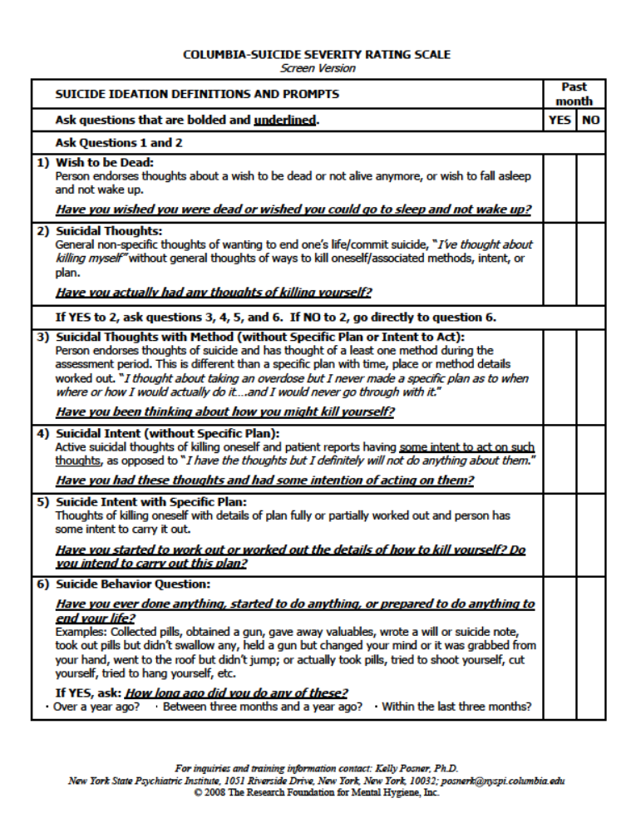
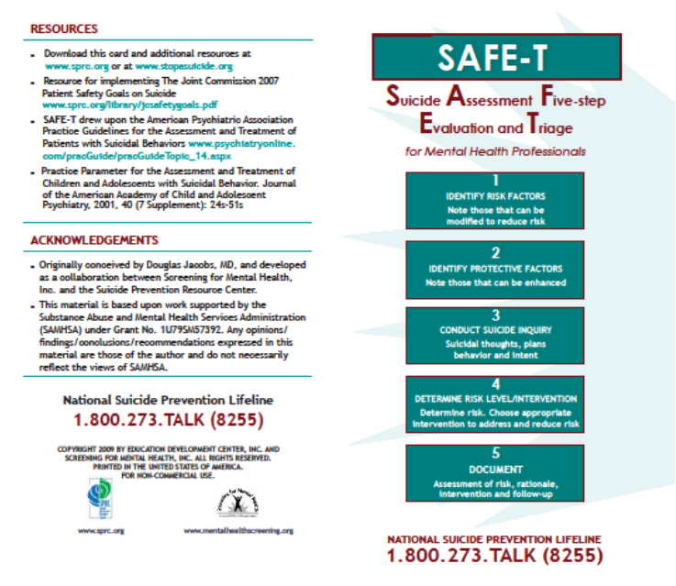
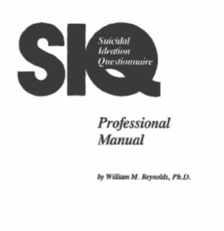
http://www.integration.samhsa.gov/clinical-practice/screening-tools#suicide

Slide 48
Suicidal Ideation Questionnaire
30 Item HS Form & 15 Item HS-JR Form.
2180 subjects from grades 7-12 – Approximately 20% black & 80% white with equal representation by sex.
High, Total score alpha coefficients .93 -.97 depending on group
N/A as self report
.72 over 4 weeks which is moderately good for state vs. trait data.
demonstrated mod correlations with Beck Depression Inventory, Children’s Depression Inventory, & Reynolds Adolescent Depression Scale
congruence with specified suicidal cognitions .7 to .9
school psychologist, guidance counselor, clinical social worker.
(20 minutes) Rating form, Professional manual.
Format:
Standardization:
Internal consistency:
Inter-rater reliability:
Test-retest:
Convergent and discriminant validity:
Criterion-related validity:
Professional Requirements:
Test materials:
Reynolds, W. (1987). Suicidal Ideation Questionnaire. Psychological Assessment Resources, LLC, Lutz, FL. SIQ
Notes:
The measure provides the user with an overall Threat Classification (i.e., Extreme Clinical risk factors, High Clinical risk factors, Moderate Clinical risk factors, Low Clinical risk factors) as well as additional cluster scores including Precipitating Factors, Early Precipitating Factors, Late Precipitating Factors, Predisposing Factors, Impulsivity, and the ACUTE Total score.
The ACUTE is designed to be used in a variety of situations and settings including emergency room, inpatient care, outpatient care, schools, and research, and can be used by a number of psychiatric/psychological personnel including physicians, psychiatrists, school psychologists, clinical psychologists, psychiatric nurses, and licensed clinical social workers. In addition, the ACUTE may be useful in assessing adverse drug reaction
.

Slide 49
Suicidal Ideation Questionnaire Administration & Interpretation Notes
Do not introduce as a suicide questionnaire, rather, a questionnaire about your life, noting that there are not right or wrong answers.
Interpretation: Interpret with caution. The SIQ is not diagnostic nor predictive The SIQ is informational. Higher scores indicate greater range and frequency of suicidal thoughts.
“Cut scores” on the HS Form Total score of 41=90th percentile, 30=84th percentile on the HS-JR Form Total score of 31=90th percentile, 23=84th percentile A student who meets cut score reflects likely significant risk of self-harm
Critical Items: 6 on HS-JR Form & 8 on HS Form. As a general clinical guide, cases in which 2 (HS-JR) or 3 (HS) items are endorsed with a score of 5 or 6 (0 to 6 scale) should be viewed as serious regardless of the Total score.
The SIQ can be scored with 27/30 & 13/15 items. See pg. 11 for special scoring.
Check for validity of administration – trust your instincts – err on the side of caution.
Reynolds, W. (1987). Suicidal Ideation Questionnaire. Psychological Assessment Resources, LLC, Lutz, FL. SIQ
Notes:
Stress: the effects of stress may be cumulative (DHHS, 2001) and may account for a significant percentage of the variance in behavior commonly attributed to mental health problems (Plancherel, Bolognini, Bettschart, Dumont, & Halfon, 1997).
Compas (1987) suggested a strong association among self-reported stressful life events and degree of psychological functioning, behavioral functioning, and physical well being among adolescents.
There is near consensus in the literature that poor resilience to negative or stressful life experiences are often implicated in the development of behavioral and/or psychological disorders, (Doll & Lyon, 1998), such as depression, impaired self-esteem, and social rejection (Schwartz, Dodge, & Coie, 1994), which in turn may become the source of further stress

Slide 50
Targeted Intervention Examples
is important to specifically address the issue(s) that led to the threat
Psychosocial Interventions
Alienation
Depression
Aggression
Egocentricism
Community-Based
Youth groups
Religious community
Sports & recreation
Law enforcement
Community mental health
School-based
CST & IEP
Guidance / MH
Supervision
Extra-curricular
Mentor programs
Ecological Interventions
Home:
School:
Targeted Interventions
Coping
Stress
Parenting workshops
Improve school culture
Anti-bullying programs
Safe listening zones
Student Safety Plan*
Social skills training
Stress & anger mgt.
No Harm Agreement*
Self advocacy
PETRA

Slide 51
Emotional or Behavioral Distress Form
Demographic Information
Gathering information
Interview those involved
Summarize the Concern
Identify the details of the incident
Characteristics of the Threat
target, means, specificity, preparation,
etc. Estimate violence risk
as high, medium, or low
Social, Emotional & Behavioral factors
in need of intervention
Estimate Suicide Risk
Low, Medium, or High
Identify Alcohol & Drug use concerns
Low, Medium, or High
Document Recommendations
Immediate & follow-up
strategies to prevent violent act
Notes / elaboration of findings
assign case manager
schedule follow up date
Follow-up & monitoring
This form is available online

Slide 52
Emotional or Behavioral Distress Form
Demographic Information
Gathering information
Interview those involved
Summarize the Concern
Identify the details of the incident
Characteristics of the Threat
target, means, specificity, preparation,
etc. Estimate violence risk
as high, medium, or low
Social, Emotional & Behavioral factors
in need of intervention
Estimate Suicide Risk
Low, Medium, or High
Identify Alcohol & Drug use concerns
Low, Medium, or High
Document Recommendations
Immediate & follow-up
strategies to prevent violent act
Notes / elaboration of findings
assign case manager
schedule follow up date
Follow-up & monitoring
This form is available online

Slide 53
The Adolescent & Child Urgent Threat Evaluation
Distress Assessment:
Understanding and Responding to Student Distress in Schools.
R. Copeland © eMed Colorado, Inc. (2000-2014)
J. Schneller © PAR (2005)
The Suicidal Ideation Questionnaire
W. Reynolds © PAR (1987)
Presented to the
Washington Association of School Psychologists
August 17, 2018
Jay Schneller, PhD, NCSP
Tacoma Public Schools

