Slide 1
Identifying Executive Function Intervention Targets & Measuring Outcomes
Scott Grewe, Ph.D., ABPP/CN
&
Steven Guy, Ph.D.
Pediatric Neuropsychologists in
Private Practice
Richland, Washington
&
Columbus, Ohio

Slide 2
Objectives for Presentation
  Describe a model for development of evidence-based executive function interventions.
  2. Describe how to use rating scales to identify specific executive targets and monitor outcomes.
  3. Describe how ratings scales can be used to efficiently develop and monitor outcomes.

Slide 3
What are the Executive Functions?
“An “umbrella” term, encompassing… those interrelated skills necessary for purposeful, goal-directed activity” (Anderson, 1998)
“Capacities that enable a person to engage successfully in independent, purposeful, self-serving behaviors” (Lezak, 1993)

Slide 4
Executive Functions: A classic definition
“The planning and sequencing of complex behaviors, the ability to pay attention to several components at once, the capacity for grasping the gist of a complex situation, the resistance to distraction and interference, the inhibition of inappropriate response tendencies, and the ability to sustain behavioral output for relatively prolonged periods.” (Stuss & Benton, 1984).

Slide 5
Executive Functions: An applied definition
“A toddler forming a sentence. A kindergartener reciting the alphabet in order. A ninth-grader staying in sync with her clique. A college senior interviewing for a job. A writer formulating his next newspaper column. An entrepreneur strategizing the company’s initial public stock offering. Despite the vast array of ages, tasks, and situations, these events all involve executive function, the mental process of planning and organizing flexible, strategic, appropriate actions.” (Moran & Gardner, 2007).

Slide 6
More Definitions…
Orchestration of basic cognitive processes during goal-oriented problem-solving (Neisser, 1967)
Ability to maintain appropriate problem-solving set for attainment of future goal (Welsh & Pennington, 1988). Involves one or more of the following:
  intention to inhibit/defer response
  strategic plan of action sequences
  mental representation of the task including relevant stimulus information and desired future goal state.

Slide 7
Critical features of Executive Control (Denckla 2007)
Provide for delayed responding
Future-oriented
Strategic action selection
Intentionality
Anticipatory Set
Freedom from interference
Ability to sequence behavioral outputs

Slide 8
Disorder of Executive/Regulatory Functioning
Inhibitory Control (unable to control response that will result in reinforcement)
  positive and negative reinforcement
Working Memory (directs activities)
  holding information/strategy in memory while performing some operation (holding goal state in mind)
Regulatory control (emotional regulation, activity regulation, motivation)
Notes:
multistep directions not held well
WM not the same as other types of memory, which is often intact!

Slide 9
Functional Domains of
The Executive
  Initiate - begin task, activity, attention
  Working Memory - hold information actively in mind
  Inhibit - stop an action or not react to impulse
  Shift - move from one task or situation to another
  Plan - anticipate future events and develop steps
  Organize - establish, maintain order
  Self-monitor - attend to & revise behavior/output
  Emotional Control - regulate emotional response

Slide 10
Outcome of “Good” Executive Function
Purposeful, goal-directed activity
Active problem solving
Self-control
Independence
Reliability and consistency
Positive self-efficacy
Internal locus of control

Slide 11
Outcome of Executive “dys”Function
  Initiate - deficits beginning task, activity
  Working Memory - difficulties holding information actively in mind
  Inhibit - problems stopping an action
  Shift - difficulties moving from one task or situation to another, perseveration, rigidity
  Plan - deficits anticipating future events and developing steps/contingencies
  Organize - problems establishing, maintaining order
  Self-monitor - lack of attention to own behavior or performance
  Emotional Control - deficits regulating emotional response

Slide 12
Behavioral Descriptors
Initiate:
  trouble starting chores
  "couch potato"
  relies on others to structure time, tasks
Sustain:
  starts strong but fades across tasks
  attention/concentration wanes
Inhibit:
  blurts out
  acts quickly without regard to consequences
  distracted, sidetracked
Shift:
  stuck on a topic or activity
  poor flexibility
  resists change in routine

Slide 13
Behavioral Descriptors
Self-monitor:
  unaware of impact of own behavior
  makes careless errors
  doesn't check work
Plan:
  does assignments at last minute
  underestimates time needed
Organize:
worse in chaos
not a leader with peers
messy
homework poorly organized
Working Memory:
  Cannot remember multi-step instructions

Slide 14
Disorders of Executive Function
1. No singular, core disorder; these difficulties are ubiquitous in learning, attention, anxiety, mood, autism spectrum, & acquired neurological disorders.
2. Symptom onset delayed due to environmental demand
3. Performance on standardized tests often appropriate
4. Discrepancy between ability and performance
5. Social domain most challenging…

Slide 15
Executive Functions & the Frontal Lobes: A Conceptual View
“There is no unitary executive function.
Rather, distinct processes related to the frontal lobes can be differentiated which converge on a general concept of control functions.”
Stuss, D.T., & Alexander, M.P. Psychological Research, 2000.

Slide 16
Executive function is a multidimensional construct
An umbrella term encompassing distinct, but interrelated, abilities that contribute to management of goal directed behaviors including inhibiting, shifting, regulation emotions, initiating, planning, organizing, and monitoring while holding goals in working memory.
Gioia, Isquith, Guy & Kenworthy, 2000

Slide 17
Orchestration of basic cognitive processes during goal-oriented problem-solving
Neisser, 1967

Slide 18


Functions of the “Orchestra”
Perception
Attention
Language processes
Visual-spatial processes
Memory
Sensory inputs
Motor outputs
Knowledge & skills
  social
  academic
Functions of the “Conductor”
Inhibit
Self-Monitor
Shift Flexibly
Modulate Emotions
Initiate
Working Memory
Plan
Organize
Task-Monitor

Slide 19
Three Factor Model
Cognitive
Regulation
Initiate, Working Memory
Plan, Organize, Monitor
Behavior
Regulation
Emotion
Regulation
Inhibit
Self-Monitor
Shift Set
Emotional Control

Slide 20
Why Are Executive Functions Important?

Slide 21
Interest in Executive Function in Children
5 articles in 1985
14 articles in 1995
501 articles by 2005
>1000 articles by 2010
>6000 articles by 2014
    Bernstein & Waber
    In Meltzer (2007) Executive Function in Education

Slide 22
Infant & Childhood Neglect
Neglected children lag behind in language, learning and executive functions (particularly planning and problem solving).
This association persists even after controlling for IQ.
De Bellis, Hooper, Spratt, & Woolley (2009). Neuropsychological findings in childhood neglect and their relationship to pediatric PTSD. Journal of the International Neuropsychological society, 15, 868-878.

Slide 24
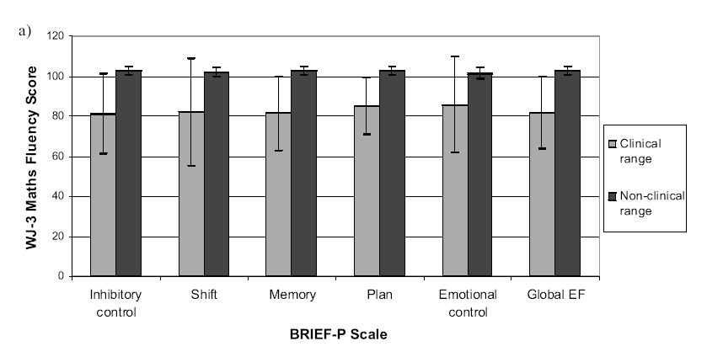
Associations between teacher ratings on the BRIEF-P at 4 years and performance on WJ3 Math Fluency at 6 years
Clark, CA, Pritchard, VE & Woodward, LJ. (2010). Preschool executive functioning abilities predict early mathematics achievement. Developmental Psychology, 46, 1176-91.

Slide 30
How Do We Assess Executive Functions?

Slide 31

Methods of Assessing EF
Micro
Molar
Macro
Genetics
Structural &
Functional
Imaging
Performance
Tests
Observations
Rating Scales

Slide 32
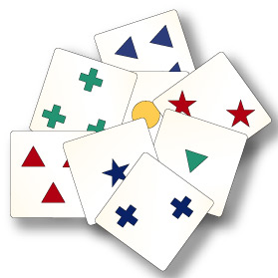
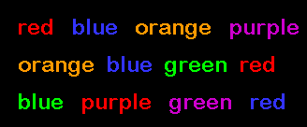
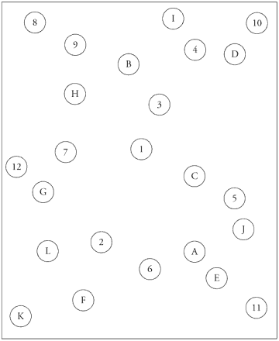
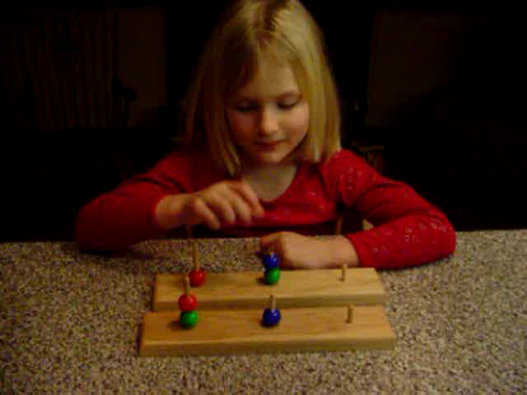
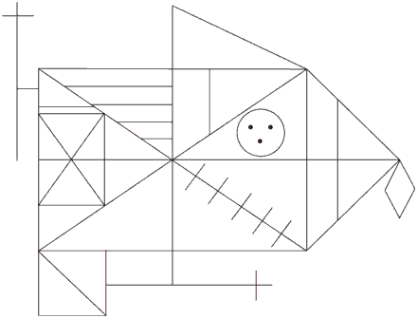
Performance Measures
Verbal Fluency / Figural Fluency
Stroop Color-Word Interference Test
Rey-Osterrieth Complex Figure
Tower of Hanoi / Tower of London
Wisconsin Card Sorting Test
Mazes
Trail Making
Continuous Performance Tests
n back
Go/No-go
Notes:
10

Slide 33
Color-Word (Stroop) Interference Test
RED BLUE GREEN BLUE GREEN RED
RED BLUE GREEN BLUE GREEN RED

Slide 34

The Rey-Osterrieth Complex Figure

Slide 35
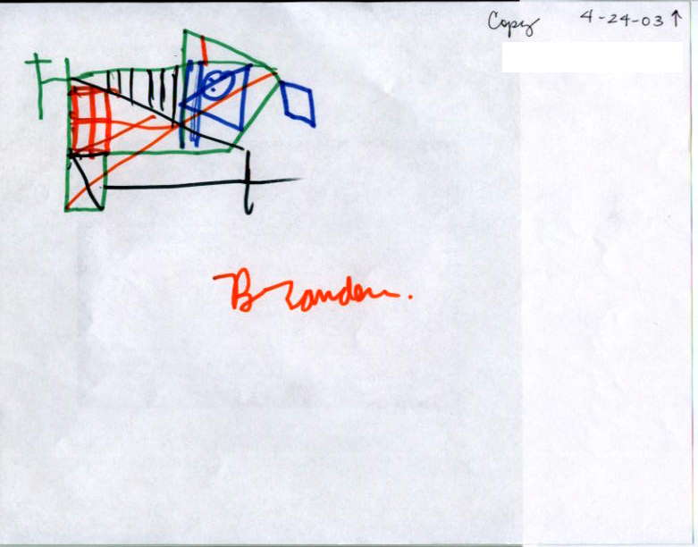
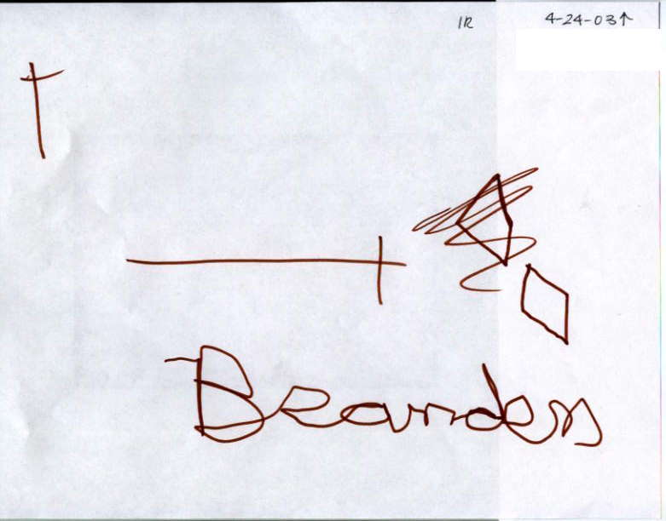
10 year-old boy with ADHD-C
Recall
Copy
Recall

Slide 36
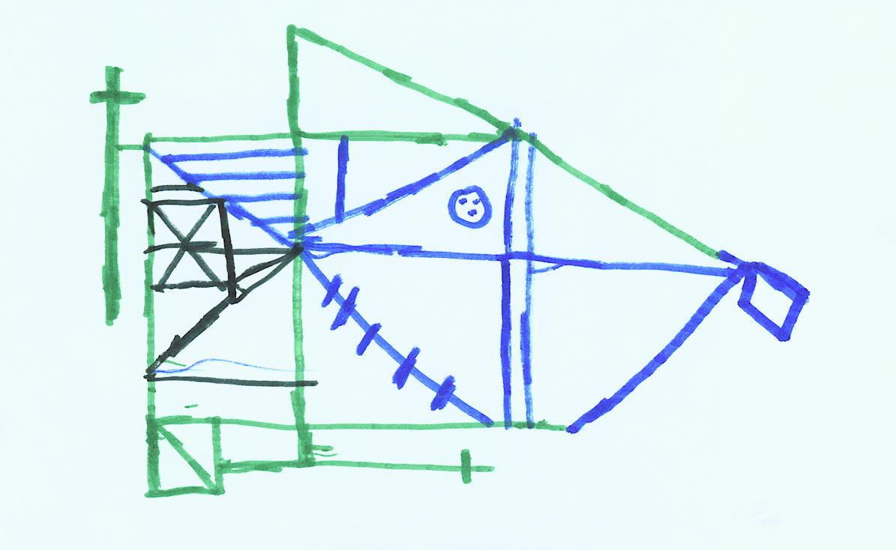

10 year old with ADHD-I
Copy
Recall

Slide 37
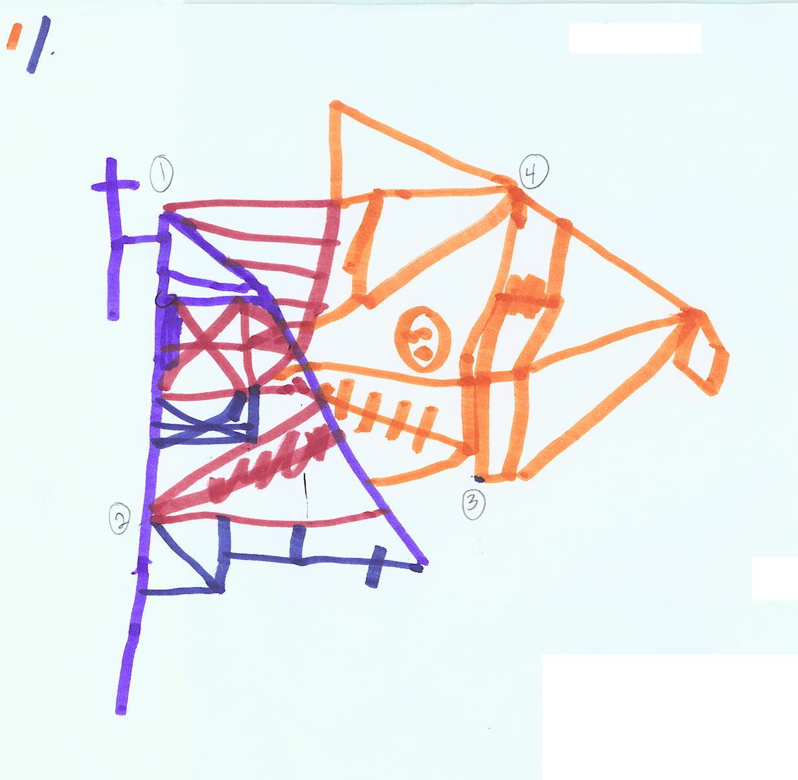

8 year-old boy with Asperger’s
Copy
Recall

Slide 38

Verbal Fluency

Slide 39
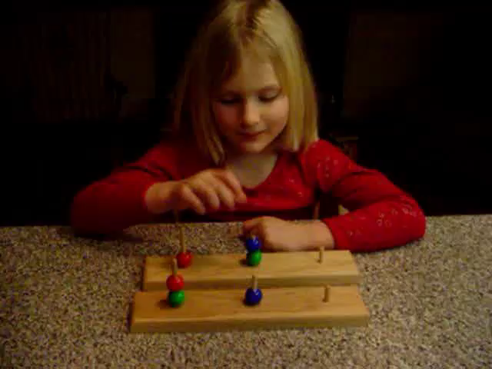
Tower of London 6 Move

Slide 40
Advantages of EF Performance Tests:
Increased specificity of processes
Increased task control and internal validity
Decades of research on test behavior

Slide 41
Limitations to Performance Tests
Performance tests tap individual components of executive function over a short time frame and not the integrated, multidimensional, relativistic, priority-based decision-making that is often demanded in real world situations
(Goldberg & Podell, 2000)

Slide 42
1994- Recognized need for…
external validation, ecological validity for tests
Standardized data about everyday executive function
Standardized parent / teacher/ self ratings
assess multiple aspects of executive functions
Time & cost efficiency
Notes:
11

Slide 43
What Do We Do About Executive Function Deficits?

Slide 44
What Executive Function Intervention is Not…
1. Specific set of skills/ information to “teach” student (e.g., group study skills class).
2. List of steps taped to top of the student’s desk.
3. Simple behavior modification to increase motivation.
4. A “student thing” - listing IEP goals without attention to the “how, who, where, when” of the classroom delivery system.

Slide 45
Initiating:
Increase structure of tasks
Establish and rely on routines
Determine minimal level of cue to help start and reduce cue over time
Break tasks into small, manageable steps
Place child with partner or group for modeling and cueing from peers
Reframe "lack of motivation" as initiation deficit for child, parent, teachers

Slide 46
Sustaining:
Increase salience in task- rely on high interest tasks
Hands-on activities support sustained attention problems
Ask child to choose among topics of interest to increase investment
Use verbal mediation to help remain focused
Write down list of what to attend to for a specific task

Slide 47
Sustaining, II:
Make time limits to work explicit (the never ending worksheet problem)
Repeat instructions as needed, perhaps quietly to the child
Keep instructions clear and concise
Have child take frequent, brief breaks (30 seconds to one minute)
Use variety - avoid lengthy, monotonous tasks

Slide 48
Inhibiting:
Increase structure in environment to set limits for inhibition problems
Make behavior and work expectations clear and explicit; review with student
Post milieu rules in view; point to them when child breaks rule
Teach response delay techniques (counting to ten before acting)

Slide 49
Shifting:
Increase routine to the day
Make schedule clear and public
Forewarn of any changes in schedule
Give 2 minute warnings of time to change
Make changes from one task to the next, or one topic to the next, clear and explicit
Shifting may be a problem of inhibiting, so apply strategies for inhibition problems

Slide 50
Organizing:
Increase organization in milieu
Increase organization of therapy to serve as model and help child grasp structure of novel material
Present the framework of new information to be learned at the outset, and review again at the end of a lesson
Begin with tasks with only few steps and increase gradually

Slide 51
Planning:
Practice with tasks with only a few steps first
Teach simple flow charting as planning tool
Practice with planning tasks (e.g., mazes)
Ask child to verbalize plan before beginning work
Ask child to verbalize second plan if first doesn't work
Ask child to verbalize possible consequences of actions before beginning
Review incidents of poor planning/anticipation with child

Slide 52
Self-monitoring:
Anticipate performance- ask child to state how he/she will do on a task, then compare gently with actual performance
Videotape child's behavior and review with child in supportive manner
Increase attention to behavior- ask child to verbalize steps as he/she is doing them

Slide 53
What else can we do?
  seat placement/facilitated attention
  individualized and untimed testing
  adjusted workload/frequent checks
  repetition of instructions/written instructions
  break things into manageable bits
  provide motivation
  make it hands on/interactive
  allow for physical activity/breaks

Slide 54
What else can we do…
Curriculum-based approaches:
1. Teach strategies that students use independently
2. Ingrain the idea of working smarter rather than harder
3. Teach self-monitoring in the face of academic challenge
4. Connect prior with new learning
5. Teach students how the brain works (encodes, stores, retrieves information)
6. Ingrain the notion that knowledge and strategy use are more important than innate ability
7. Teach students about active learning
8. Help students understand themselves as learners (what works, what doesn’t).
These are good approaches for all students. However, they are imperative for “at risk” students, who do not tend to discover them on their own.

Slide 55
Between Teacher and Child
by Dr. Haim G. Ginott
I have come to a frightening conclusion.
I am the decisive element in the classroom.
It is my personal approach that creates the climate.
It is my daily mood that makes the weather.
As a teacher I possess tremendous power to make a child's life miserable or joyous.
I can be a tool of torture or an instrument of inspiration.
I can humiliate or humor, hurt or heal.
In all situations, it is my response that decides whether a crisis will be escalated or de-escalated,
and a child humanized or de-humanized.

Slide 56
Classroom Management I: Tips for Teachers
Educate yourself about learning, attention, anxiety/mood, autism spectrum, & acquired neurological disorders (nature, course, outcome, & causes).
Keep in mind the 30% rule; anticipate the difficulties!
Keep in mind that interventions within the school setting are most effective for improving school performance
Get in-depth training and consultation on behavioral principles & modification
Pick good administrators ☺; those that support & recognize your efforts!
Know your limits and practice good self-care…

Slide 57
Classroom Management II: More Tips for Teachers
Establish behavioral control – Primary objective in the first two weeks of school
Decrease workload, or give smaller quotas of work
Traditional desk arrangement & seat close to teaching area
Target productivity first; accuracy comes later
Don’t send home unfinished class work
Give weekly homework assignment sheets; ahead of time!
Consider reducing/eliminating homework!?!?
Allow restlessness…
Review homework at start of class; this helps all students!
Help the student “think aloud & think ahead”

Slide 58
General & Specific Resources
Executive function in education: From theory to practice (2007). L. Meltzer (ed.). The Guilford Press.
Executive skills in children and adolescents: A practical guide to assessment and intervention (2010). P. Dawson & R. Guare. The Guilford Press.
Coaching students with executive skills deficits (2012). P. Dawson & R. Guare. The Guilford Press.
ADAPT: Attention deficit accommodations plan for teaching (1992). H. Parker. Specialty Press, Inc.
The ADD‑Hyperactivity handbook for schools (1992). H. Parker. Routledge Press.
Ch.A.D.D. educator’s manual on AD/HD, 2nd edition. (2007). Ch.A.D.D.
Treatment of ADHD in the school setting (2006). R. Barkley. In Attention deficit hyperactivity disorder: A handbook for diagnosis and treatment. R. Barkley. The Guilford Press.
Overcoming underachieving: An action guide to helping your child succeed in school (1998). S. Goldstein & N. Mather. Wiley Press.
Why bright kids get poor grades: And what you can do about it (1996). S. Rimm. Three Rivers Press.

Slide 59
A Collaborative Problem-Solving Model of Everyday Executive Function Intervention
Mark Ylvisaker & Tim Feeney
Knowledge Base
Settings
Delivery System
Tool Kit

Slide 60
Knowledge Base
Operational Definitions of EF
Clinical Profiles
Assess executive functions

Slide 61
Settings: Where to Intervene?
Home
School
Community (Job, sports, theater, peers)

Slide 62
Delivery: Who Intervenes?
Key Personnel: Mentor/ coach/ co-conductor
“With” not “for”
External to internal

Slide 63
Tool Kit
Targeted Functional Domains
Strategies
Scripts/ Routines

Slide 64
EF Intervention
General Principles
Teach goal-directed problem-solving process,
within everyday meaningful routines,
having real-world relevance and application,
using key people as models & “coaches”
Based on the work of Mark Ylvisaker & Tim Feeney

Slide 65
Goal-Plan-Do-Review
GOAL
What do I want to accomplish?
PLAN
How am I going to accomplish my goal?
MATERIALS/ EQUIPMENT STEPS/ASSIGNMENTS
1. 1.
2. 2.
PREDICTION: HOW WELL WILL I DO?
Self rating 1 2 3 4 5 6 7 8 9 10
Other Rating 1 2 3 4 5 6 7 8 9 10
How much will I get done?
DO
PROBLEMS SOLUTIONS
1. 1.
2. 2.
3. 3.
REVIEW: HOW DID I DO?
Self rating 1 2 3 4 5 6 7 8 9 10
Other rating 1 2 3 4 5 6 7 8 9 10
WHAT WORKED? WHAT DIDN'T WORK
1. 1.
2. 2.
WHAT WILL I TRY NEXT TIME?

Slide 66
COACHING
Intervention strategy in which a “coach” (adult or peer) works with a student to set goals (long-term, short-term, daily) designed to enhance executive skills and lead to improved self-regulation.
Dawson, P. Guare, R. (2012). Coaching Students with Executive Skills Deficits, Guilford Press

Slide 67
Key Components of Coaching
Goal-setting (long, short-term)
Correspondence training
Coach in daily goal-oriented plans
Teach students self-management

Slide 68
Goal-Setting
Evidence shows that individuals who set goals are more likely to achieve higher levels of performance.
Have student set goals

Slide 69
Correspondence Training
Correspondence training is based on evidence that individuals who make a verbal commitment are more likely to follow through.
Have students verbally state goals

Slide 70
Meet with students to make daily plans linked to their goals.
Basic Format: R.E.A.P.
Review: go over plans from previous session to determine if carried out
Evaluate: Did the student carry out plan? If not, why not?
Anticipate: Plan tasks to accomplish today--review upcoming tests, assignments.
Plan: Have the student identify when he plans to do each task and how he plans to do each task.

Slide 71
Change in grades with coaching
 | A-B | C-D
Before coaching | 19 | 81
During coaching | 63 | 37
Chi Square = 39.41, p < .001

Slide 72
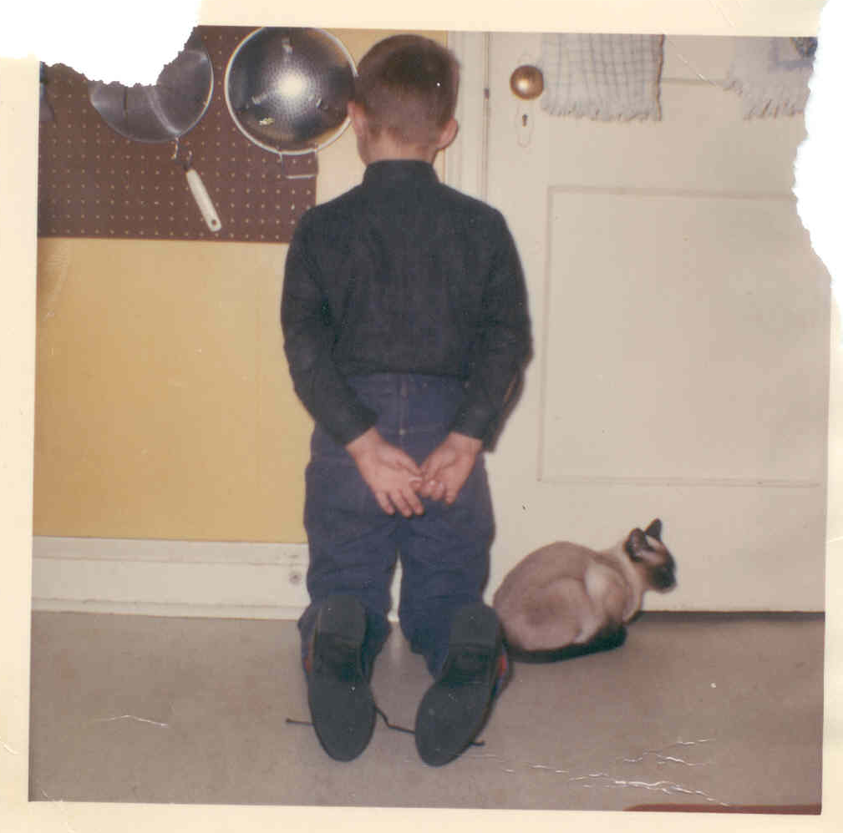
Learning Executive Function 1965

Slide 73

Learning Executive Function circa 2014:

Slide 74
Specific Interventions
Diamond, A. & Lee, K. (2011) Science, 333
www.devcogneuro.com

Slide 75
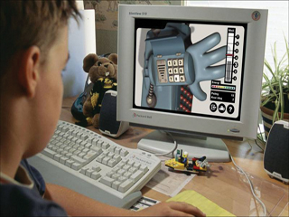
Working Memory Training
Most studied intervention
Gains do not generalize beyond WM
Some evidence of gains in classroom
Gains maintained at six months
Gains more limited at 1 year

Slide 76
Inhibition Training
More limited success
No evidence of transfer beyond computer
Combination of WM and Inhibition training: those trained on WM did not improve on Inhibition and vice versa

Slide 77

Aerobics?
Running improved 8-12 yr olds’ cognitive flexibility and creativity but not non-EF skills
2 hrs fitness training improved working memory in 7-9 year olds vs controls

Slide 78

Martial Arts Executive Training?
Martial arts training (with mindfulness) associated with improved attention, generalized to tests and classroom

Slide 79

Tools of the Mind
Preschool curriculum based on Vygotsky’s notions of development
Pretend play requires inhibition, flexibility, and working memory
Children involved in Tools program showed better performance on range of EF tasks

Slide 80
Diamond et al, 2011
Children with poor EF gain most from training
Largest differences seen on more demanding EF tasks; Little on low demand tasks
Must be continuously challenged; keeping status quo does not lead to improvement
Transfer of EF benefits fairly narrow

Slide 81
It is not what we do but how we do it.
Adele Diamond, 2015

Slide 82
Medication Intervention Studies using Rating Scale Measures
ADHD | Other
Biderman et al., 2011 | Tourette’s: Cummings et al., 2002
DuPaul et al., 2012 | TBI: Beers et al., 2005
Findling et al., 2009 | Depression: Roth et al., 2012; Madoo et al., 2014
Maziade et al., 2009 | Hypertension (lande et al., 2010
Turgay et al., 2010
Yange et al., 2011

Slide 83
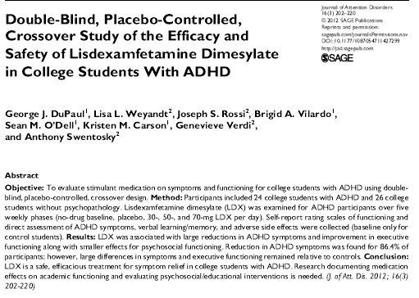

Slide 84
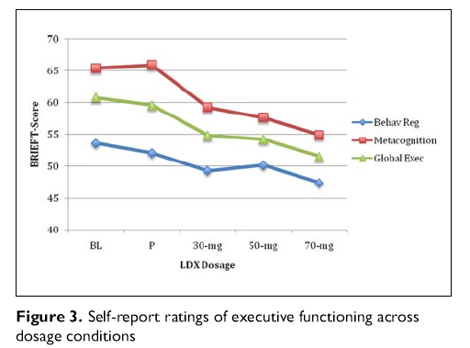
DuPaul et al., 2012

Slide 85
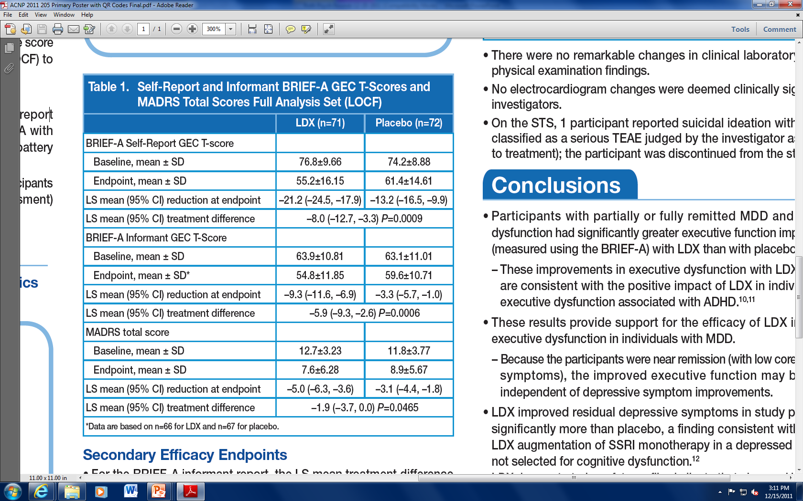
Effect of Lisdexamphetamine Dimesylate (Vyvanse)
in Adults with Executive Dysfunction
and Partial or Full remission of Major Depression
DSM-IV dx of MDD- recurrent, no psychotic features
Executive Dysfunction defined as BRIEF-A GEC T > 60
MADRAS < 18 at screening and baseline
Madhoo et al. (2014) Neuropsychopharmacology

Slide 86
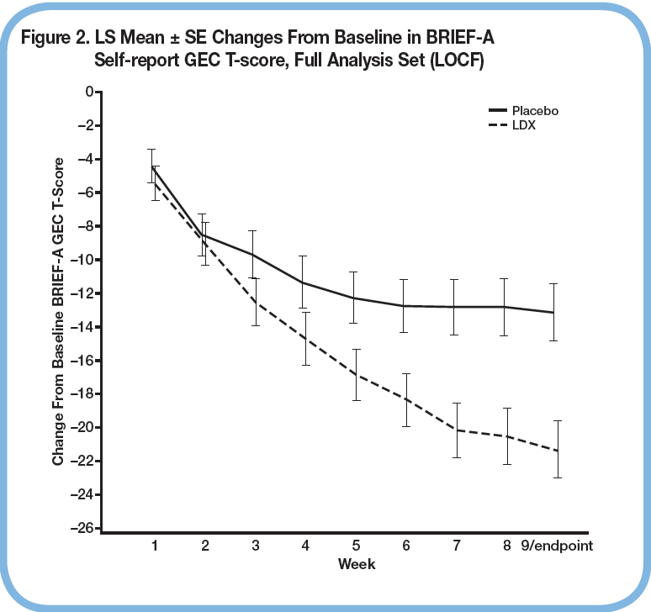

Slide 87
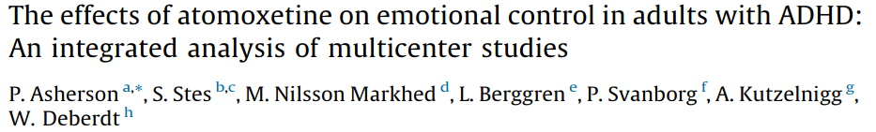
Emotional control recognized as a characteristic in ADHD for 100 years
Thought to be associated with ADHD, but recent evidence suggests it may be a core symptom
Treatment studies show emotional control responds to treatment for ADHD
Integrated analysis of 2846 adults with ADHD treated with atomoxetine and 829 placebo controls in 10-12 week clinical studies

Slide 88
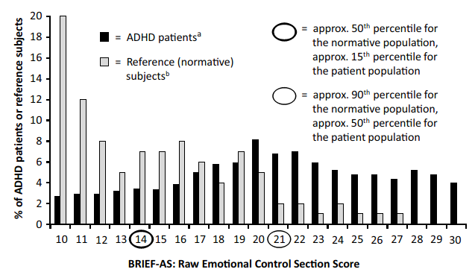
BRIEF-A Emotional Control scores in ADHD vs Controls

Slide 89
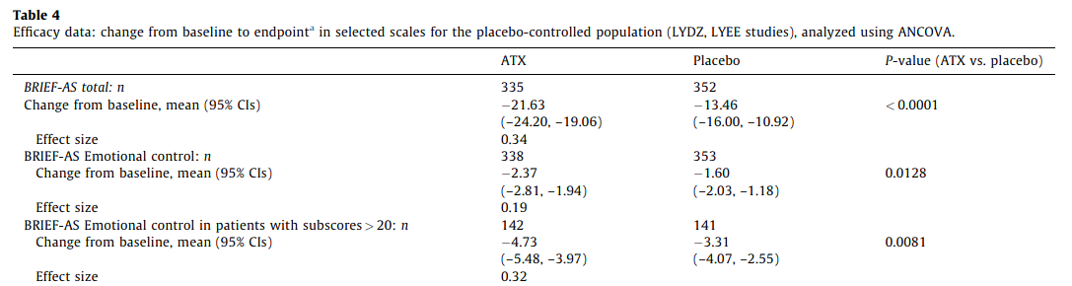
Treatment effects in Atomoxetine vs Placebo

Slide 90
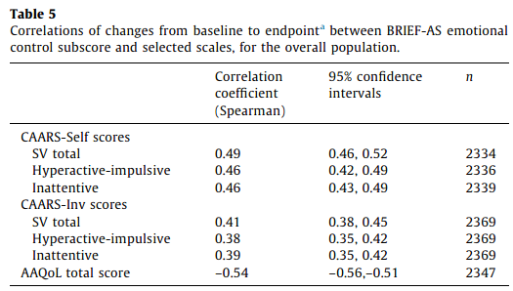
BRIEF-A EC Correlates with Change in ADHD Symptoms

Slide 91
Non-medication interventions using Rating Scales as Outcome Measures
Liver transplant: Sorenson et al., 2011
Chemotherapy: Kesler et al., 2011; McDonald et al., 2013
Corticosteroids: Mrakostsky, 2012
Family Problem Solving; Wade et al., 2004, 2005
Cognitive Remediation: Beck et al., 2010; Hahn-Markowitz 2011, Toglia 2010
Flexibility in ASD: Kenworthy et al., 2014

Slide 92
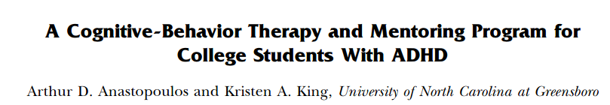
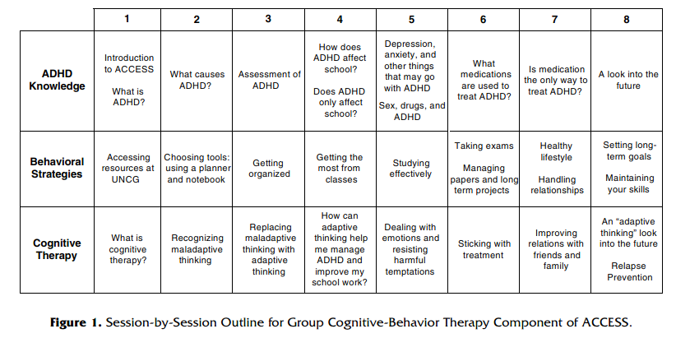

Slide 93
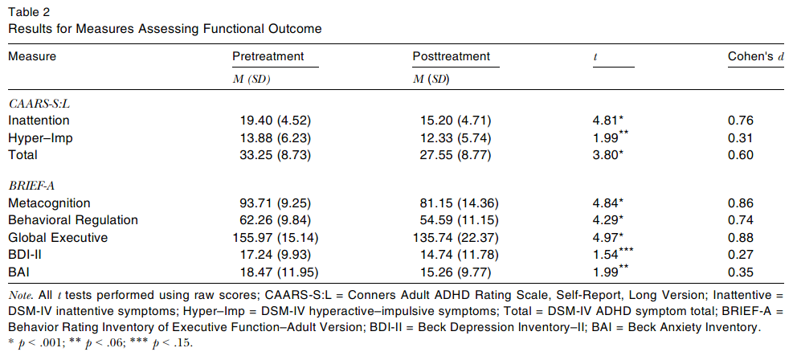
N=43

Slide 94
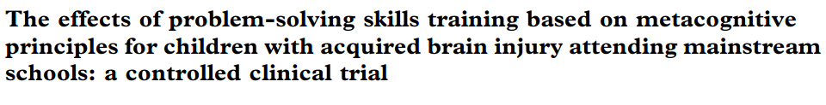
32 children with mod-severe TBI
32 non-injured children
Participated in problem solving skills training to teach metacognitive awareness and problem solving

Slide 95
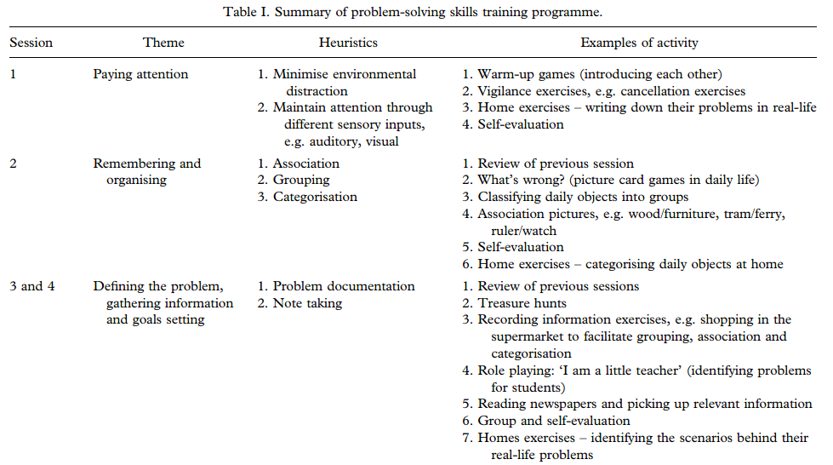

Slide 96
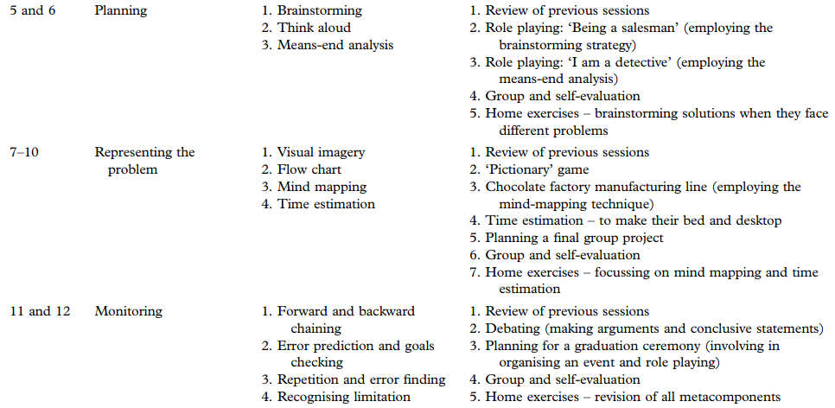

Slide 97
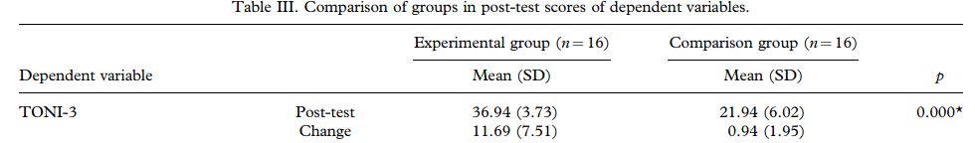
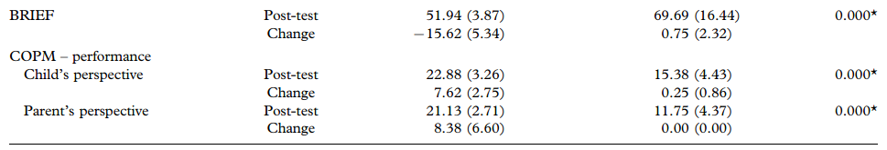

Slide 98
The Slow-to-Recover Youth (Post-Concussion Syndrome?)
The Montreal Children’s Hospital Active Rehabilitation Program for Slow-To-Recover Children & Adolescents: Four-component graded rehabilitation program
1. Submaximal aerobic training
2. Light coordination exercises
3. Visualization and imagery techniques
4. Home program for continued tranining
Post-Concussion Scale* 17.4 ± 12.8 2.7 ± 3.2 3.79 0.004
Energy level (PedsQL)*
General fatigue 47.9 ± 16.9 83.3 ± 12.1 −5.43 <0.001
Cognitive fatigue 63.7 ± 11.6 85.8 ± 10.2 5.48 <0.001
Sleep/rest 49.9 ± 18.8 81.6 ± 10.9 4.47 0.002
Fatigue total score 52.1 ± 12.3 83.1 ± 9.1 −5.91 <0.001
Beck Youth Depression 45.0 ± 8.4 41.3 ± 6.9 3.26 0.01

Slide 99
Active Rehabilitation
1. Rest during “Temporal Window” – Rest during the first couple of days addresses cellular & vascular changes, allows for physical & cognitive recovery, prevents second injury, and facilitates the recovery process.
2. Exercise as Treatment – Converging lines of evidence clearly indicate the positive effects of exercise on brain health & functioning, including cognition, fitness, self-esteem, & somatic complaints.
3. Education & Reassurance as Early Intervention – Ponsford et. al. (2001) showed that youth provided information and support early in recovery were less symptomatic at 3 months. School personnel are in an ideal position to assist with this.

Slide 100
Well designed feasibility study with:
30 preschooler aged 4-6 years
At risk or significant behavior/emotional problems
8 week summer intensive program:
  Parent behavior management training
  Behavior modification
  School readiness
  Social-emotional and self-regulation training

Slide 101
Change in EF and ER with Intervention
Note: Decreased BRIEF scores and Increased Lab scores = improvement
Increased ER Checklist scores = improved functioning

Slide 102

Real-World Collaborative Problem-Solving Intervention for EF in ASD
Lauren Kenworthy & Laura Anthony, Children’s National

Slide 103
Unstuck Philosophy: Principles of Remediation
Teach by Doing—Coaching Model: Support, Fade, Generalize
Talk Less—Self-regulatory scripts
Be consistent
Provide visual cues
Collaborate, use humor, have fun
Ylvisaker & Feeny, 1998; Feeny & Ylvisaker, 2008

Slide 104
Unstuck and On Target!
Introduction
Topic 1
Topic 2
Topic 3
Topic 4
The Meaning of Flexibility
Cognitive Flexibility Defined
Coping Strategies
Personal Heroes
Guide to Using This Manual
Topic 5
Topic 6
Topic 7
Topic 8
Topic 9
Topic 10
Why Be Flexible?
Your Goals: Getting What You Want
Scripts for How to Be Flexible
Journey to Target Island
Being Flexible Makes You a Good Friend
Flexible Futures

Slide 105
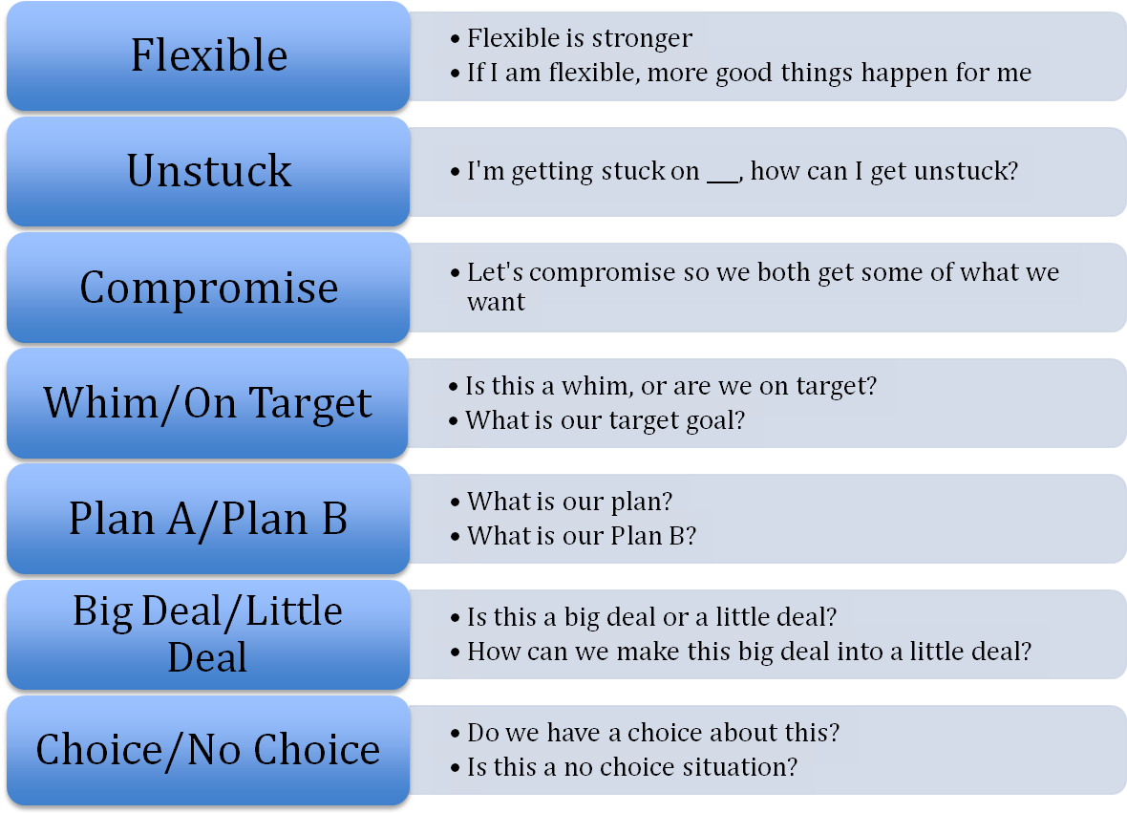

Slide 106


Slide 107
“Real World,” Well-Matched Methods
67 3rd-5th grade children in 14 schools randomized
Children met full criteria for diagnosis and were already receiving services
Existing school staff led interventions
Interventions matched on number of sessions (28) and training:
  Interventionists: Manual, 7 training sessions, 2 fidelity observations with feedback
  Parents: Manual, 2 training sessions, visual supports
  Mainstream Teachers: 1 training session, visual supports
Notes:
Real world children, real world sites, real world treatment providers, and manualized, available published manuals

Slide 108
Mean Challenge Task Flexibility
Higher score = Less flexible
Kenworthy & Anthony et al, 2014

Slide 109
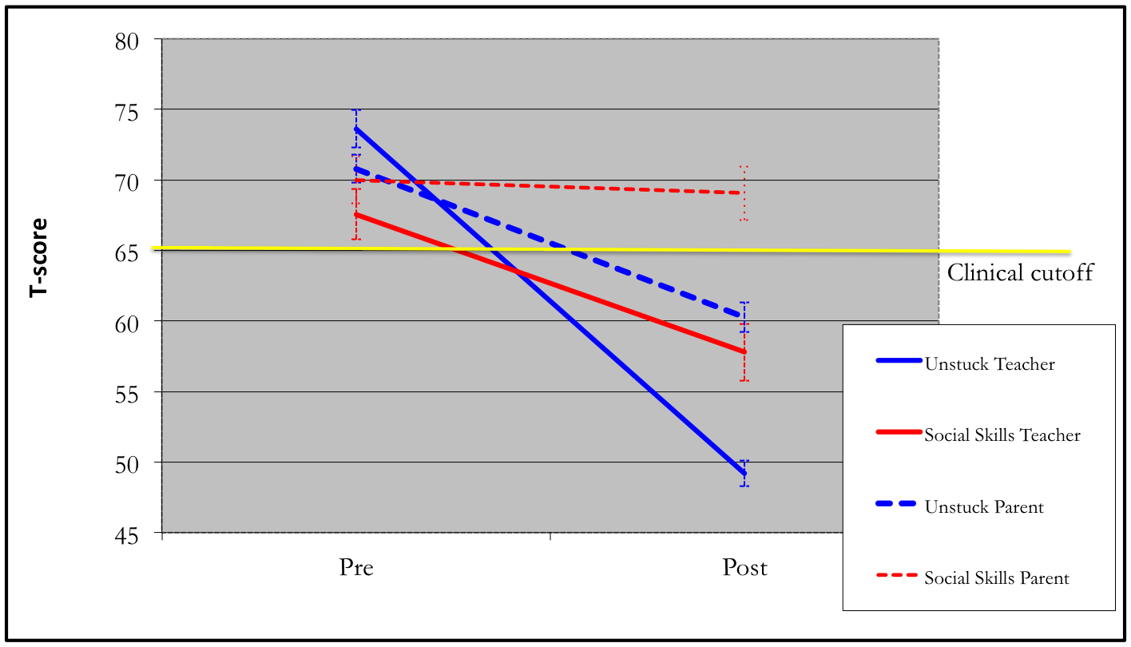
Parent & Teacher BRIEF Shift
Higher score = Less flexible
Parent Cohen’s d=-0.64; Teacher Cohen’s d=-0.89

Slide 110
Enhancements to BRIEF

Slide 111
Representative Standardization Sample
A large standardization sample (1,400 Parent/Teacher; 803 Self-Report) matched by age, gender, ethnicity, parent education level, and geographic region to recent nationwide population figures. 50 States are represented.

Slide 112
Concise Scales
More concise scales that reduce respondent burden (Approximately 10 minutes)

Slide 113
Equivalence with BRIEF
No new items on clinical scales, allowing for consistency of data collection between the BRIEF and BRIEF2.

Slide 114
Increased Sensitivity
Items were selected for maximum performance in over 6000 clinical cases
Increased sensitivity to executive function problems in clinical groups, such as attention-deficit/hyperactivity disorder (ADHD) and Autism Spectrum Disorders (ASD)

Slide 115
Parallelism in Item Content
Increased parallelism in item content and order with most items shared between the Parent Form and Teacher Form and approximately half of the items also shared with the Self-Report Form
  easier to compare and contrast raters.
  base rates of rater discrepancies provided
Notes:
handout

Slide 116
New to BRIEF2

Slide 117
Factor Structure
Scales supported by factor analysis
Three indexes consistent with accepted theory: Behavior Regulation, Emotion Regulation, and Cognitive Regulation

Slide 118
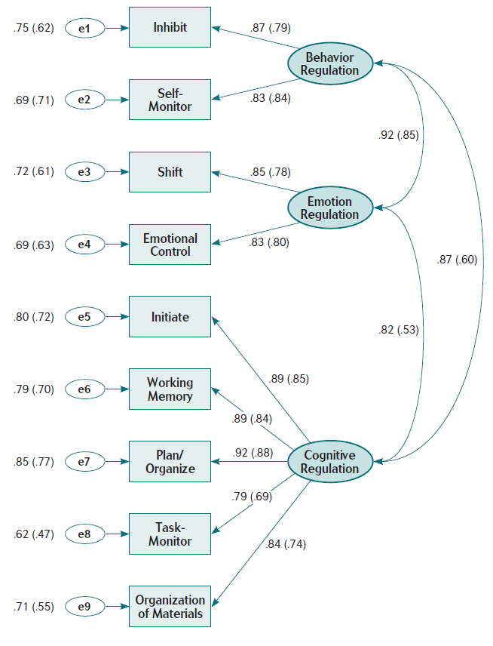
Parent Form
Confirmatory Factor
Analysis

Slide 119
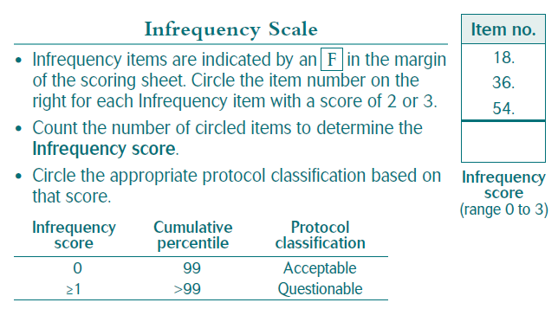
Infrequency Scale
Helps identify unusual responding
Parent Form | Teacher Form | Self-Report Form
Forgets his/her name | Forgets his/her name | I forget my name
Has trouble counting to three | Has trouble counting to three | I have trouble counting to three
Cannot find the front door of home | Cannot find the front door of school | I cannot find the front door of my home

Slide 120
Screening Forms
New 12-item parallel Screening Parent, Teacher, and Self-Report Forms
Quickly indicate whether executive function assessment is needed
Correlate with Global Executive Composite scores < .90

Slide 121
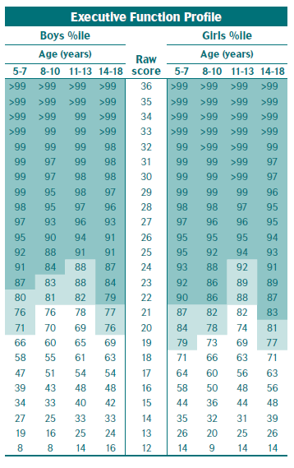
Screening Forms (cont.)
Cutoffs by normative group
  Light shading = potentially
  clinically elevated
  Dark shading = clinically elevated

Slide 122
New Statistics that Support Interpretation
Reliable change indexes
Interrater agreement metrics
Base-rate tables for standardization & clinical samples
Contingency statistics (sensitivity/specificity, Likelihood ratios)

Slide 123
Reliable Change

Slide 124
Interrater Agreement Metrics

Slide 125
Base Rates – Standardization Sample

Slide 126
Base Rates – Clinical Samples
Clinical Groups
ADHD-Combined | ADHD/Learning Disability | Tumor
ADHD-Inattentive | ASD | Epilepsy
ADHD-Sluggish Cognitive Tempo | Neurofibromatosis type 1 | Diabetes
TBI | Acute lymphoblastic leukemia | Anxiety
Learning Disability

Slide 127
Base Rates – Clinical Samples

Slide 128
Contingency Statistics

Slide 129
Components

Slide 130
At a glance
Ages: 5-18 years
Administration time:
  5 minutes Screening
  10 minutes full version
Qualification Level: B

Slide 131
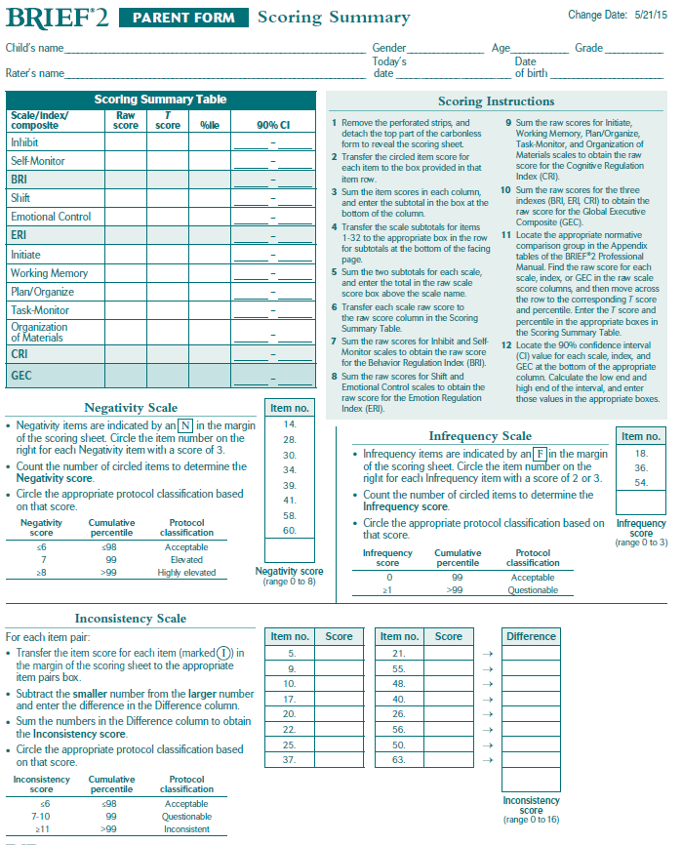
Components – Full Version
BRIEF2 Professional Manual
  Combining information about Parent, Teacher and Self-Report forms
Parent, Teacher, Self-Report Rating Forms
Parent, Teacher, Self-Report Scoring/Profile Form

Slide 132
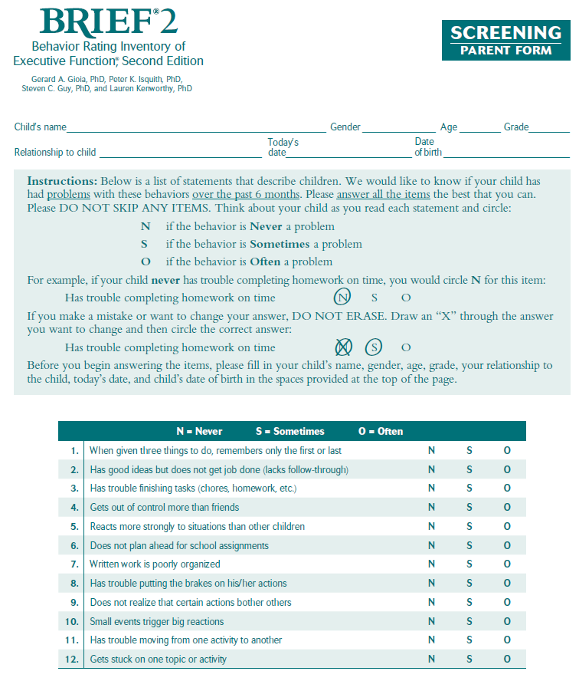
Components – Screening Version
Parent, Teacher, Self-Report Screening Scoring/Profile Form

Slide 133
BRIEF2 iConnect
Full Forms | Screening Forms
Interpretive Report Score report is an option | Score Report
Feedback Report | Screening Protocol Summary Report
Protocol Summary Report
Updated Intervention section in interpretive reports
Contingency statistics for ASD and ADHD dx in Parent and Teacher Interpretive Reports
Parent, Teacher and Self-Report now available in one Protocol Summary Report

Slide 134
Reliability and Validity

Slide 135
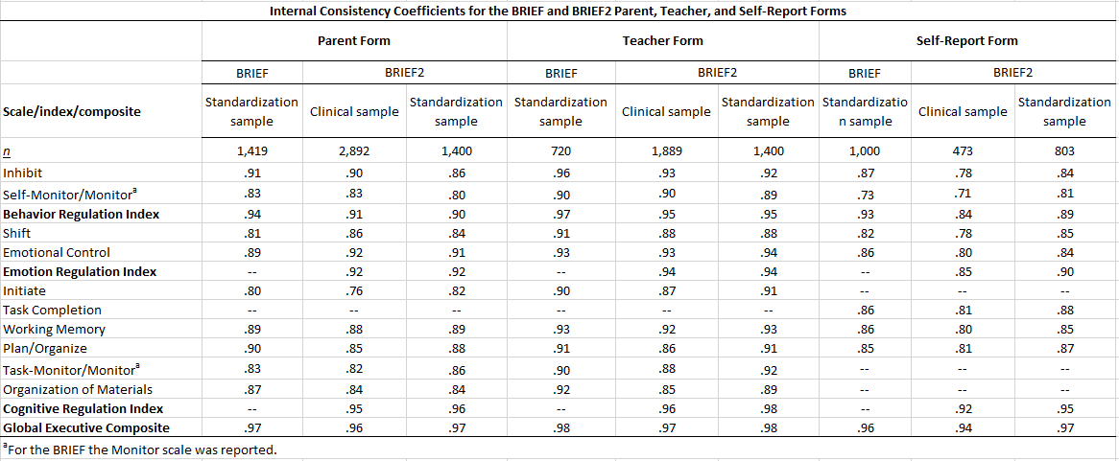
Internal Consistency

Slide 136
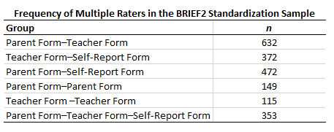
Inter-rater Studies
Parent/Teacher
Parent/Self-Report
Teacher/Self-Report
Parent/Parent
Teacher/Teacher
Parent/Teacher/Self-Report

Slide 137
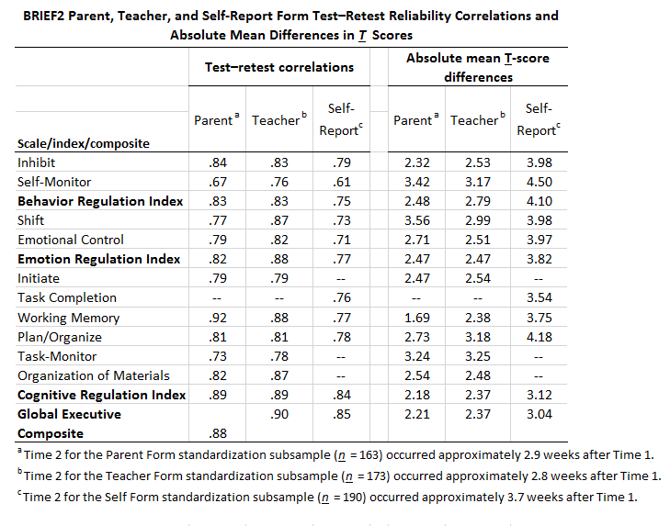
Test-Retest

Slide 138
Concurrent Validity
Child Behavior Checklist (CBCL, Achenbach, 1991a)
  Teacher’s Report Form
  Youth Self Report
Behavior Rating Assessment System for Children, Second Edition (BASC-2, Reynolds & Kamphaus, 2004)
  Parent Rating Scales
  Teacher Rating Scales
  Self-Report of Personality
Conners’ = Conners’ 3rd Edition (Conners, 2008)
  Parent Short Form
  Teacher Short Form
ADHD-Rating Scale-IV (DuPaul, Power, Anastopoulos, & Reid, 1998)
WISC-IV = Wechsler Intelligence Scale for Children, Fourth Edition (Wechsler, 2003)
WAIS-IV = Wechsler Adult Intelligence Scale, Fourth Edition (Wechsler, 2008)
RIAS = Reynolds Intellectual Assessment Scales (Reynolds & Kamphaus, 2003)

Slide 139
Parent Form
Confirmatory Factor
Analysis

Slide 140
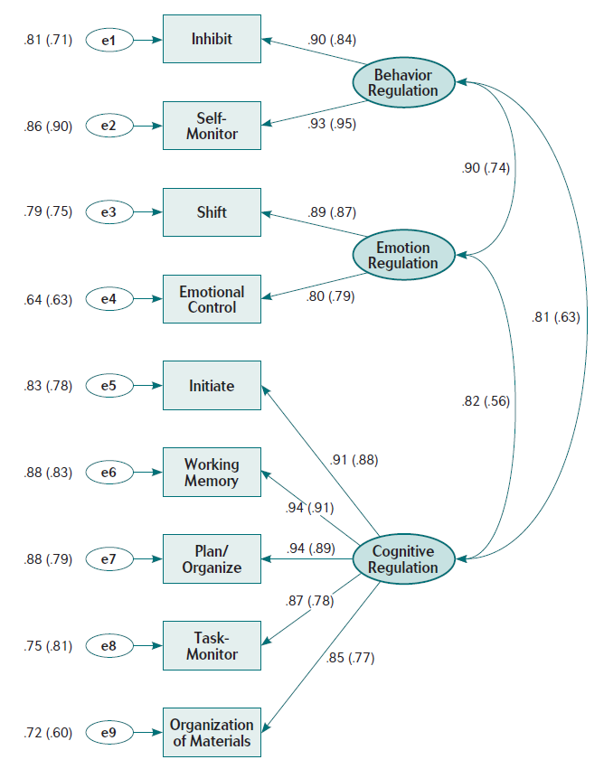
Teacher Form
Confirmatory Factor
Analysis

Slide 141
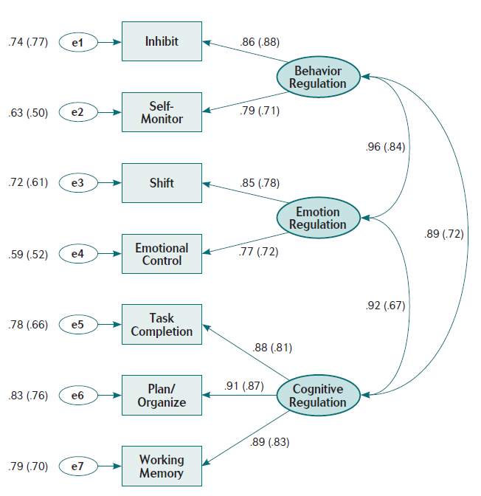
Self-Report Form
Confirmatory Factor
Analysis

Slide 142
Clinical Validity
Clinical Groups
ADHD-Combined | ADHD/Learning Disability | Tumor
ADHD-Inattentive | ASD | Epilepsy
ADHD-Sluggish Cognitive Tempo | Neurofibromatosis type 1 | Diabetes
TBI | Acute lymphoblastic leukemia | Anxiety
Learning Disability

Slide 143
Parent Form Profile Analysis

Slide 144
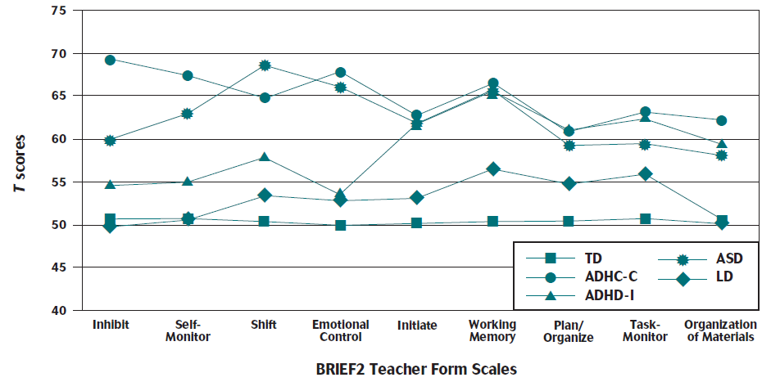
Teacher Form Profile Analysis

Slide 145
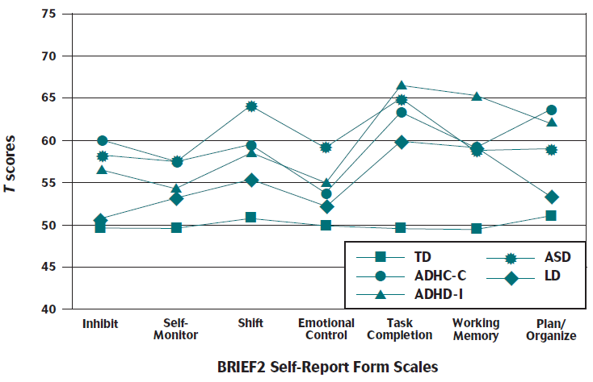
Self-Report Form Profile Analysis

